Slide 1
Welcome to the Hayward Regional Meeting!
Please enjoy this time for coffee, breakfast, and conversation! We’ll get started at 9:45.
Notes:
Beth welcomes everyone
Why do we do regional meetings

Slide 2
Hayward Regional Meeting
Notes:
Beth starts meeting.

Slide 3
Purpose of the Day
Make Connections
Collaborate
Take Action
Notes:
Beth welcomes everyone
Why do we do regional meetings

Slide 4
Agenda
9:00 Networking Breakfast
9:45 Welcome
10:00 Community Spotlight
10:15 Roundtable Discussion
10:45 Community Spotlight
11:00 Cancer Plan Chapter Discussion
11:45 Wrap-Up Discussion
12:00 Adjourn
Notes:
Beth welcomes everyone
Why do we do regional meetings

Slide 5
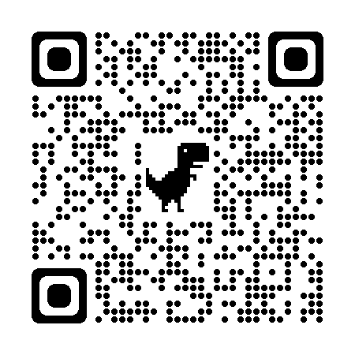
Become a Wisconsin Cancer Collaborative Member!
Online networking directory
Monthly and quarterly members-only newsletters
Email alerts with new resources
Free access to events
Leadership opportunities
Tools and resources to support your organization’s efforts to implement the Wisconsin Cancer Plan 2020-2030
Opportunities to collaborate with other Wisconsin Cancer Collaborative Members
Join Us!
Membership is free! Scan the QR code to join us today.
Notes:
What’s in it for those attending, describe benefits
Share about WCC and what we’ve accomplished
Briefly share how to join

Slide 6
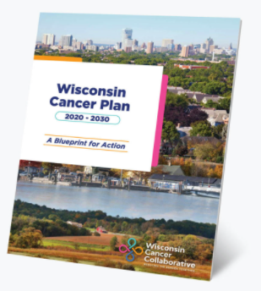
Wisconsin Cancer Plan 2020-2030
Serves as a common framework and foundation for action for all working on cancer prevention and control in Wisconsin
Designed to provide a vision of what needs to be done and the resources needed to reduce the burden of cancer in Wisconsin
Wisconsin Cancer Plan 2020-2030
Notes:
Beth
Discuss WI Cancer Plan (See below text for example language)
The Wisconsin Cancer Plan 2020-2030 lays forth a blueprint for action with a singular vision: creating a healthier Wisconsin by reducing the burden of cancer for everyone. It spans the entire cancer control continuum, from risk reduction through end of life. The success of the Wisconsin Cancer Plan depends on people and organizations from multiple sectors coming together to take action.
Organizations can look to the Wisconsin Cancer Plan 2020-2030 for evidence-based, sustainable solutions to reduce the burden of cancer in their communities and across the state, through policy and systems-level change. The Wisconsin Cancer Plan 2020-2030 includes a framework that encompasses the vision, mission, and overarching goals across seven chapters. Each chapter includes priorities, strategies, and specific action steps.
It combines best practices, reliable data, and concrete action steps.
The Wisconsin Cancer Plan 2020-2030 is designed to serve:
Health system leaders
Public health advocates
Policy makers
Researchers
Every Wisconsinite working to prevent cancer and improve health outcomes
It contains proven tools to expand your impact and to make the most effective impact on the cancer burden in your community. Use the Wisconsin Cancer Plan 2020-2030 for:
Best practices and strategies to guide your work
Reliable data
Concrete action steps (online only)
Progress measures (online only)
Related resources to support and expand your impact (online only)
It also contains expert guidance across the cancer care continuum.
It was designed by experts to offer strategic guidance in:
Health equity
Risk reduction and prevention
Screening and early detection
Treatment
Survivorship
End of life
Access to quality data

Slide 7
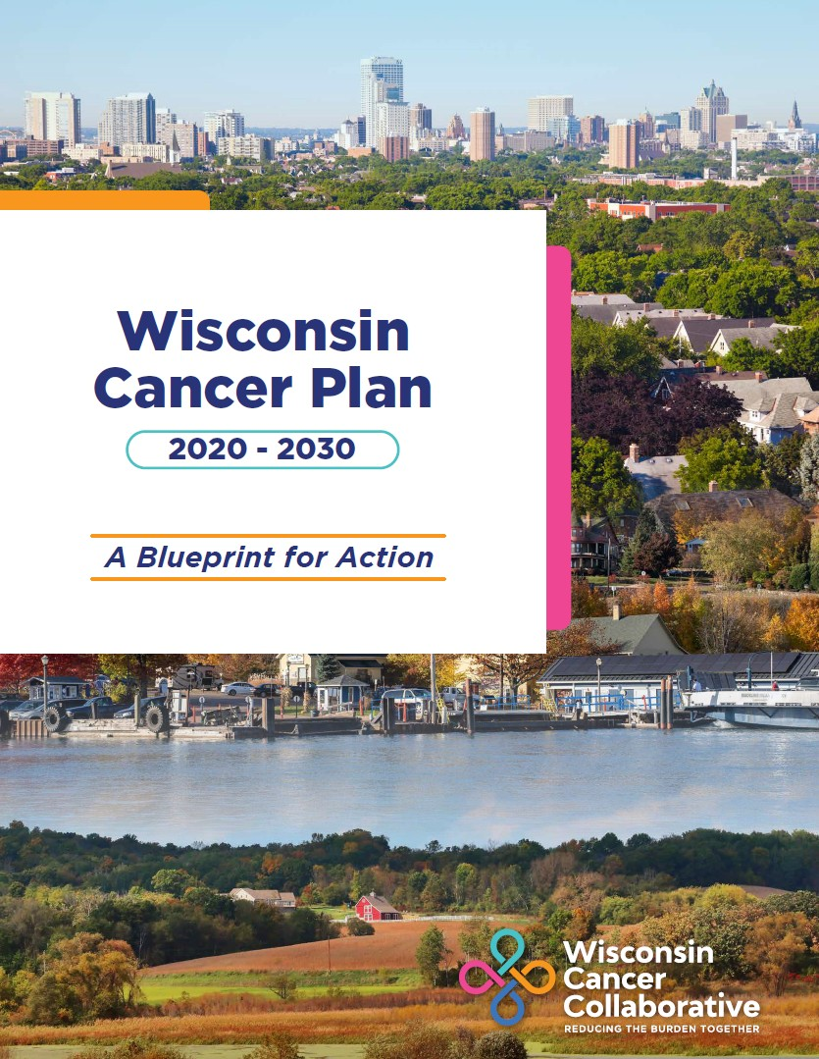
Wisconsin Cancer Plan 2020-2030 Chapters
Chapter 1: Health Equity
Chapter 2: Risk Reduction
Chapter 3: Early Detection & Screening
Chapter 4: Treatment
Chapter 5: Survivorship
Chapter 6: End of Life
Chapter 7: Data
-
Notes:
Beth
Discuss WI Cancer Plan Chapters

Slide 8
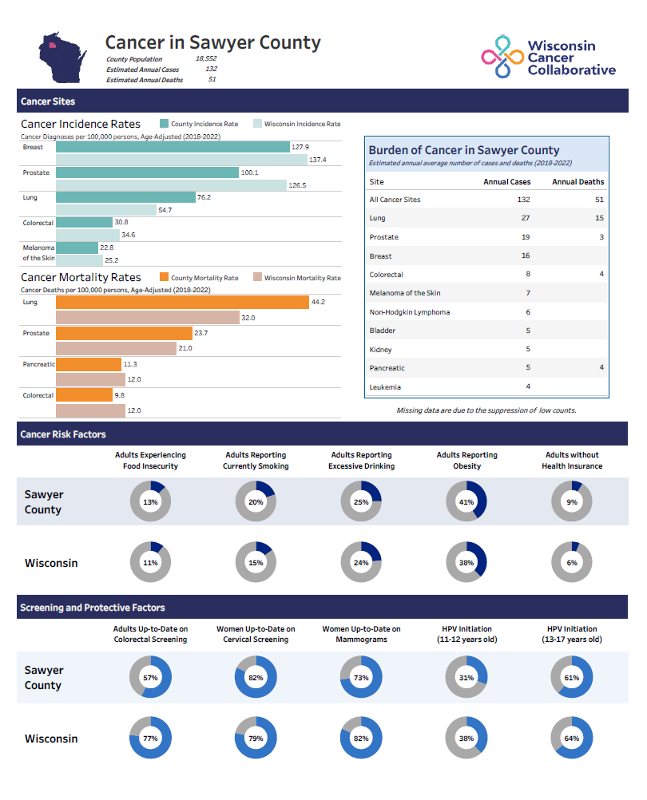
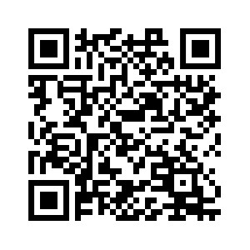
County Cancer Profiles Link:
New Profiles Coming Soon:
County Cancer Profiles
NEW County Cancer Profiles Coming Soon!!
Notes:
Mention county cancer profiles, what people can use them for, and where to find them

Slide 9
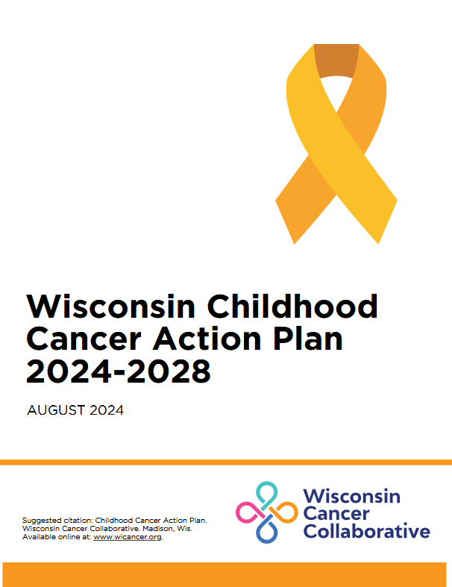
Look what we’ve been up to
Lung Cancer Report
Childhood Cancer Action Plan
Notes:
Beth
Highlight recent reports published

Slide 10
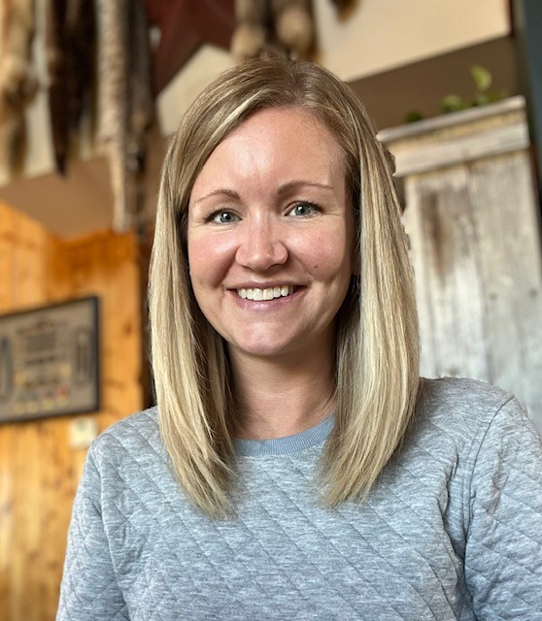
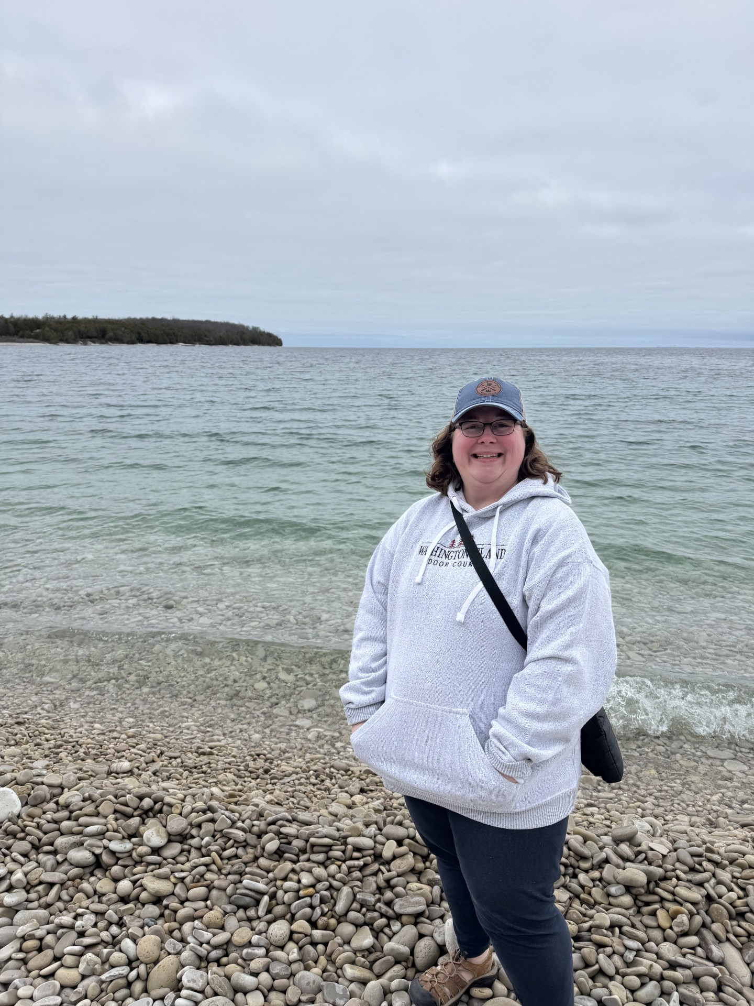
Community Spotlight
Amanda McKuen, CHPC, Operations Manager Northwest Wisconsin Cancer Center of Tamarack Health Ashland Medical Center
Laura Martinsen, BS, CSW, Social Worker​
Northwest Wisconsin Cancer Center of Tamarack Health Ashland Medical Center​
Notes:
Beth introduces Tiffany Allen and Christie Johnston Tiffany Allen is a Nurse Practitioner and serves as the Program Director for SWCAP Neighborhood Health Partners and Care Coordination Network. She has a passion for working with underserved populations and helping individuals achieve their health goals and improved health equity within their communities. Outside of her professional role, Tiffany loves spending time with her two young boys, Markus and Major, cooking and baking, reading, staying active and being outdoors, and cheering on the UW-Platteville football team!
Christie Johnston joined the Behavioral Health Partnership as a Program Coordinator in August 2022. Prior to joining the Partnership, she worked with children, parents, and families in a variety of educational settings. In this work, Christie saw an increasing need for both individual and community mental health support. One avenue of sustainability for the Partnership was offering community-based support to assist in navigation towards resources. The Care Coordination Network at SWCAP was a perfect collaboration.
In November of 2023, Christie joined the Care Coordination Network as the Program Manager. “It has been an amazing experience to see individual relationships being built to support, encourage, and empower those who need it. From help with rides to Immigration court dates or cancer treatments to helping someone fill out a job application, our Community Health Workers are connecting with residents and meeting them where are they are in their lives.”

Slide 11
Northwest Wisconsin Cancer Center [NWCC]
Joint Venture of: Tamarack Health - Ashland Medical Center & Essentia Health
Wisconsin Cancer Collaborative
Regional Meeting- Hayward, WI
Monday, May 12, 2025

Slide 12
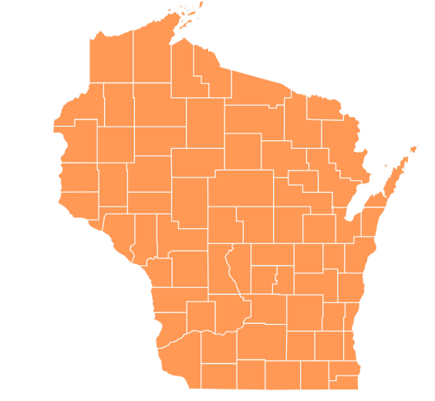
Who Are We:
Ashland, WI
NWCC is a comprehensive cancer center with a patient population with diverse needs. NWCC has both medical oncology and radiation oncology services. NWCC is part of an Integrated Network Cancer Program with Essentia Health.
NWCC operates within a rural area that services a 20% patient population under the poverty level and has a lower than average per capita income.
The wide geographical area NWCC serves is patients who reside in Iron, Bayfield, Ashland, Sawyer, Douglas and Washburn counties in northern Wisconsin and the counties of Gogebic, Iron and Ontonagon upper peninsula of Michigan.
For perspective:
Ashland population [2023]: 7,878
Ashland County population [2023]: 16,079
# of patients NWCC sees in a year: approx. 4,000 [Does include non-oncology patients]

Slide 13
Our Team:
Two part-time Medical Oncologists [split time between NWCC site and Essentia Health-Duluth]
Radiation Oncologist
Nurse Practitioner
12 Registered Nurses
4 Certified Medical Assistants
Social Worker
Certified End of Life Doula
Physicist
Dosimetrist
3 Radiation Therapists
Patient Financial Specialist
Patient Access & Prior Auth Specialist
Physician Office Support & Prior Auth
Physician Office Support & Registrar
5 volunteers
Also work closely with:
Ashland Medical Center Clinical Dietician
Ashland Medical Center Chaplain
Essentia Health Ashland Clinic lab DBA Essentia Health Duluth Clinic

Slide 14
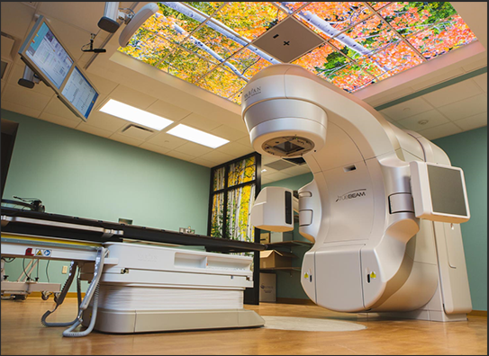
Radiation Oncology Success:
Varian Linear Accelerator
Identify – surface guided motion management from submillimeter accuracy, automated beam hold, and couch shifts.
HyperArc – stereotactic radiosurgery solution, that delivers highly precise cranial frameless SRS therapy, using only a single isocenter. Utilizes compact dose distributions, avoiding normal brain and critical structures.

Slide 15
NWCC Compassionate Care Funds [CCF] Program:
A financial assistance program that helps to offset the costs of mortgage and utility payments; offers gift cards for gas, lodging, meals and aims to offer a financial lift to those who need it most.
Not income-based [sets us a part from many other programs]
Cannot pay for car repairs or medical bills
Raffle for a Cause- annual fundraiser [raised approx. $40,000 in 2024].
100% of all funds stay local to our patients [and their loved ones] in need.
** Example: Patient who lives over 2 hours away [one-way] from Ashland is needing daily radiation treatments. We were able to pay for 100% of his lodging while going through treatment. **
https://www.wdio.com/lift-online/compassionate-care-fund-eases-financial-burden-on-cancer-patients/
Duluth Clinic Foundation Donation | Essentia Health

Slide 16
Courageous Connections [NWCC’s Cancer Support Group]:
Open to patients diagnosed with cancer and caregivers impacted by cancer
Meet monthly on the 4th Tuesday of every month [except July and December]
Hybrid option –virtual or in-person
Our purpose is to provide a safe and welcoming space to allow for sharing patients’ and caregivers’ experiences. We also provide guest speakers on cancer and caregiver-related topics such as: fear of recurrence, emotional impacts of cancer finding hope and much more.
Example of guest speakers: Jackie Herigodt [Director of Partnership and Engagement with Imerman Angels]; Monica Bryant [Chief Operating Officer with Triage Cancer]; Jill Meyer-Lippert [RDH with Side Effect Support; Social Worker with local palliative care/hospice agency]
All men attended one session

Slide 17
Together We Heal [NWCC’s Grief Support Group]:
Open to patients diagnosed with stage IV cancer or if you have lost a loved one to cancer [regardless of time since passing of loved one]
Meets monthly on the first Tuesday of the month
In person only
Hoping to utilize guest speakers, periodically
Purpose: Grief can be overwhelming, isolating and have profound impacts on the way we live our lives. Together, we will learn about the different types of grief, effects grief can have, healthy coping skills and so much more. While we navigate these waters, we will also create a safe space for sharing our experiences with loss.

Slide 18
Oncology Health Fair:
First annual- held on October 11, 2024 at the Northwood Technical College in Ashland.
Cancer has a way of impacting people in all aspects of their lives from physically to socially to spiritually to financially and so much more. Come join the Northwest Wisconsin Cancer Center [NWCC] on Friday, October 11th 9:00 am-2:00 pm at the Northwood Technical College for an oncology health fair. There will be local, state and national vendors and agencies that are both directly and indirectly related to cancer.
We had over 40 attendees and 16 local, State and National agencies that provide direct and indirect care to patients diagnosed with cancer and their loved ones
Had lunch catered in.
Will be hosting 2nd annual event this fall with the hopes of offering a few different presenters [scattered throughout the day; some potential topics: end-of life planning; a patient’s personal journey with cancer and how the caregiver can care for themselves].

Slide 19
Challenges We are Currently Facing:
Space
** In the process of planning for expansion. Infusion volume has increased 30% in the past year.
Staffing due to rural setting
** Needing to utilize travelers to help address increase in volume.

Slide 20
Thank you!
Thank you to Wisconsin Cancer Collaborative for allowing us to take part both in the work they are trying to do across the State. Also, thank you for allowing us to speak today about who we are as an agency, where we hope to go and current challenges we are facing.
If you have any questions or would like to reach out:
* Laura Martinsen, Social Worker * Amanda McKuen, Operations Manager
715-685-5004 715-685-5276
lamartinsen@tamarackhealth.org almckuen@northwestwisconsincancercenter.com

Slide 21
Table Discussions
Notes:
Beth will have people breakout into small groups to go over prompt questions and discuss their work

Slide 22
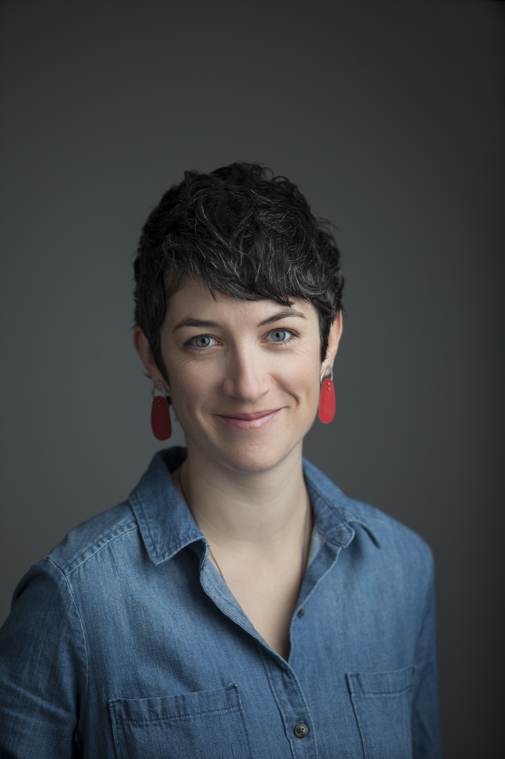
Community Spotlight
Charmaine Swan, Manager, Advocacy & Public Policy American Lung Association in Wisconsin Northwest Wisconsin Lung Health Alliance
Notes:
Beth introduces Tiffany Allen and Christie Johnston Tiffany Allen is a Nurse Practitioner and serves as the Program Director for SWCAP Neighborhood Health Partners and Care Coordination Network. She has a passion for working with underserved populations and helping individuals achieve their health goals and improved health equity within their communities. Outside of her professional role, Tiffany loves spending time with her two young boys, Markus and Major, cooking and baking, reading, staying active and being outdoors, and cheering on the UW-Platteville football team!
Christie Johnston joined the Behavioral Health Partnership as a Program Coordinator in August 2022. Prior to joining the Partnership, she worked with children, parents, and families in a variety of educational settings. In this work, Christie saw an increasing need for both individual and community mental health support. One avenue of sustainability for the Partnership was offering community-based support to assist in navigation towards resources. The Care Coordination Network at SWCAP was a perfect collaboration.
In November of 2023, Christie joined the Care Coordination Network as the Program Manager. “It has been an amazing experience to see individual relationships being built to support, encourage, and empower those who need it. From help with rides to Immigration court dates or cancer treatments to helping someone fill out a job application, our Community Health Workers are connecting with residents and meeting them where are they are in their lives.”

Slide 23
Cancer Plan Chapter Discussion
*Prevention *Screening *Survivorship
Notes:
Beth will have people breakout into small groups to go over prompt questions and discuss their work

Slide 24
2025 Wisconsin Cancer Summit
September 24 & 25 | Glacier Canyon Conference Center | Wisconsin Dells, WI
The Wisconsin Cancer Collaborative is excited to celebrate 20 years of cancer control and prevention work in Wisconsin with our member organizations. This summit will highlight milestones and successes throughout the coalition's history.
The Wisconsin Cancer Summit is free and open to the public. You don't have to be a member to attend, but we would love to have you join us! Joining is free.
Notes:
Beth
As the most comprehensive cancer conference in Wisconsin, the WI Cancer Summit brings together experts and advocates from across Wisconsin to explore emerging issues, gain tangible tools, and network with other cancer control leaders.
Registration details will be coming soon, so stay tuned!
We hope to see you at this year’s Summit! It will build off 2023’s summit and focus on how we can build more connections throughout the state!

Slide 25
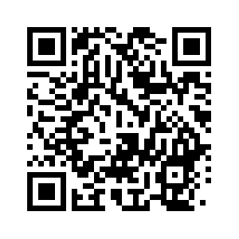
2025 Hayward Regional Meeting Survey
Please use the QR code to complete a short survey.
(Scan using your camera on your phone)

