Slide 1
Welcome to the Green Bay Regional Meeting!
Please enjoy this time for coffee, breakfast, and conversation! We’ll get started at 9:45.
Wifi Username: Guest
Password: Lodge@24
Notes:
Beth welcomes everyone
Why do we do regional meetings

Slide 2
Green Bay Regional Meeting
Notes:
Beth starts meeting.

Slide 3
Purpose of the Day
Make Connections
Collaborate
Take Action
Notes:
Beth welcomes everyone
Why do we do regional meetings

Slide 4
Agenda
9:00 Networking Breakfast
9:45 Welcome
10:00 Community Spotlight
10:15 Roundtable Discussion
10:45 Community Spotlight
11:00 Cancer Plan Chapter Discussion
11:45 Wrap-Up Discussion
12:00 Adjourn
Notes:
Beth welcomes everyone
Why do we do regional meetings

Slide 5
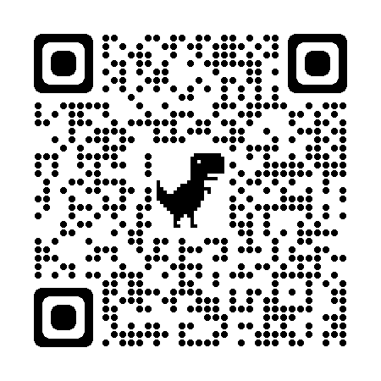
Become a Wisconsin Cancer Collaborative Member!
Online networking directory
Monthly and quarterly members-only newsletters
Email alerts with new resources
Free access to events
Leadership opportunities
Tools and resources to support your organization’s efforts to implement the Wisconsin Cancer Plan 2020-2030
Opportunities to collaborate with other Wisconsin Cancer Collaborative Members
Join Us!
Membership is free! Scan the QR code to join us today.
Notes:
What’s in it for those attending, describe benefits
Share about WCC and what we’ve accomplished
Briefly share how to join

Slide 6

Wisconsin Cancer Plan 2020-2030
  Serves as a common framework and foundation for action for all working on cancer prevention and control in Wisconsin
  Designed to provide a vision of what needs to be done and the resources needed to reduce the burden of cancer in Wisconsin
Wisconsin Cancer Plan 2020-2030
Notes:
Beth
Discuss WI Cancer Plan (See below text for example language)
The Wisconsin Cancer Plan 2020-2030 lays forth a blueprint for action with a singular vision: creating a healthier Wisconsin by reducing the burden of cancer for everyone. It spans the entire cancer control continuum, from risk reduction through end of life. The success of the Wisconsin Cancer Plan depends on people and organizations from multiple sectors coming together to take action.
Organizations can look to the Wisconsin Cancer Plan 2020-2030 for evidence-based, sustainable solutions to reduce the burden of cancer in their communities and across the state, through policy and systems-level change. The Wisconsin Cancer Plan 2020-2030 includes a framework that encompasses the vision, mission, and overarching goals across seven chapters. Each chapter includes priorities, strategies, and specific action steps.
It combines best practices, reliable data, and concrete action steps.
The Wisconsin Cancer Plan 2020-2030 is designed to serve:
Health system leaders
Public health advocates
Policy makers
Researchers
Every Wisconsinite working to prevent cancer and improve health outcomes
It contains proven tools to expand your impact and to make the most effective impact on the cancer burden in your community. Use the Wisconsin Cancer Plan 2020-2030 for:
Best practices and strategies to guide your work
Reliable data
Concrete action steps (online only)
Progress measures (online only)
Related resources to support and expand your impact (online only)
It also contains expert guidance across the cancer care continuum.
It was designed by experts to offer strategic guidance in:
Health equity
Risk reduction and prevention
Screening and early detection
Treatment
Survivorship
End of life
Access to quality data

Slide 7

Wisconsin Cancer Plan 2020-2030 Chapters
Chapter 1: Health Equity
Chapter 2: Risk Reduction
Chapter 3: Early Detection & Screening
Chapter 4: Treatment
Chapter 5: Survivorship
Chapter 6: End of Life
Chapter 7: Data
-
Notes:
Beth
Discuss WI Cancer Plan Chapters

Slide 8
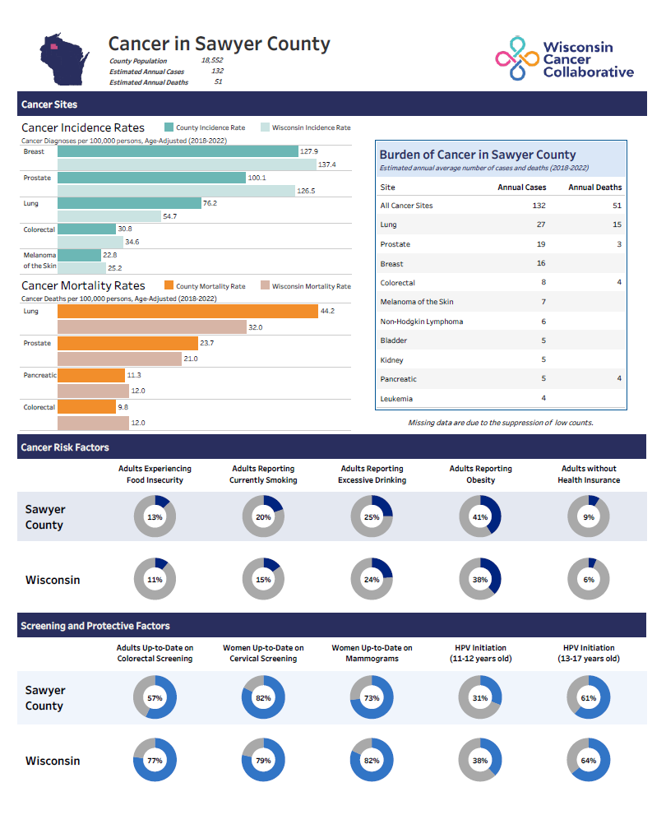
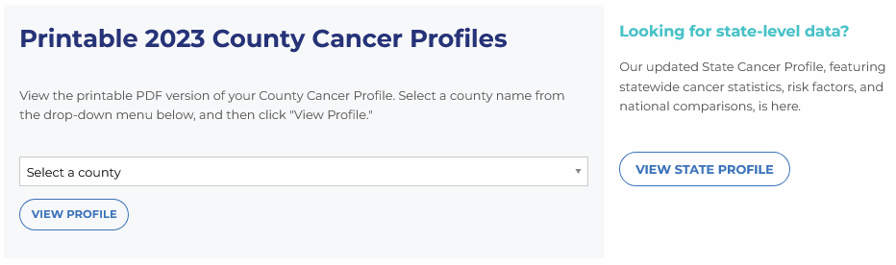
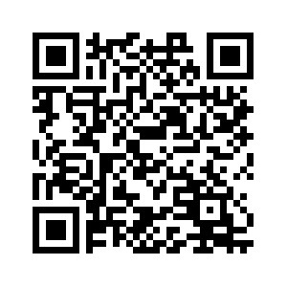
County Cancer Profiles Link:
New Profiles Coming Soon:
County Cancer Profiles
NEW County Cancer Profiles Coming Soon!!
Notes:
Mention county cancer profiles, what people can use them for, and where to find them

Slide 9


Look what we’ve been up to
Lung Cancer Report
Childhood Cancer Action Plan
Notes:
Beth
Highlight recent reports published

Slide 10
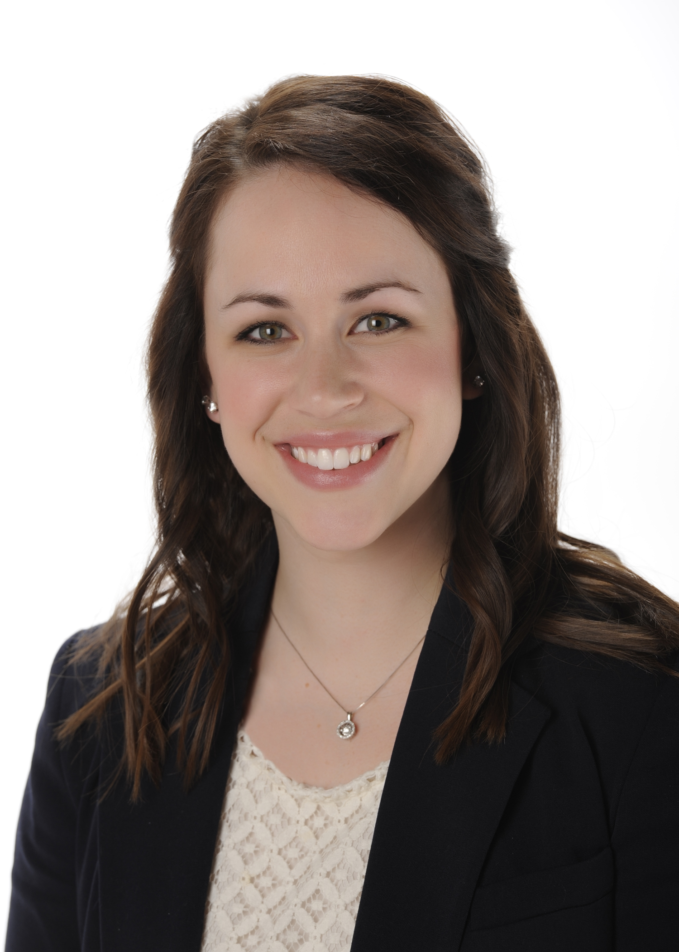
Community Spotlight
Meghan McHugh, RN, BSN, OCN
Manager CT Lung Screening Program
Advocate Health – Midwest
Notes:
Beth introduces Tiffany Allen and Christie Johnston
Tiffany Allen is a Nurse Practitioner and serves as the Program Director for SWCAP Neighborhood Health Partners and Care Coordination Network. She has a passion for working with underserved populations and helping individuals achieve their health goals and improved health equity within their communities. Outside of her professional role, Tiffany loves spending time with her two young boys, Markus and Major, cooking and baking, reading, staying active and being outdoors, and cheering on the UW-Platteville football team!
Christie Johnston joined the Behavioral Health Partnership as a Program Coordinator in August 2022. Prior to joining the Partnership, she worked with children, parents, and families in a variety of educational settings. In this work, Christie saw an increasing need for both individual and community mental health support. One avenue of sustainability for the Partnership was offering community-based support to assist in navigation towards resources. The Care Coordination Network at SWCAP was a perfect collaboration.
In November of 2023, Christie joined the Care Coordination Network as the Program Manager. “It has been an amazing experience to see individual relationships being built to support, encourage, and empower those who need it. From help with rides to Immigration court dates or cancer treatments to helping someone fill out a job application, our Community Health Workers are connecting with residents and meeting them where are they are in their lives.”

Slide 11
Lambeau’s Deadliest Opponent: Tackling Lung Cancer with
Early Screening!
WI Cancer Collaborative
2025 Regional Meeting – Green Bay
Meghan McHugh, RN BSN OCN Manager Lung Screening Program
Advocate Health – Midwest Region

Slide 12


Lambeau Field Capacity ~ 81K
NFL Draft saw ~ 250K Visitors

Slide 13
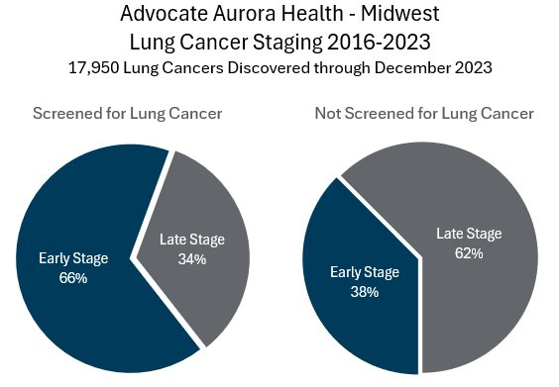
Game Changer: Lung Cancer Screening

Slide 14
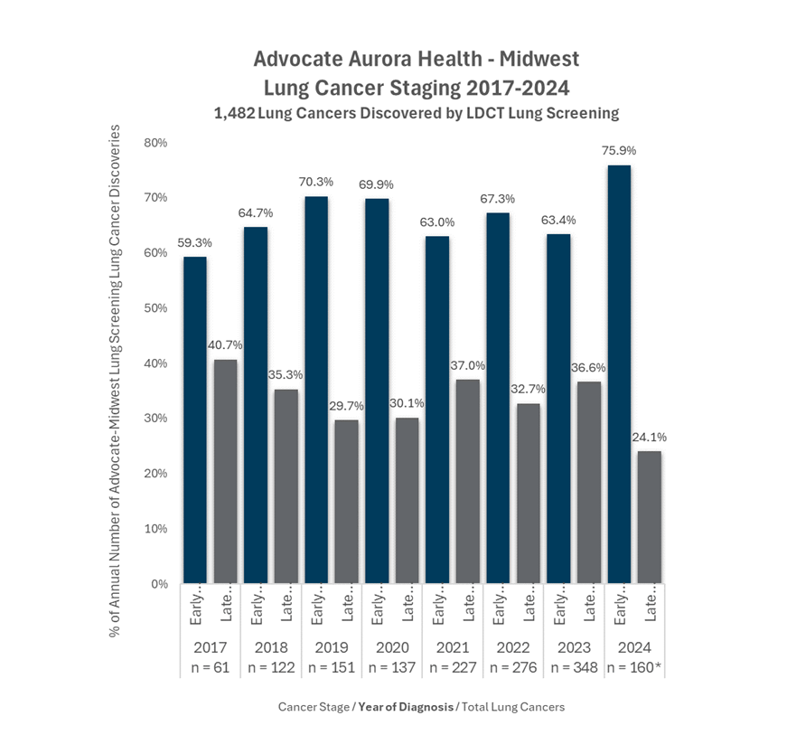
Stage Shift
July 2024 – nearly 76% were diagnosed at an early stage (Stage 1/2)
In WI – nearly 30% of all lung cancers were early stage

Slide 15
Building Our Team
2014-2016 – 9 Decentralized LDCT Sites opened in WI, cases submitted to the ACR Registry since 2016
2017 – Best Practice Alert created in the EHR
Fall 2018 – dedicated team in WI was created, Advocate and Aurora Merger
Fall 2022 – Combined IL and WI programs
  One LCSR Registry
  Standardized workflows and policy
  Staff education on program and support
  Two additional dedicated Thoracic tumor conferences created (4 total across WI and IL)
2025…

Slide 16
Who
RN Nurse Coordinator
Data Specialist
Physician Champions
26K patients in 2024
What
Hybrid model
USPSTF and CMS Criteria
Smoking cessation
Patient education
Where
50 locations across WI and IL
Hospitals and outpatient imaging centers
Community education and awareness events
Primary care offices

Slide 17
Nodule seen on LDCT or found incidentally
Patient presented at lung nodule clinic
Consult with pulmonary provider
Diagnostic work up or follow up imaging
Seen at Multidisciplinary Lung Cancer Clinic
Patient
Nurse Navigators
Interventional Pulmonary
Thoracic Surgery
Radiology
Medical/Radiation Oncology

Slide 18
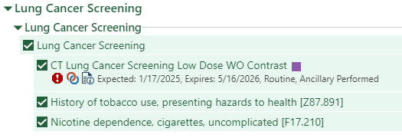
Executing the Gameplan
Health Maintenance Topic/Best Practice Advisory
Unique Orders for screening
  Baseline/Annual
  Follow up
Quality Metrics and Evaluation
  Bronchoscopy Complication Rates
  Screening Rate
  Adherence to Annual Screening
  Tobacco Documentation
Staff and Community Outreach
  Lobby tables
  Community festivals and health fairs
  Sporting events

Slide 20
Multi-center Analysis of Extrapulmonary Malignancies Identified during Low-Dose Lung Cancer Screening
Total 24 renal EMs
1 patient died of lung cancer
Unpublished data, manuscript in process
Tisileli S. Tuifua, MD Philip Kaminsky, MD
Abraham Weiss, MD Meghan McHugh, RN, BSN Daniel Malone, MD¹

Slide 21
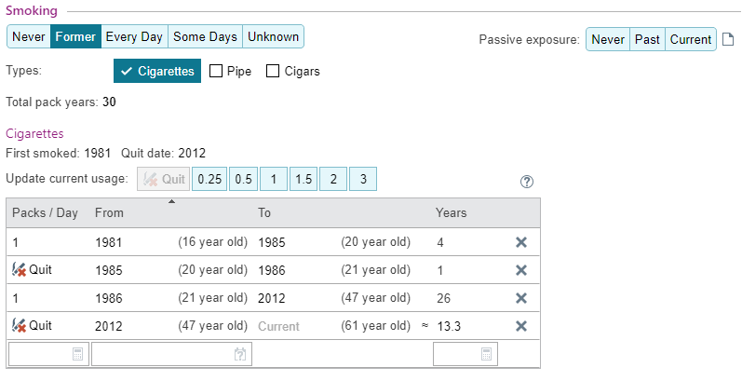
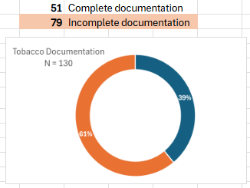
First Line of Defense:
Tobacco Screening and Documentation

Slide 22
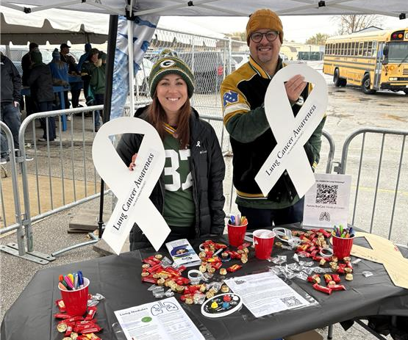
Tackling our Challenges
~20% Screening Rate
Community Education
  Lobby tables
  Community events – festivals, sporting events, etc.
  Media
Staff Awareness
  Attend monthly meetings
  Created/Updated a learning module
  Hotline phone number
Increase access and availability
Smoking cessation tools and documentation
  Registration high, completion low
  Smart sets
  Education and working with Epic partners

Slide 23
Thank you!
Questions?
Meghan.McHugh@aah.org
800-252-2990

Slide 24
Table Discussions
Notes:
Beth will have people breakout into small groups to go over prompt questions and discuss their work

Slide 25
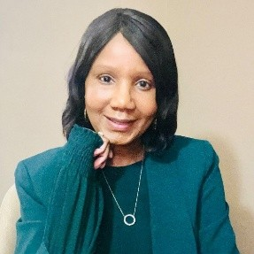
Community Spotlight
Keeshia Jones
Director of Healthcare & Community Partnerships ABCD
After Breast Cancer Diagnosis
Notes:
Beth introduces Tiffany Allen and Christie Johnston
Tiffany Allen is a Nurse Practitioner and serves as the Program Director for SWCAP Neighborhood Health Partners and Care Coordination Network. She has a passion for working with underserved populations and helping individuals achieve their health goals and improved health equity within their communities. Outside of her professional role, Tiffany loves spending time with her two young boys, Markus and Major, cooking and baking, reading, staying active and being outdoors, and cheering on the UW-Platteville football team!
Christie Johnston joined the Behavioral Health Partnership as a Program Coordinator in August 2022. Prior to joining the Partnership, she worked with children, parents, and families in a variety of educational settings. In this work, Christie saw an increasing need for both individual and community mental health support. One avenue of sustainability for the Partnership was offering community-based support to assist in navigation towards resources. The Care Coordination Network at SWCAP was a perfect collaboration.
In November of 2023, Christie joined the Care Coordination Network as the Program Manager. “It has been an amazing experience to see individual relationships being built to support, encourage, and empower those who need it. From help with rides to Immigration court dates or cancer treatments to helping someone fill out a job application, our Community Health Workers are connecting with residents and meeting them where are they are in their lives.”

Slide 26




CUSTOMIZED, ONE-TO-ONE EMOTIONAL SUPPORT
Wisconsin Cancer Collaborative
Regional Meeting, Green Bay, WI
Presented by Keeshia Jones, Director of Healthcare & Community Partnerships
May 6th, 2025

Slide 27

What We Do
abcd
ABCD offers free, personalized emotional support and information for anyone impacted by breast cancer.
With a fully virtual platform, ABCD helps people worldwide, ensuring no one faces breast cancer alone.
Anyone. Anywhere. Any Stage.
© ABCD, Inc. 2025. Proprietary and all rights reserved.

Slide 28
Our Vision
ABCD’s vision is that anyone impacted by breast cancer receives personalized emotional support and has access to services and resources to enhance their health and well-being.
Our Mission
To inspire hope and transform lives by providing emotional support to anyone impacted by breast cancer, anywhere, at any stage.
© ABCD, Inc. 2025. Proprietary and all rights reserved.

Slide 29

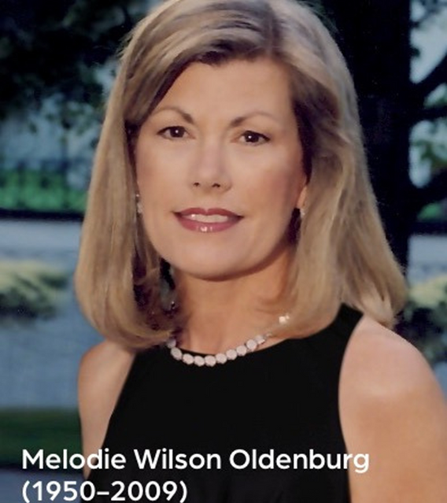


Our History
est. 1999
© ABCD, Inc. 2025. Proprietary and all rights reserved.

Slide 30

ABCD’s Signature
Service
Our signature service is creating a customized match with a professionally trained volunteer Mentor who not only shares a similar diagnosis and treatment plan, but is also of similar age, has common interests, personal traits and family dynamics.
© ABCD, Inc. 2025. Proprietary and all rights reserved.

Slide 31
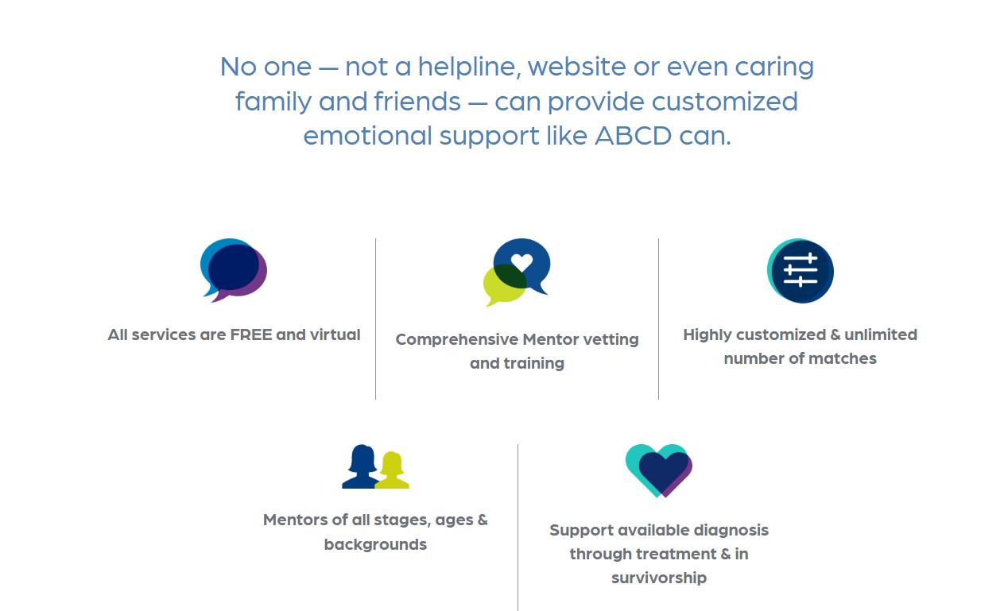
© ABCD, Inc. 2025. Proprietary and all rights reserved.

Slide 32


ABCD Mentors
We currently have over 275 active and diverse Mentors located throughout the United States, enabling us to make truly personalized connections.
ABCD Mentors are volunteers who are breast cancer survivors at least 1 year past completing treatment (with the exception of hormone replacement therapy), living with metastatic/Stage IV disease, or a friend, family, or caregiver of a breast cancer patient.
© ABCD, Inc. 2025. Proprietary and all rights reserved.

Slide 33
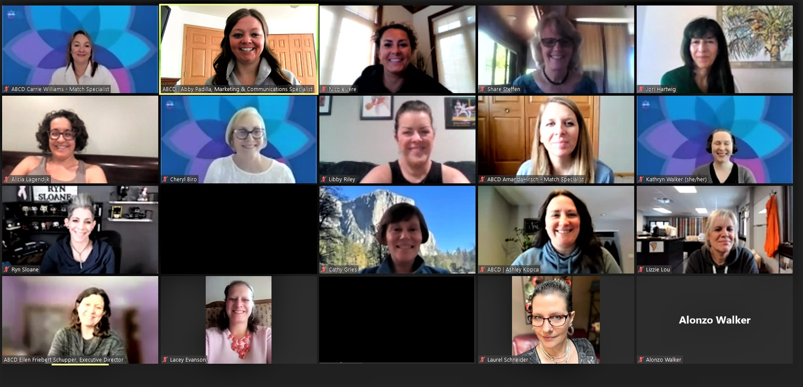
Virtual Mentor Training
Each Mentor has been interviewed, screened, and completed a comprehensive training program specifically developed for ABCD to help them best use their personal breast cancer experience to comfort and guide those they will be mentoring.
© ABCD, Inc. 2025. Proprietary and all rights reserved.

Slide 34
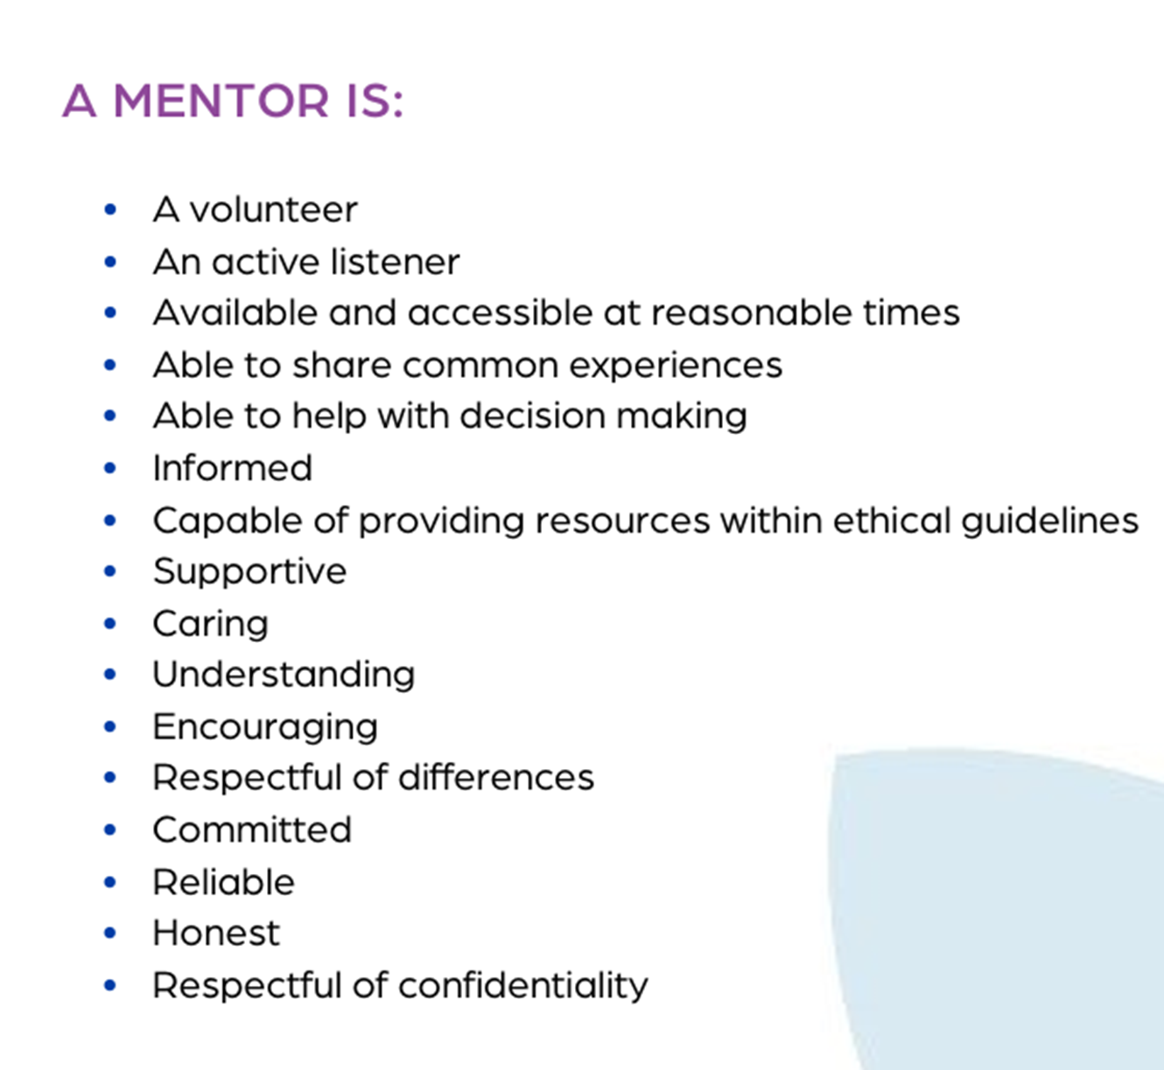
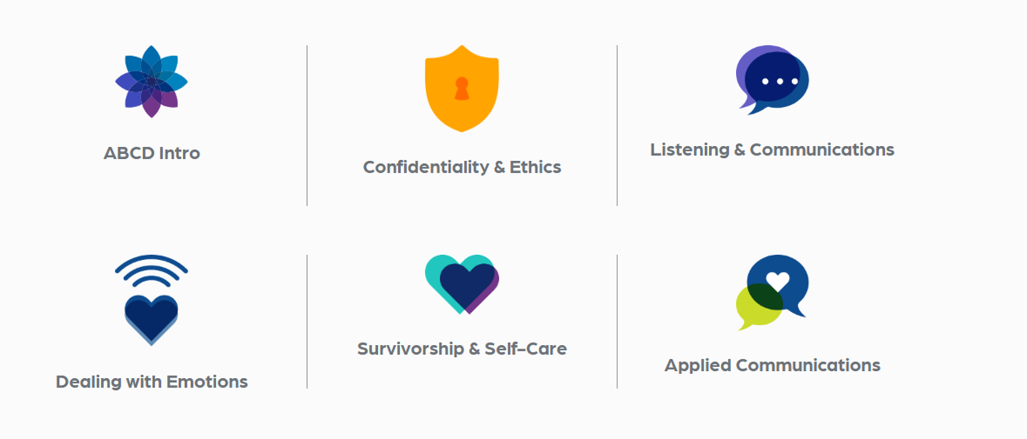
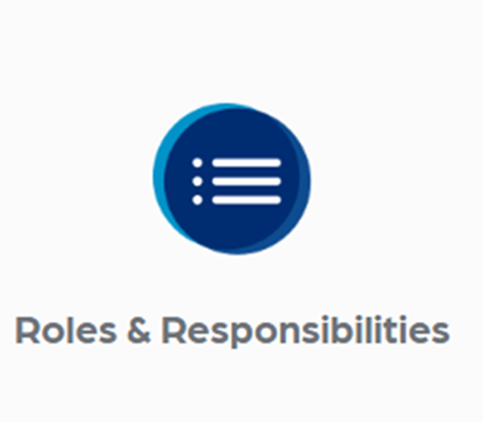
Mentor Training Topics
© ABCD, Inc. 2025. Proprietary and all rights reserved.

Slide 35
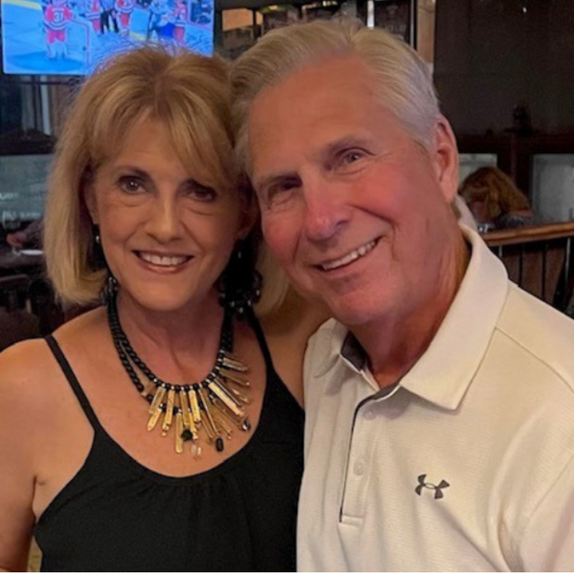
“This isn’t a great revelation,
but it is so important that people have strong support during this time. I would encourage them, men, and women, to seek support like ABCD.”
Tom, ABCD Mentor
© ABCD, Inc. 2025. Proprietary and all rights reserved.

Slide 36



The Match Process
FREE | EASY | NO WAITLIST
Contact ABCD through our website, email or over the phone
Tell us about your diagnosis, treatment plan, age, and what is important to you
Our Match Specialists pair you with a Mentor who’s just right for you
© ABCD, Inc. 2025. Proprietary and all rights reserved.

Slide 37

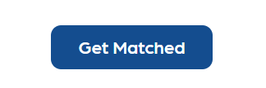

Request Support
For Patients to Request a Mentor
Get free, customized emotional support
Whether you want to talk to someone who understands what you’re going through, or you need trusted, reliable resources to help answer all of your questions, the ABCD team is here to support you every step of the way.
Visit: https://abcdbreastcancersupport.org/get-support/
Click on: GET MATCHED and complete the form for yourself or someone impacted by a breast cancer diagnosis.
© ABCD, Inc. 2025. Proprietary and all rights reserved.

Slide 38

Submit a Referral
For Healthcare Professionals and Cancer Support Organizations
We know that patients have many online forms and paperwork to fill out. All we need is basic information from you and your patient to get them the support they need.
Visit: abcdbreastcancersupport.org/for-healthcare-providers/
Click on: MAKE A REFERRAL and complete the form for your patient.
© ABCD, Inc. 2025. Proprietary and all rights reserved.

Slide 39
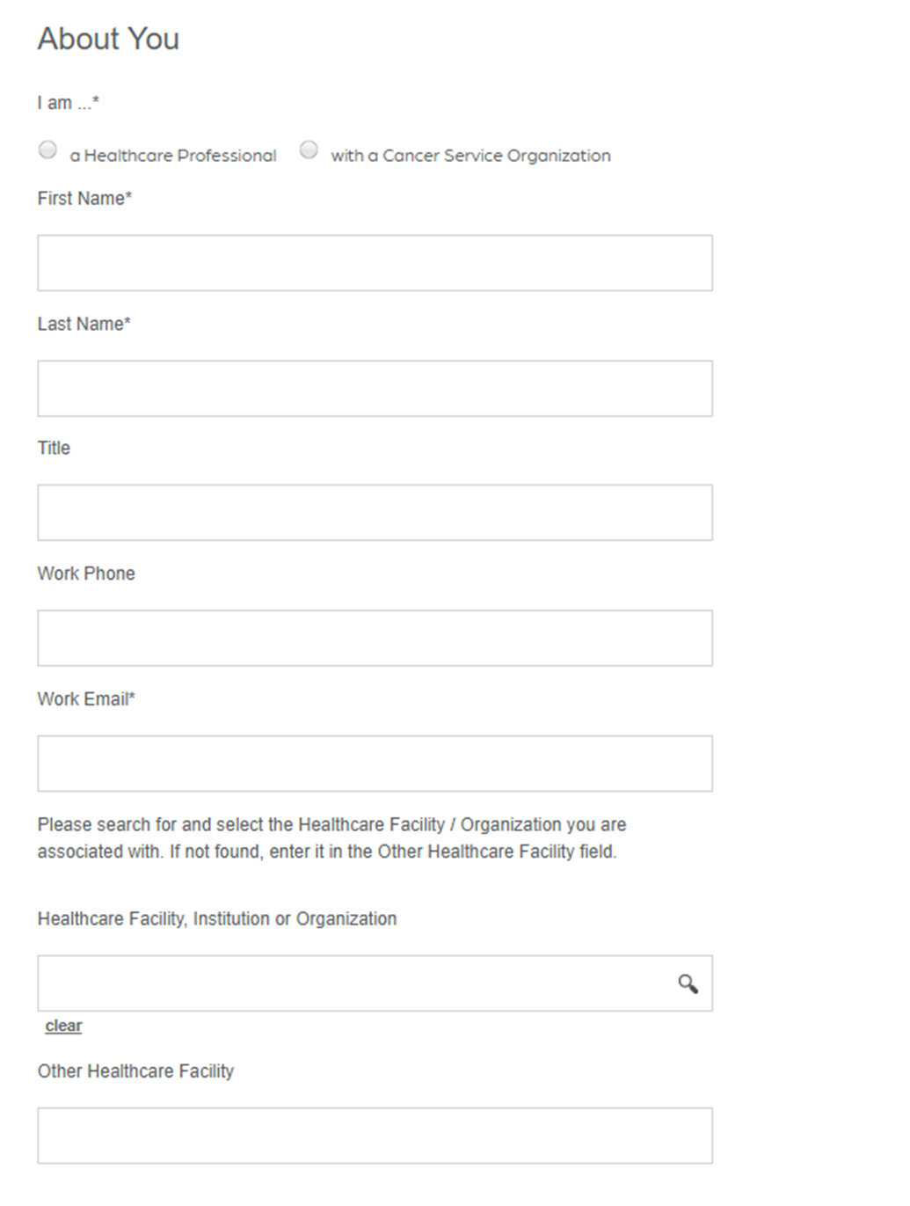
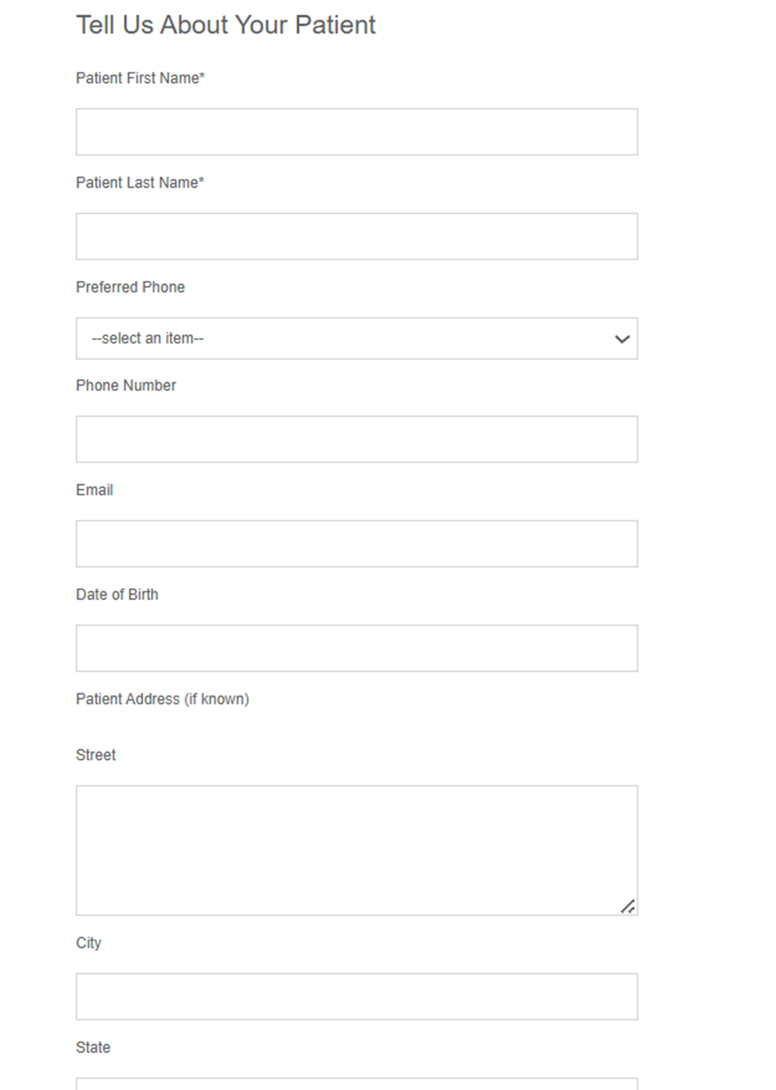
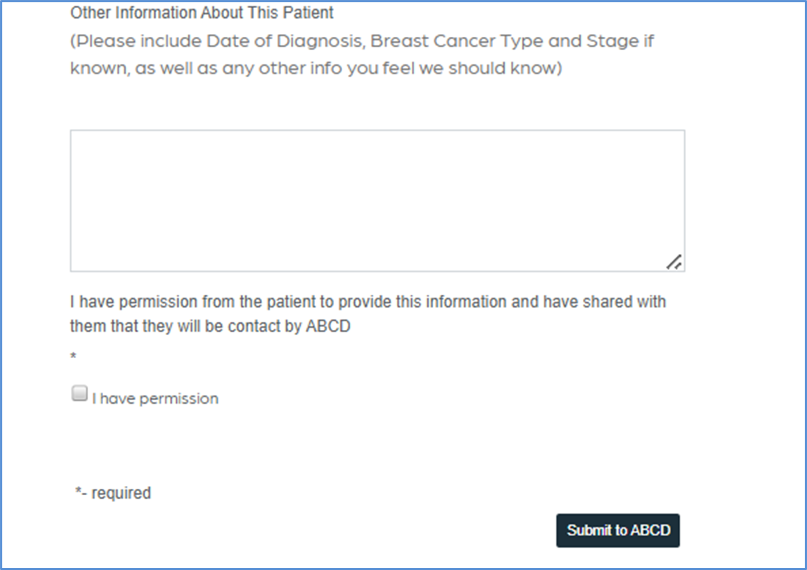
© ABCD, Inc. 2025. Proprietary and all rights reserved.

Slide 40
Decades of research indicate that patients who take advantage of non-clinical support like ABCD’s …
More likely to finish treatment
Improved survival rates
Reduced risk of recurrence
Less stress
Healthier social relationships
Improved quality of life
For ABCD Mentors, volunteering can have positive social and emotional health benefits, such as greater life satisfaction, and lower rates of depression.
© ABCD, Inc. 2025. Proprietary and all rights reserved.

Slide 41
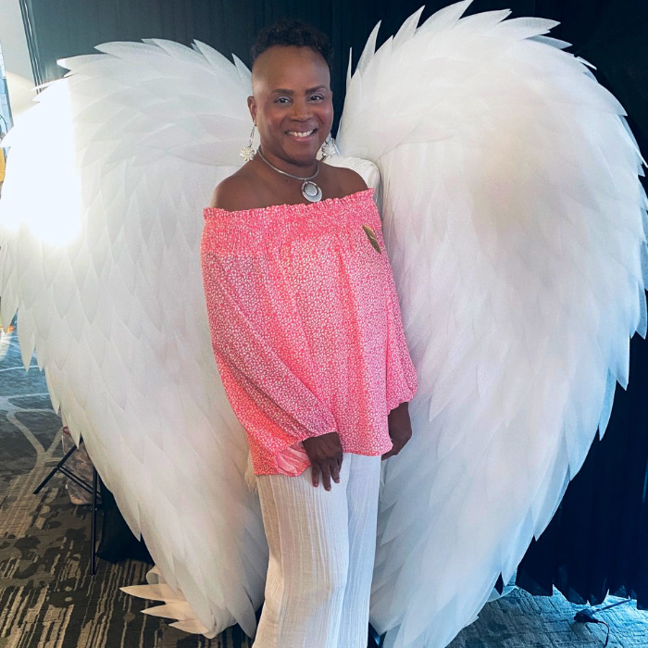
“ABCD’s New Mentor Training was just incredible.
It helped me make sense of my own situation, my own journey.”
Melodie, ABCD Mentor
© ABCD, Inc. 2025. Proprietary and all rights reserved.

Slide 42

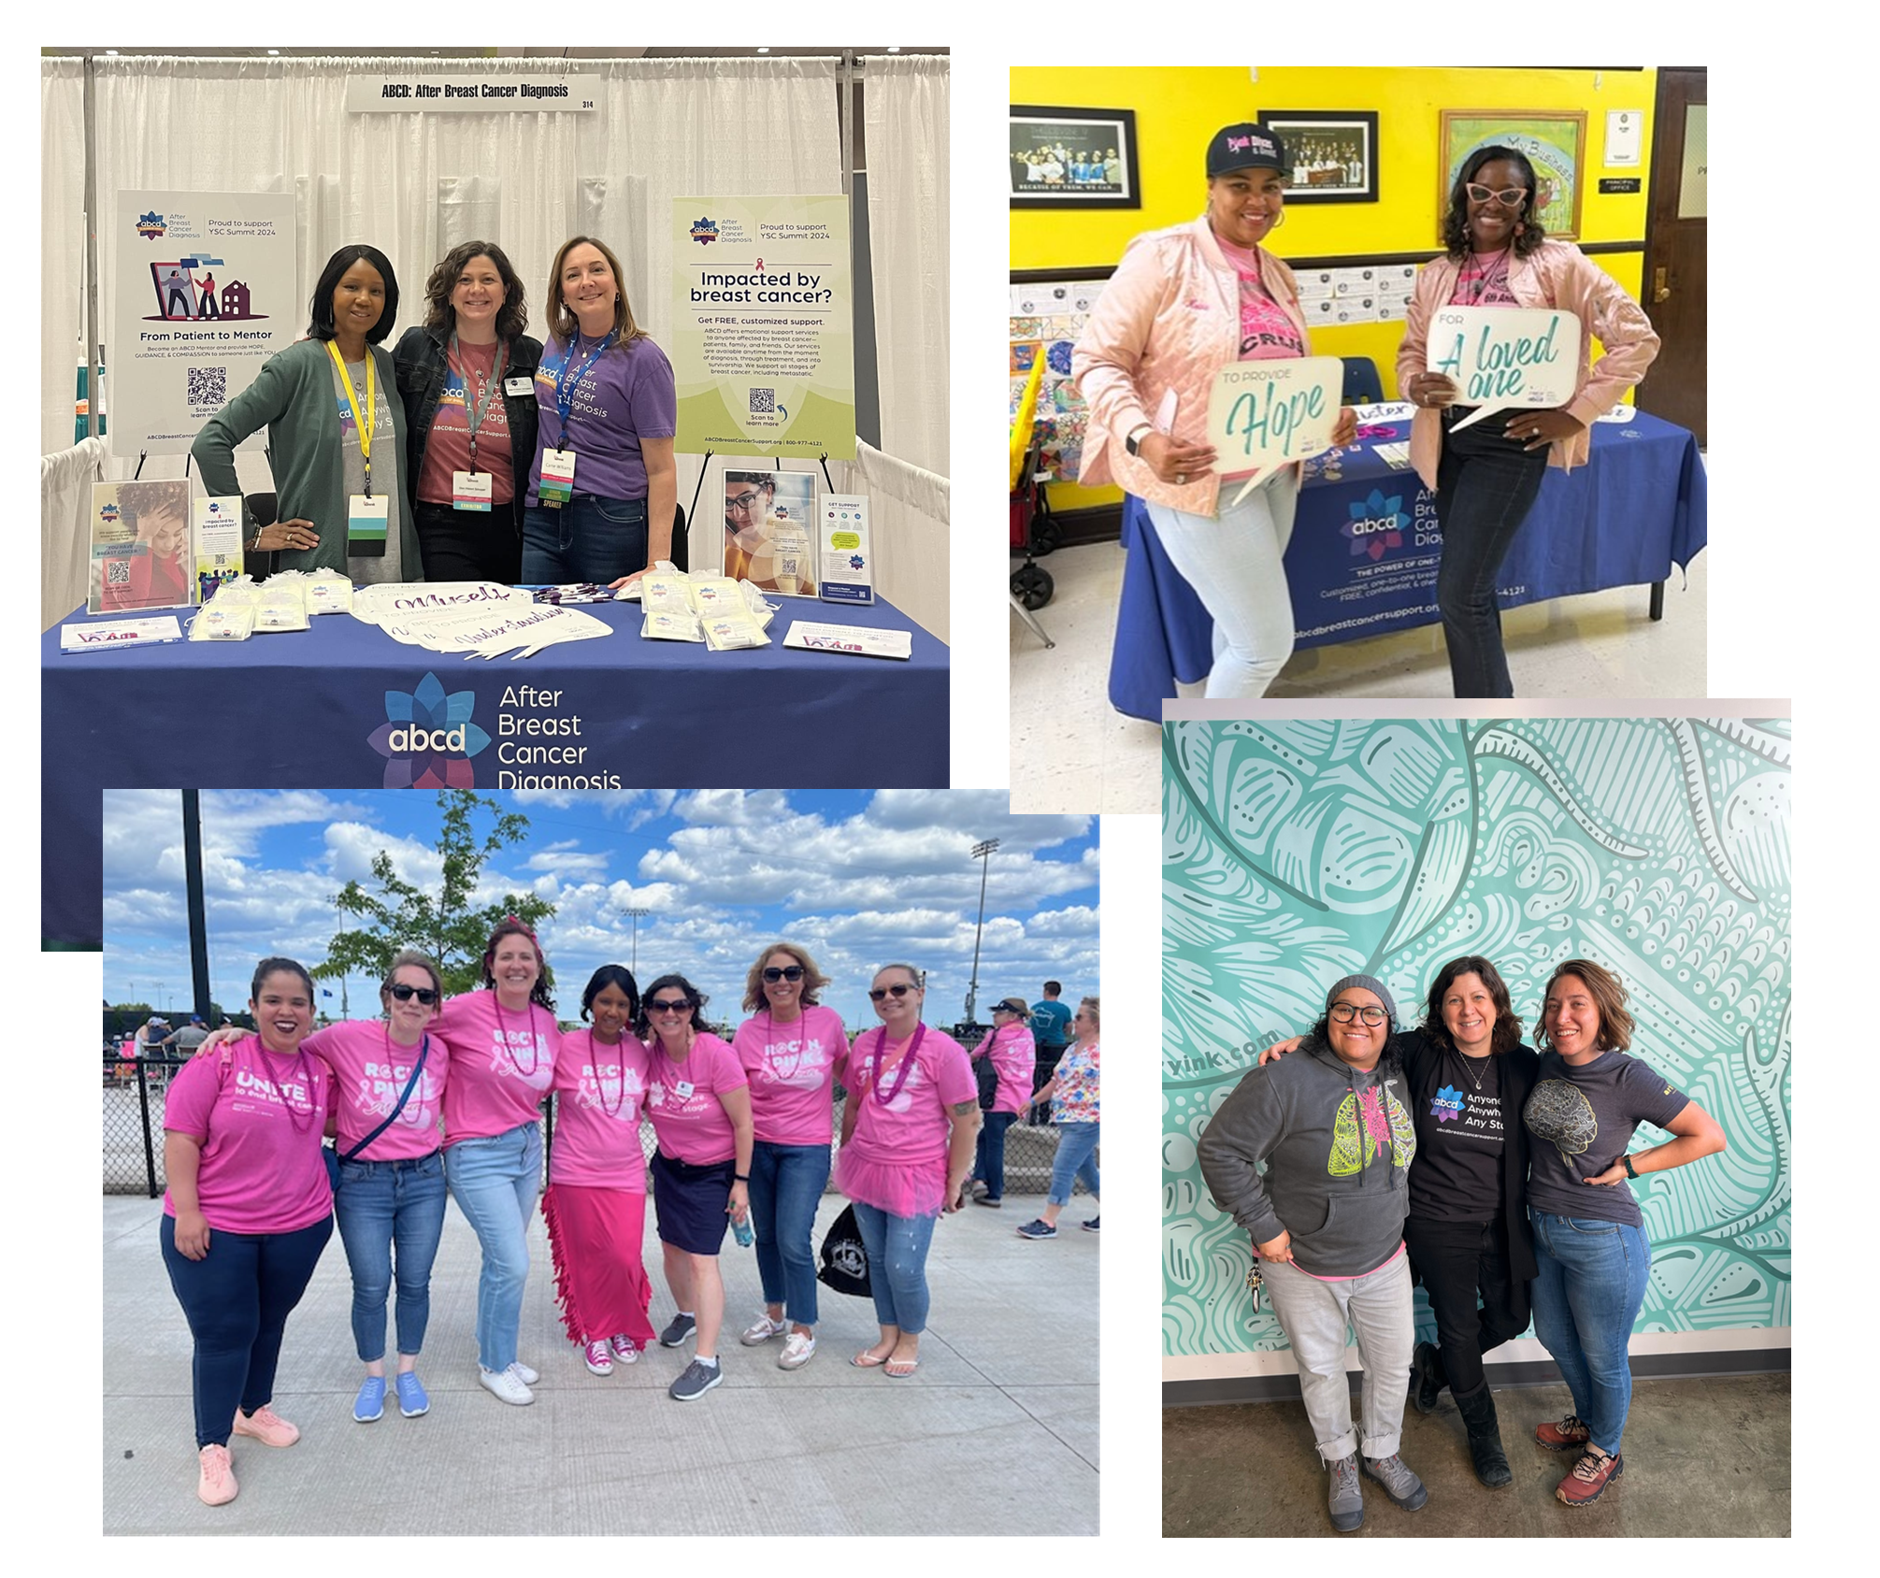





ABCD Outreach
Healthcare
Professionals
ABCD Staff & Volunteers
Corporations
& Businesses
Breast Cancer Organizations
Community Organizations
© ABCD, Inc. 2025. Proprietary and all rights reserved.

Slide 43


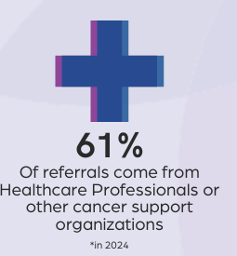



25 Years of Impact
8,194+
110K+
928
Total one-to-one matches
People served in 50 states & 10 countries
Mentors trained, including 70 this year
*Statistics as of January 31, 2025
© ABCD, Inc. 2025. Proprietary and all rights reserved.

Slide 44


ABCD gives the invaluable gift of emotional support as a free service to anyone who needs it.
ABCD relies 100% on the generosity of donors to do this important work.
Putting your donations to work
Donations benefit
© ABCD, Inc. 2025. Proprietary and all rights reserved.

Slide 45

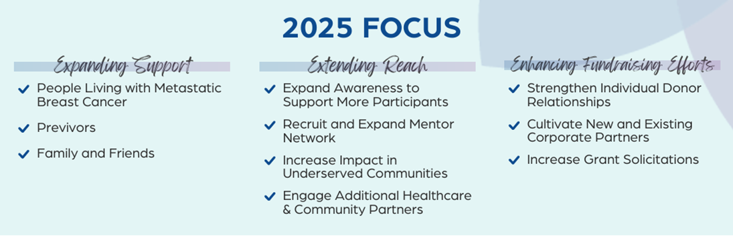
© ABCD, Inc. 2025. Proprietary and all rights reserved.

Slide 46








































Cancer Support Partners
© ABCD, Inc. 2025. Proprietary and all rights reserved.

Slide 47










Wisconsin Healthcare Partners
© ABCD, Inc. 2025. Proprietary and all rights reserved.

Slide 48
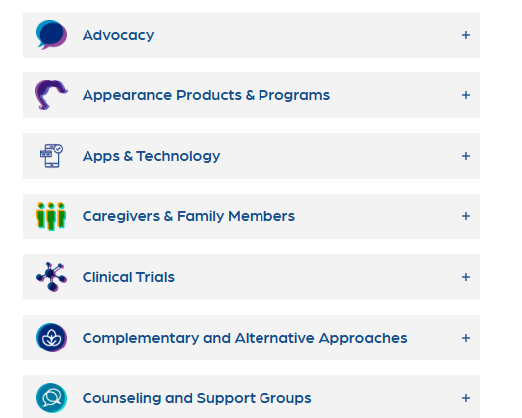
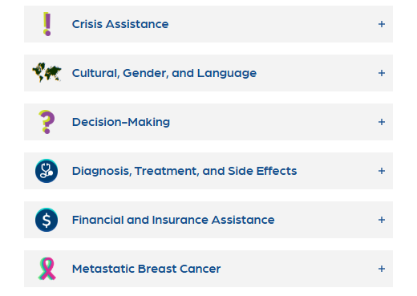
Electronic Resource Guide
© ABCD, Inc. 2025. Proprietary and all rights reserved.

Slide 49
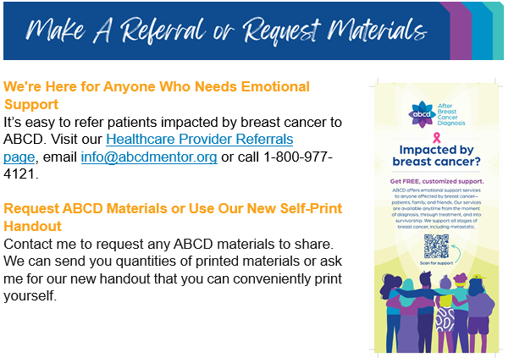
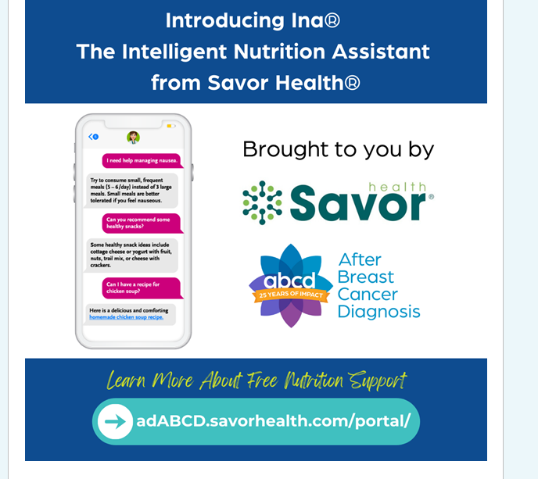
© ABCD, Inc. 2025. Proprietary and all rights reserved.

Slide 50


Finding the Grace in the Gray: Dealing with the Emotional Impact of a Health Scare
July 16 | 6:30-7:30 PM CT
Featuring: Susan Hall, author of Decide Happy: A Practical Guide for Less Stress
What's in Your Genes:
Understanding Genetic Risks & Myths
November 12 | 6:30-7:30 PM CT
Featuring: Jenny Geurts, MS, CGC, from the Medical College of Wisconsin
https://abcdbreastcancersupport.org/events/
© ABCD, Inc. 2025. Proprietary and all rights reserved.

Slide 51

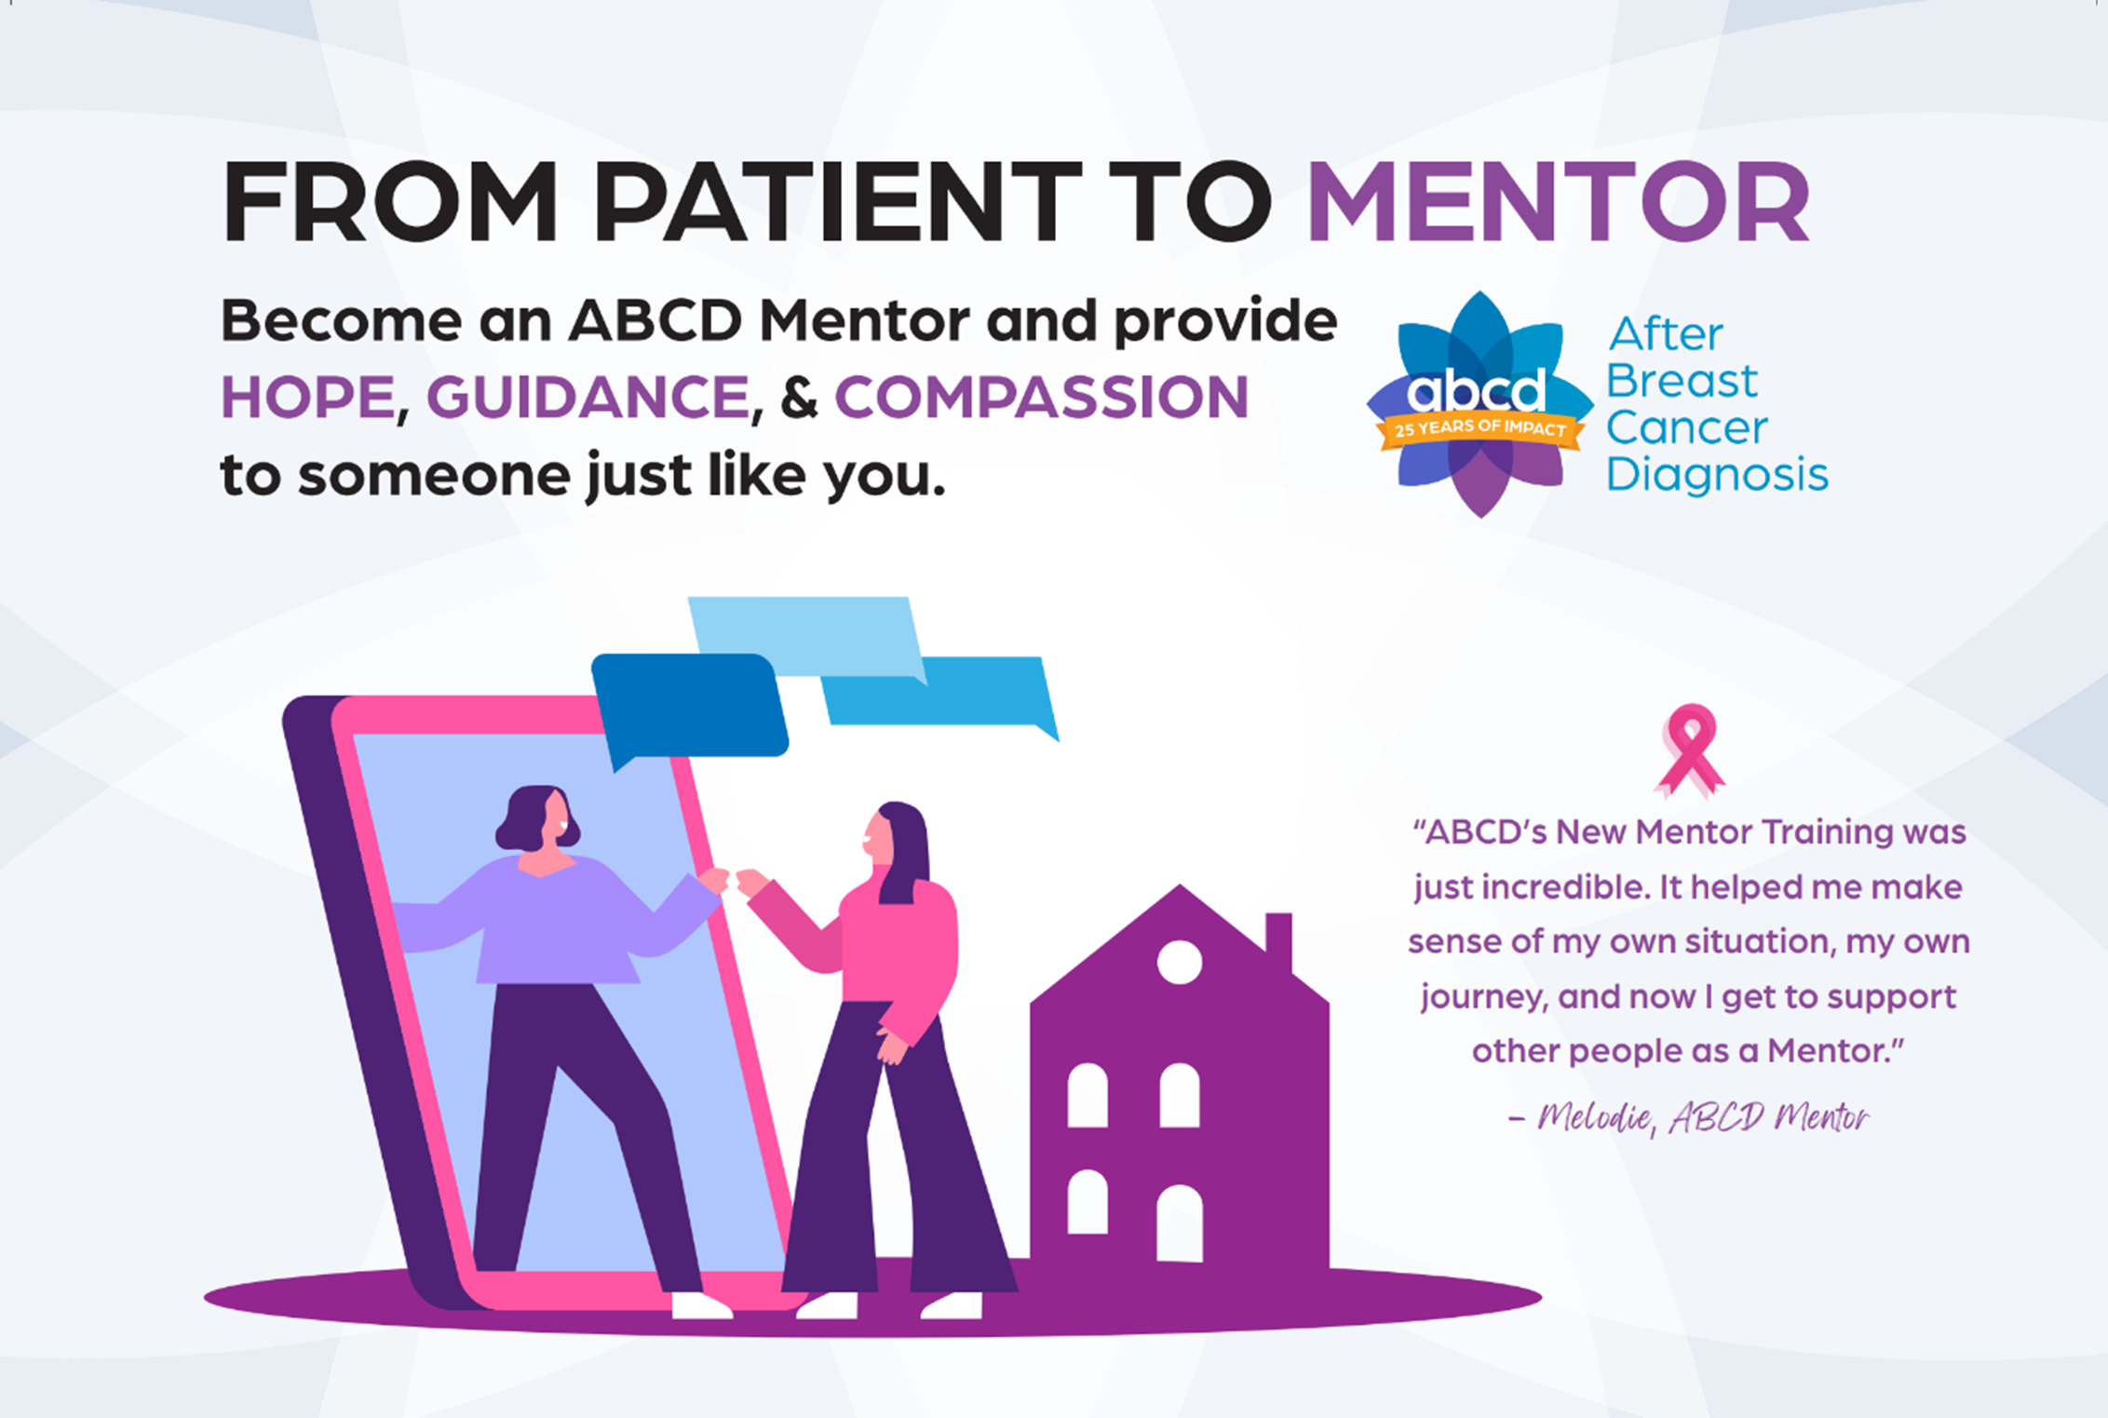
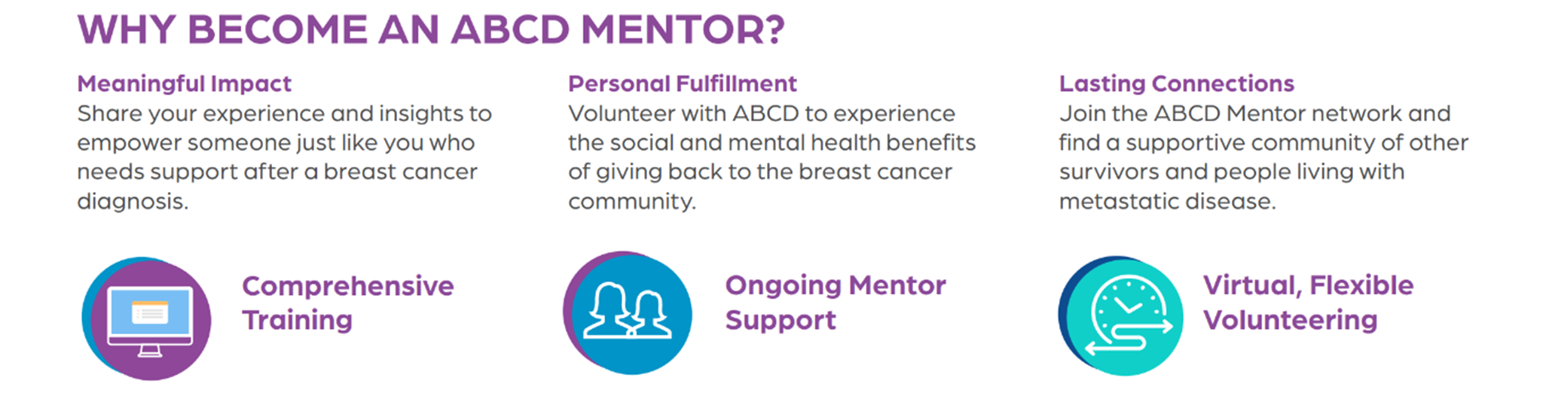
New Mentor Training for
Breast Cancer Survivors
Visit the Get Involved page on our website to learn more:
ABCDBreastCancerSupport.org/get-involved
© ABCD, Inc. 2025. Proprietary and all rights reserved.

Slide 52


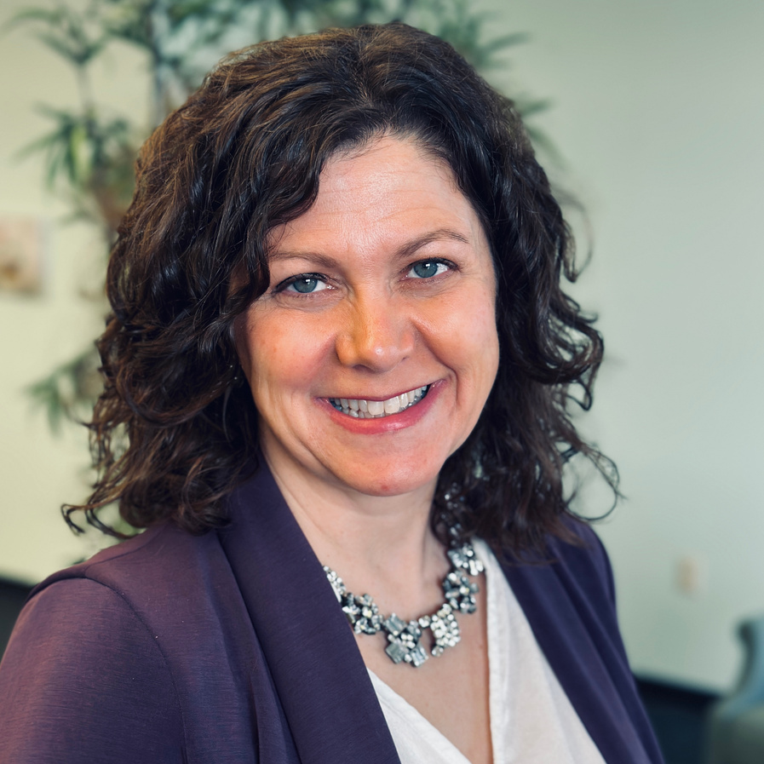
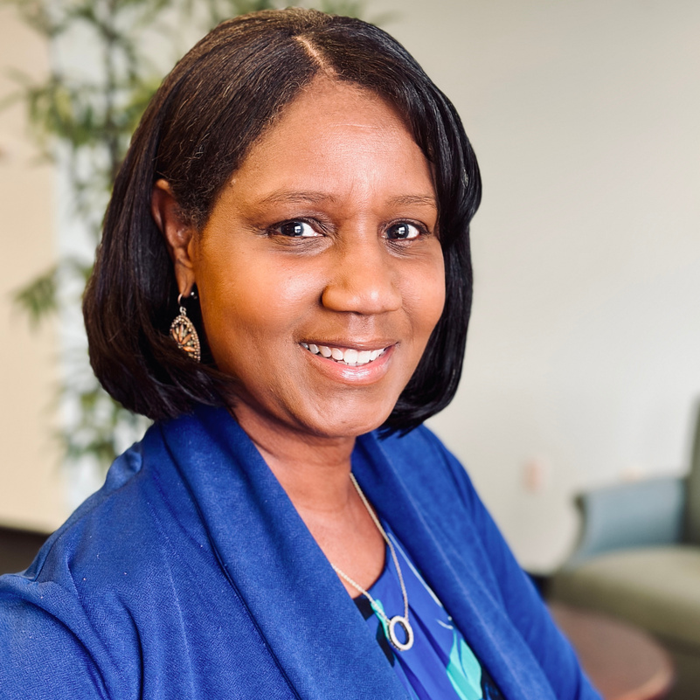
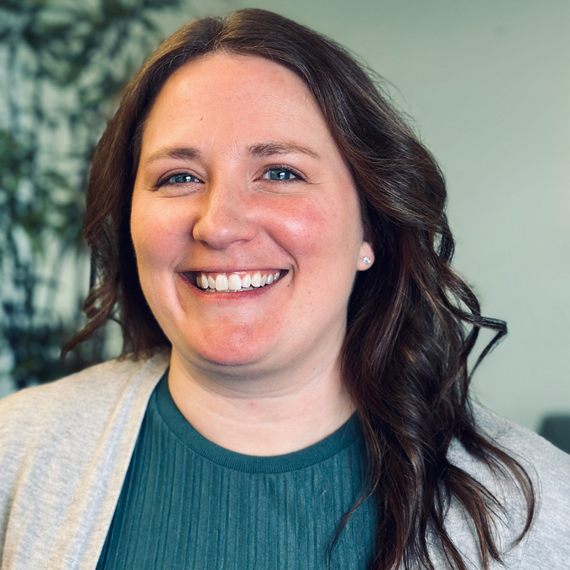

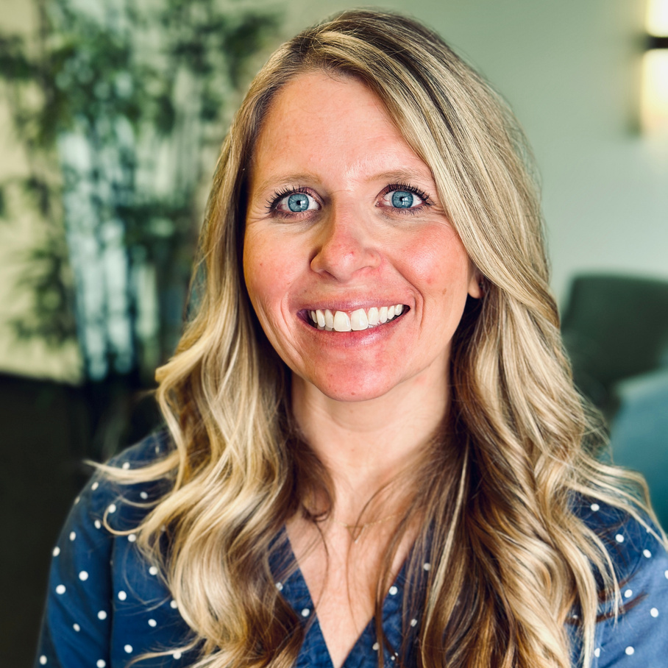
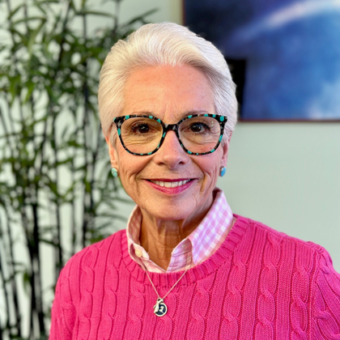
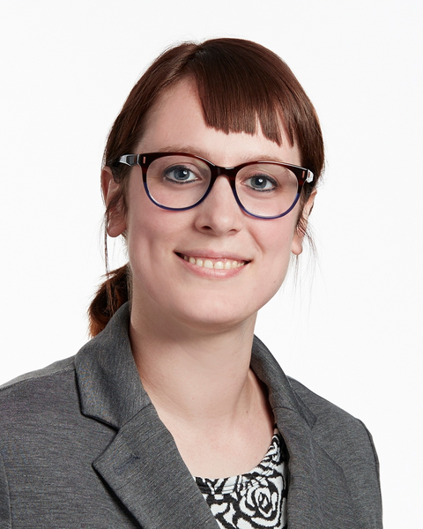
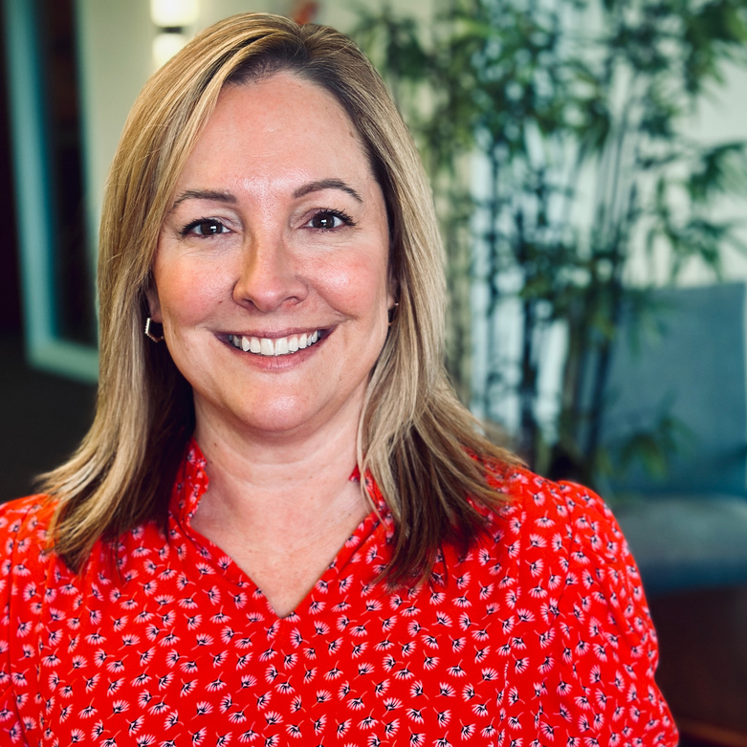
abcd
Ellen Friebert Schupper
Keeshia Jones
Ashley Kopca
Executive Director
Director of Healthcare & Community Partnerships
ABCD Mentor
Director of Corporate Partnerships & Events
Team Members
Carrie Williams
Amanda Hirsch
Linda Settler
Megan Brown
Director of Service Delivery & Mentor Engagement
ABCD Mentor
Match Specialist
Match Specialist
ABCD Mentor
Marketing & Communications Support
ABCD Mentor
© ABCD, Inc. 2025. Proprietary and all rights reserved.

Slide 53
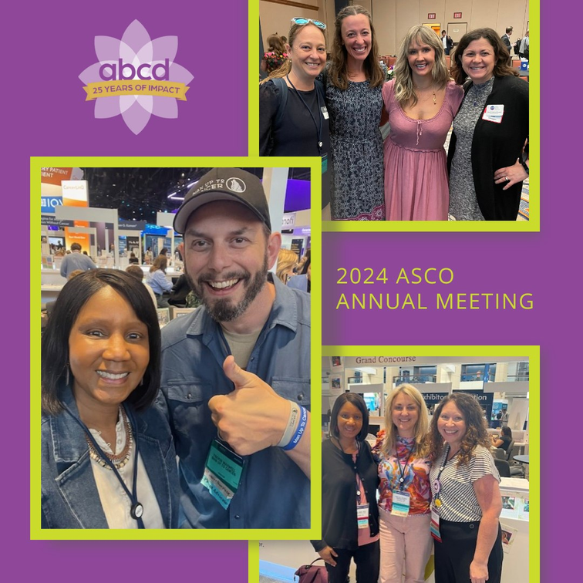

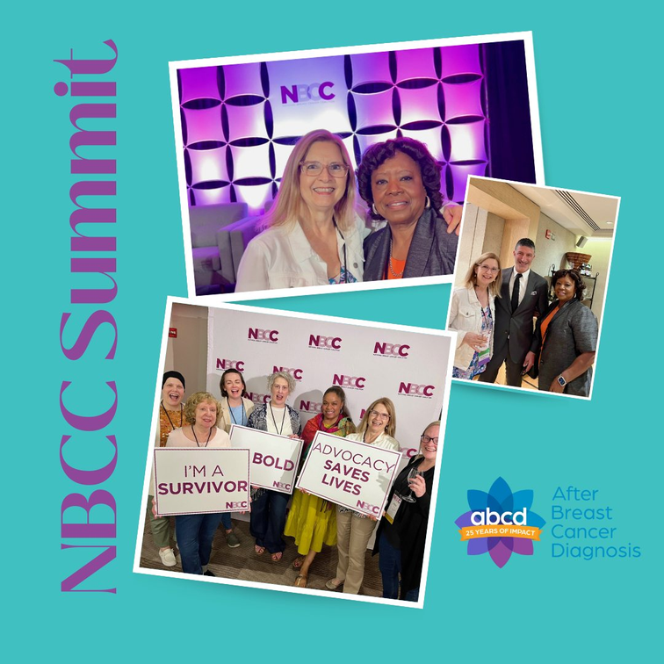

abcd
25
YEARS
OF
IMPACT
© ABCD, Inc. 2025. Proprietary and all rights reserved.

Slide 54
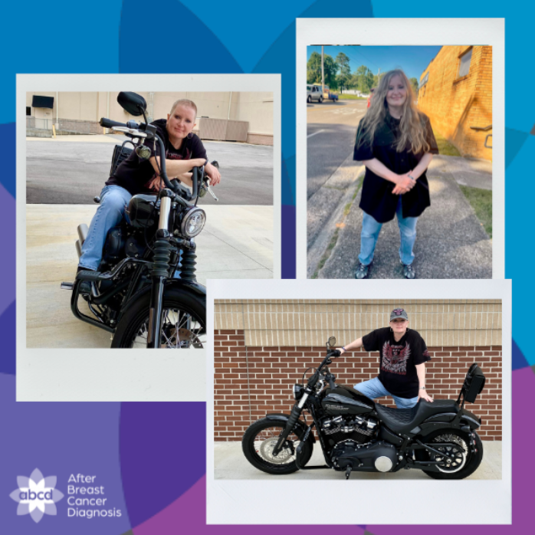
“ABCD couldn’t have picked a more perfect Mentor for me.
She had the same type
of breast cancer. She also rides a Harley. That connection meant the world to me.”
Donna, ABCD Participant
© ABCD, Inc. 2025. Proprietary and all rights reserved.

Slide 55



FREE, CUSTOMIZED, ONE-TO-ONE EMOTIONAL SUPPORT
For more information:
ABCDBreastCancerSupport.org | 800-977-4121
Follow us on social media
ABCDAfterBreastCancerDiagnosis

Slide 56
Cancer Plan Chapter Discussion
*Prevention
*Screening
*Survivorship
Notes:
Beth will have people breakout into small groups to go over prompt questions and discuss their work

Slide 57

2025 Wisconsin Cancer Summit
September 24 & 25 | Glacier Canyon Conference Center | Wisconsin Dells, WI
The Wisconsin Cancer Collaborative is excited to celebrate 20 years of cancer control and prevention work in Wisconsin with our member organizations. This summit will highlight milestones and successes throughout the coalition's history.
The Wisconsin Cancer Summit is free and open to the public. You don't have to be a member to attend, but we would love to have you join us! Joining is free.
Notes:
Beth
As the most comprehensive cancer conference in Wisconsin, the WI Cancer Summit brings together experts and advocates from across Wisconsin to explore emerging issues, gain tangible tools, and network with other cancer control leaders.
Registration details will be coming soon, so stay tuned!
We hope to see you at this year’s Summit! It will build off 2023’s summit and focus on how we can build more connections throughout the state!

Slide 58
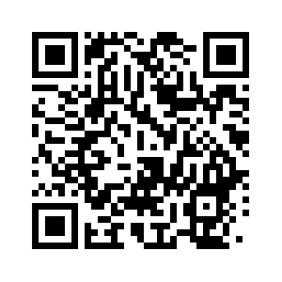
2025 Green Bay Regional Meeting Survey
Please use the QR code to complete a short survey.
(Scan using your camera on your phone)

