Slide 1
Empowering Cancer Survivors:
Crafting a Transformative Wellness Program for Lifelong Well-being
Presented by: Ilka Hoffins, Program Director for Aurora Cancer Care’s Team Phoenix
Overview of the Team Phoenix Training Program
How Team Phoenix changes the lives of female cancer survivors
Tips for crafting a transformative wellness program for cancer survivors
Notes:
Hi My name is Ilka Hoffins, and I’m the program director for Aurora Health Care’s Team Phoenix.
My hope is to provide you with an understanding of what Team Phoenix is, the lasting positive impact it has on the lives of cancer survivors, and some tips we’ve learned about crafting a wellness program for cancer survivors that instills healthy lifestyle habits and a life-long support network.

Slide 2
Team Phoenix Leadership Team
Aurora Cancer Services:
Ellen Feinstein and Dr. James Weis: Cancer Service Line VPs
Dr Jamie Cairo, Director of Clinical Program Development-System Cancer Services
Medical Advisors:
Dr Leslie Waltke, Cancer Rehabilitation Coordinator
Dr. Michael Mullane, Medical Director, Hereditary Cancer Prevention and Management Center
Program Director: Ilka Hoffins
Certified Triathlon Coach: Kim Kelley
Contact: Teamphoenix@aah.org
Notes:
I’m fortunate to work with a dedicated team of medical advisors, clinicians, and certified triathlon coaches to help survivors have a safe and successful training experience.

Slide 3
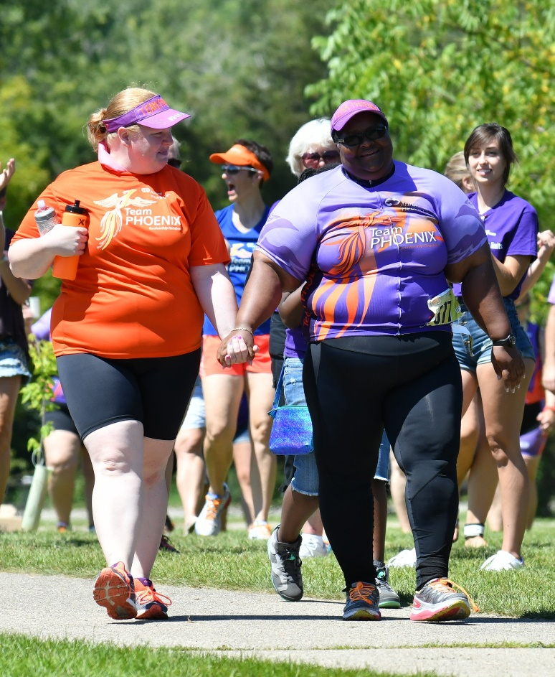
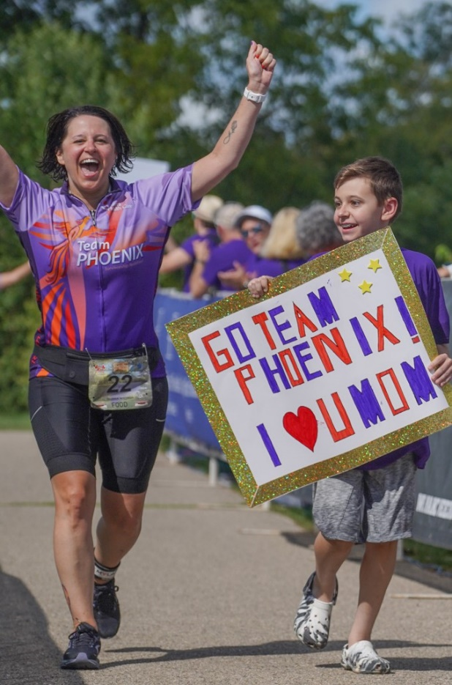
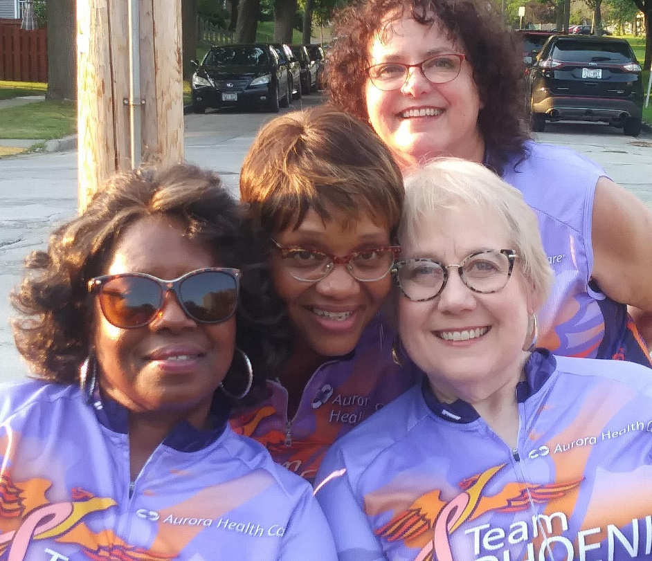
Mission: To help cancer survivors improve their quality of life and longevity by establishing life-long habits of exercise, healthy eating, and camaraderie
Team Phoenix Triathlon Training Program
Survivorship Redefined
Since 2011 Team Phoenix has helped over 375 women gain back their mojo!
Over 70%
of survivors would have liked more support from treatment to survivorship
Notes:
Since 2011 Team Phoenix has helped more than 375 women gain back their confidence and energy with training and healthy life-style education.
We’ve learned that there’s a great need for programs like Team Phoenix because over 70% of cancer survivors would have liked to receive more support in their transition from treatment to survivorship.
Our goal is to offer a program that establishes new habits and healthy lifestyles that will extend on to their families and ripple out into the community. Hopefully increasing the quality of life and longevity for cancer survivors with the ultimate hope of decreasing the incidence of cancer overall.

Slide 4
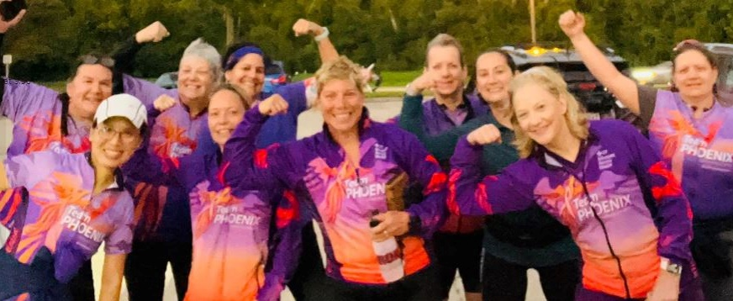
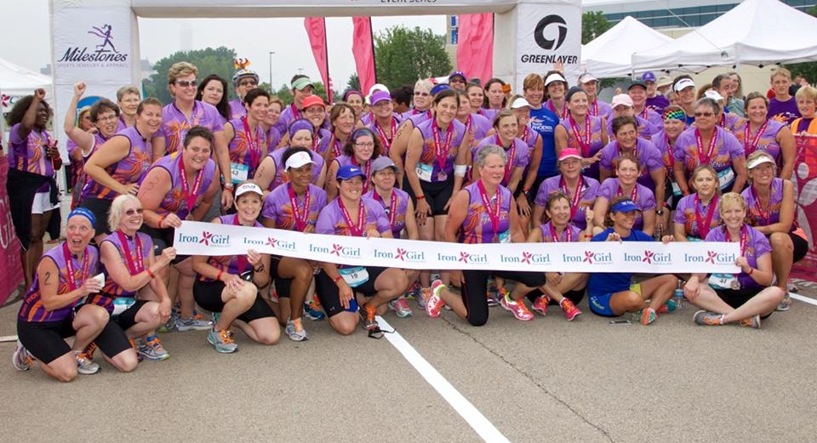
Team Phoenix Triathlon Training
Working Toward a Common Challenging Goal Over an Extended Period Time
Surgery – Chemo – Radiation: Not By Choice
Swim – Bike – Run: By Choice
Common (Challenging) Goal: Safe and successful training and completion of Sprint distance Triathlon. (Swim ¼ mile, bike 15+ miles, run/walk 3.1 miles) Less than 2% of the general population have completed a triathlon!
Extend Time: 14-week training plan from Mid April – End of July (Learn to Swim Mid March – Mid April)
Education: Nutrition, Mindfulness, Yoga sessions
Graduation: Crossing the finish line of the Triathlon. Athletes become “triathletes” and “alumnae” gain access year round support
Notes:
The Team Phoenix triathlon training program is based on the concept of consistent goal-oriented training and education The goal is challenging, a sprint distance triathlon, which helps motivate athletes to attend group training and stay accountable with their training plans. Fun fact – only 2% of the general population have completed a triathlon making the title of “triathlete” a huge accomplishment!
Each summer we have a new “Cohort” of survivor athletes who join the program. Together with coaches, medical volunteers and alumnae from past years, survivors make valuable connections and learn to set up new daily routines, and prioritize time for self care, exercise, eating healthy.

Slide 5
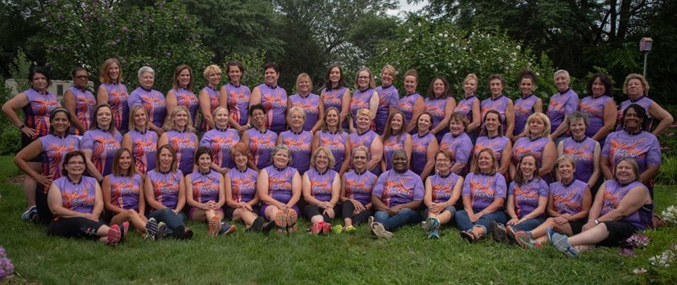
Removing Common Barriers to Exercise
No Judgement Zone
Any type of invasive cancer (DCIS included) of all stages
All ages and fitness levels (see minimal requirements below)
Cancer treatment completion – no limit on when treatment was completed
Treatment from any Cancer Center – not limited to Advocate/Aurora patients
Basic Ability + Desire for Change
Over 50%
“Can Do” Attitude – trust the process
Availability for 14 week group training and triathlon
Commitment to follow the training plan
Medical Clearance – oncologist or PCP
Swim any stroke or style for a length of the pool, including deep water (If an athlete cannot swim we offer access to swimming lessons prior to the season)
Walk 100 yards unassisted
Bike 100 yards unassisted
of Team Phoenix athletes have NEVER been a part of an exercise class or athletic team
Notes:
For over 50% of Team Phoenix survivor athletes this is their very first experience with organized exercise classes or athletic teams. We strive to remove common barriers to exercise by including all ages, abilities, and types of cancer. As long as a survivor is available to commit to the 14 week training session our physical requirements to join are pretty basic, they need to be able to walk and bike 100 yards unassisted and swim the length of the pool (or take our learn to swim classes)

Slide 6
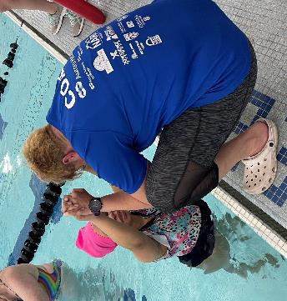
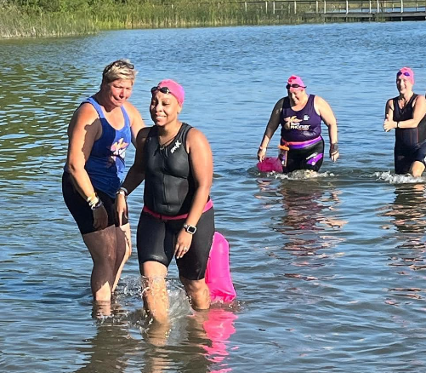
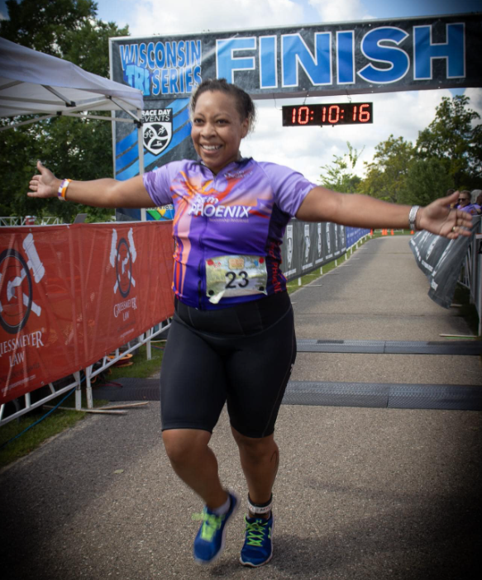
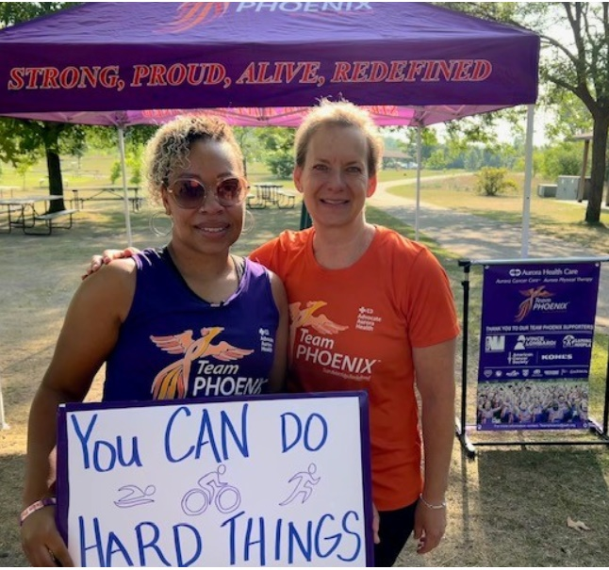
Individualized Training
“Because of Team Phoenix I Will No Longer Allow My Fears to Hold Me Hostage”
Learn To Swim Session
5 Weeks of Group Training – one on one
Overcome Fear of the Water
Swim Angels for Open Water Swims/Triathlon Day
Prescribed Leveled 14 week training plan
3 levels for each of the 4 disciplines
Beginner, Intermediate, Advanced
Swim, Strength, Bike, Run
Group Training twice a week
Individual training three times a week
Encouraged to involve family, co-workers, friends
Individual training three times a week
Fitness Tracker/Online Training Plan
Connects fitness activity to online App
Track heart rate, distance, duration
Benchmarks to assure proper progress
Communication with Coach
Notes:
Since we welcome many survivors with limited athletic experience, one of the barriers many athletes need to overcome is learning to swim. Some even have a complete fear of the water. For those folks we offer a 5 week pre season Learn to Swim session. For those who have basic swimming skills, they join for 14 weeks of training. Each athlete is evaluated and receives leveled online training plans – beginner, intermediate and advanced for each of the 4 activities - strength, swimming, biking, and running or walking. Training together twice a week as a group helps athletes feel medically supported and guided by our coaches. Each week there’s a benchmark to assure that every athlete is on track for a safe and successful triathlon event. We focus on completion rather than competition for the training and triathlon event.

Slide 7
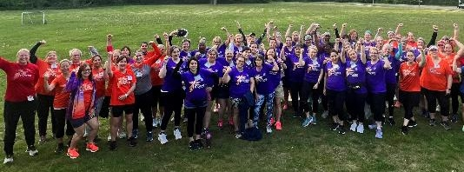
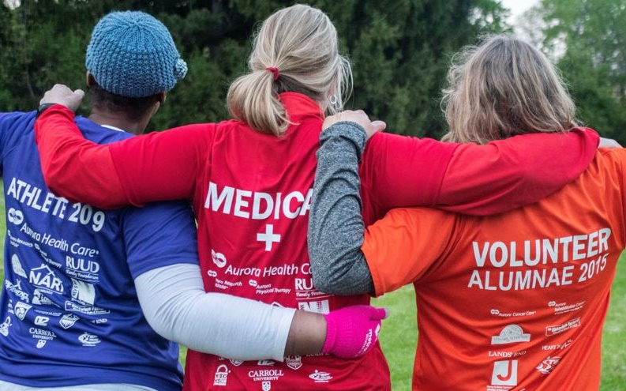
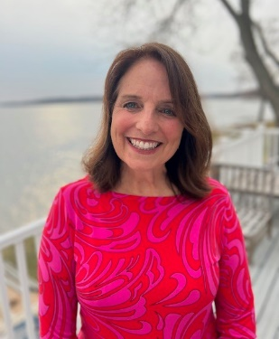
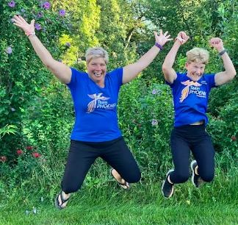
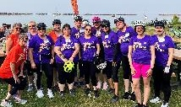
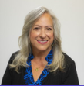
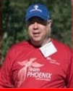
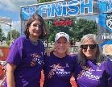
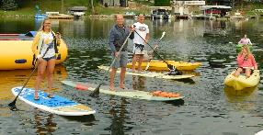
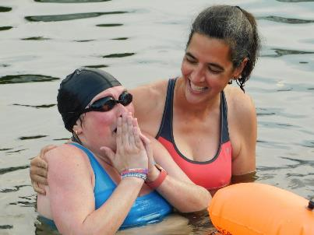
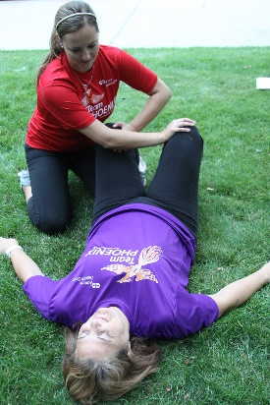
Team Phoenix Comprehensive Infrastructure
“Team Phoenix has helped re-ignite my SPARK to make positive life-long changes through kindness, encouragement, nutrition and friendship.”
Program Director
Coaches
Alumnae/Mentors
AHC Medical Leadership & Clinicians
Community Volunteers
Swim Angels
Medical Volunteers
Family/Friend Supporters!
Community Partners
Notes:
Team Phoenix has a comprehensive infrastructure of people that work as a team to identify cancer survivors who will benefit from the program, coordinate all of the necessary resources, and support our survivor athletes to assure they have a safe and successful training experience.

Slide 8
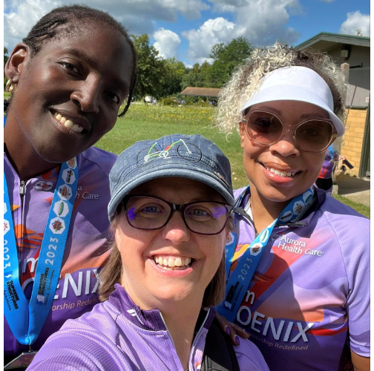
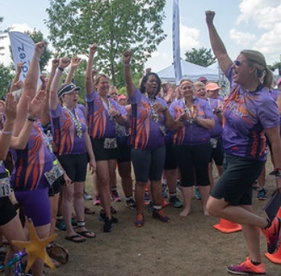
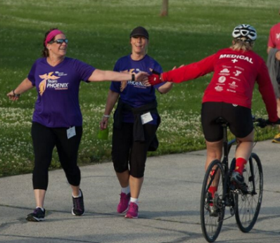
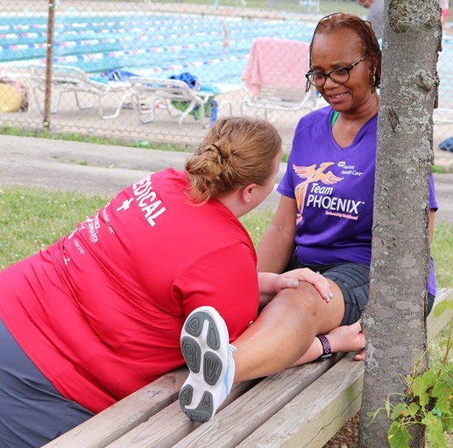
Clinicians, Coaches, Medical & Alumnae Volunteers
“I’m in AWE of all of the alumnae and clinicians who volunteered to support us throughout the season”
Tri Certified Coaches
Physicians/Nurses
Physical Therapists
Athletic Trainers
Alumnae Mentors
Swim Angels
Lifeguard
Bike/Run/Swim Experts
Notes:
This comprehensive team is a key to our success! Research shows patients are more likely to join survivorship programs like Team Phoenix if it’s recommended by their clinician. Patients often see it as a “prescription for health”. Offering medical volunteers at training sessions helps reassure athletes learn to trust their body and builds ongoing connections with providers and specialists. Our certified coaches are trained to work specifically with the side effects that can come from cancer treatment. One of our most unique group of volunteers is our very own Team Phoenix alumnae – they come back to train alongside the new group of athletes offering support, encouragement and inspiration. Some become Swim Angels to swim alongside athletes who aren’t confident to swim alone in open water, and other become Alumnae mentors who act as a confidant to answer questions and gather athletes who live in the same area to train and socialize together.

Slide 9
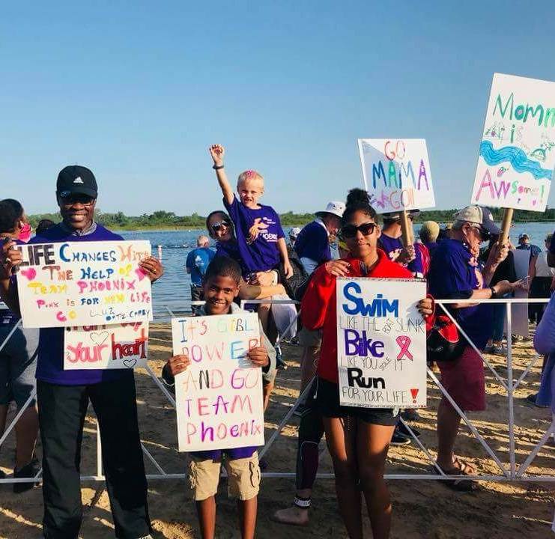
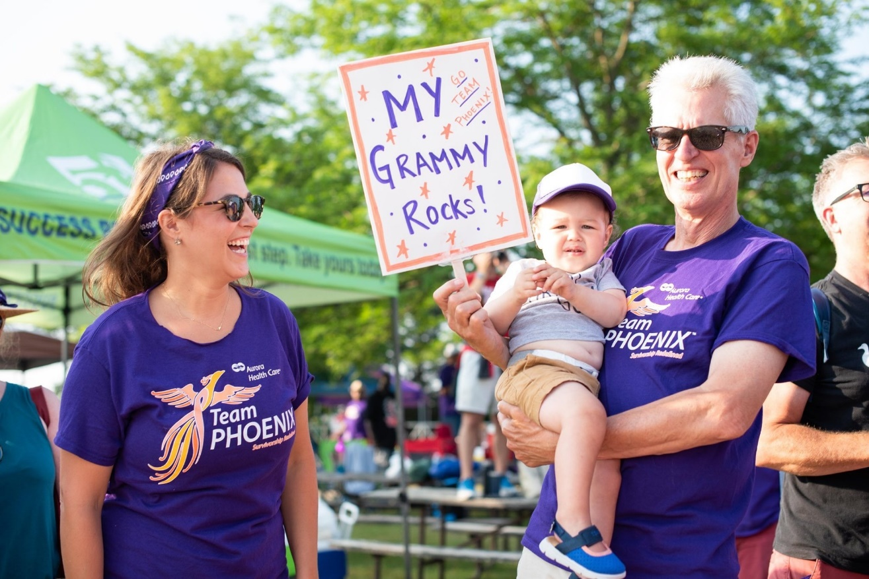
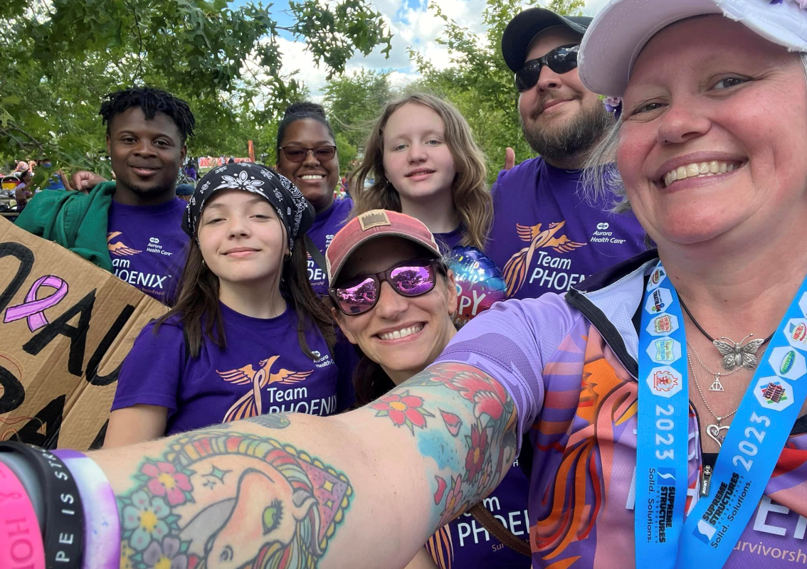
Community, Friends and Family Support
“So many friends, family and even co-workers offered to train with me!”
Notes:
Three-four training sessions a week are completed at home and athletes often involve their family, friends and co-workers. Every year we have hundreds of supporters who attend the triathlon to cheer everyone on carrying signs and wearing their purple Team Phoenix shirts which we fondly call our “Sea of Purple”

Slide 10
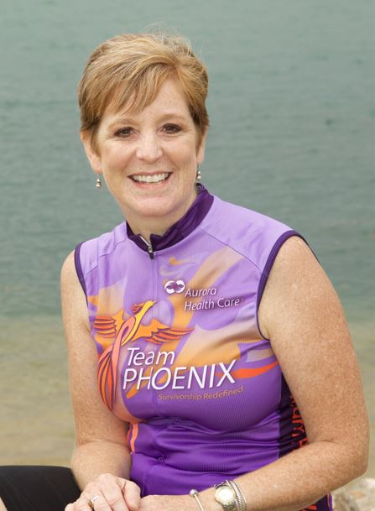
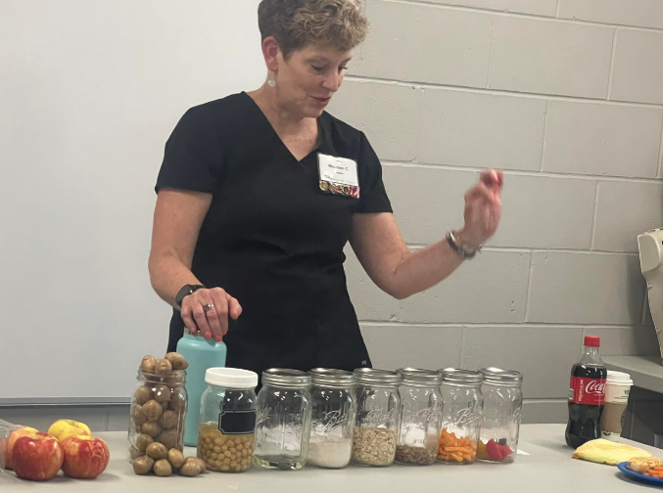
Healthy Eating and Wellness Education
Interactive Sessions With Maureen Cline, Registered Dietician and Team Phoenix Alumnae 2015
TP alumnae: “Saw my PCP today! I’m very happy to report that my A1C is 1/10 of a point above normal range. Last August it was 1/10 of a point from the diabetes diagnosis. So thankful for Team Phoenix and the healthier lifestyle I’ve been working at. Kudos to Maureen for teaching me what I know in the nutrition realm. Making your famous spinach dip for New Years! ☺”
AHC Health News Articles and Guest Speakers
Notes:
Throughout the training season we incorporate Healthy eating, self care and wellness education. From in person sessions with our registered dietician (who’s also Team Phoenix alumnae from 2015) to the weekly newsletter and on demand guest lecture videos, our survivor athletes learn a lot about how to make healthy changes in their lifestyle habits.

Slide 11
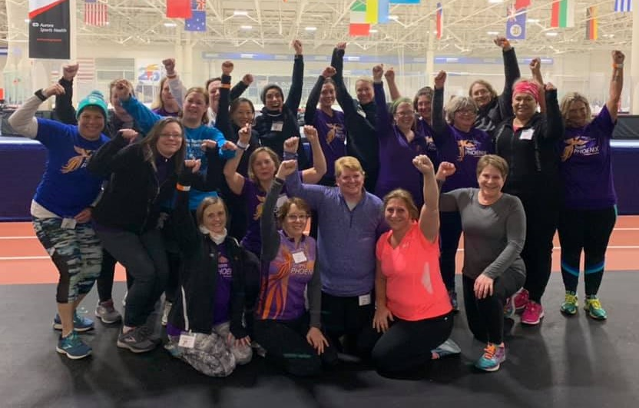
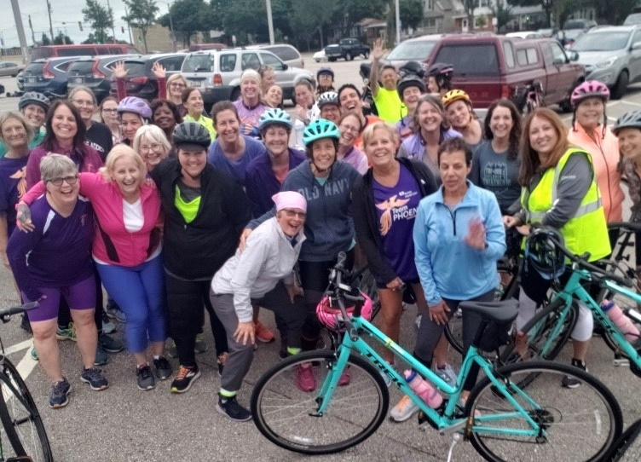
Team Phoenix Year-Round Programs
I found incredible strength, determination and resources to keep myself healthy and give cancer a kick in the behind!
“Team Phoenix literally changed my life. Not only did I complete a triathlon sprint, which I never thought I could do, I made lifetime friends with my TP sisters and found incredible strength, determination and resources to keep myself healthy and give cancer a kick in the behind!”
Notes:
We know from survey data that even years after alumnae complete the 14 week triathlon training program and cross the finish line of the triathlon, they are staying committed to daily physical activity and eating healthy.
In 2018 we expanded to a year round program to help support alumnae who wanted to continue the camaraderie of training TOGETHER – and it’s been a huge hit. This Fall we have over 75 alumnae training as part of our “ALL IN” online and in person walk/run program at the Pettit Ice Center Indoor track.

Slide 12
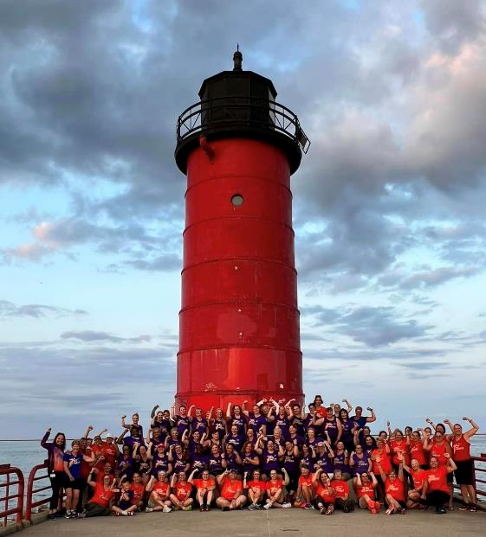
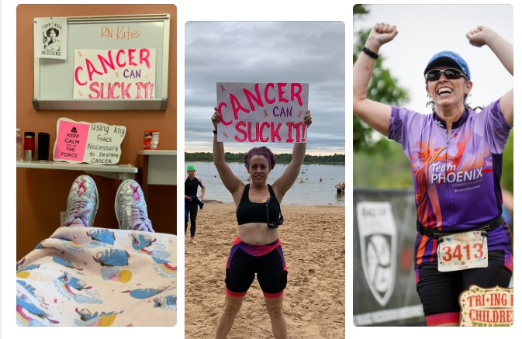
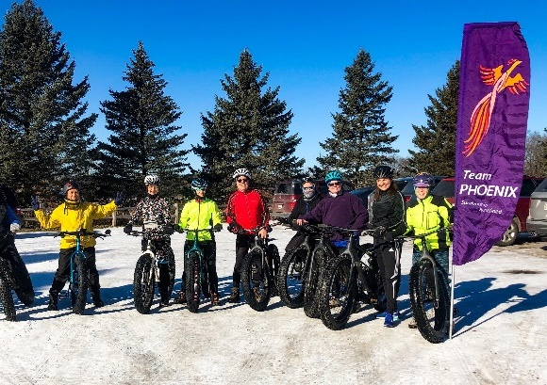
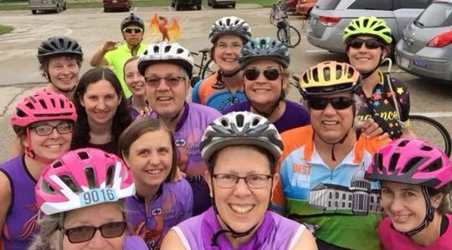
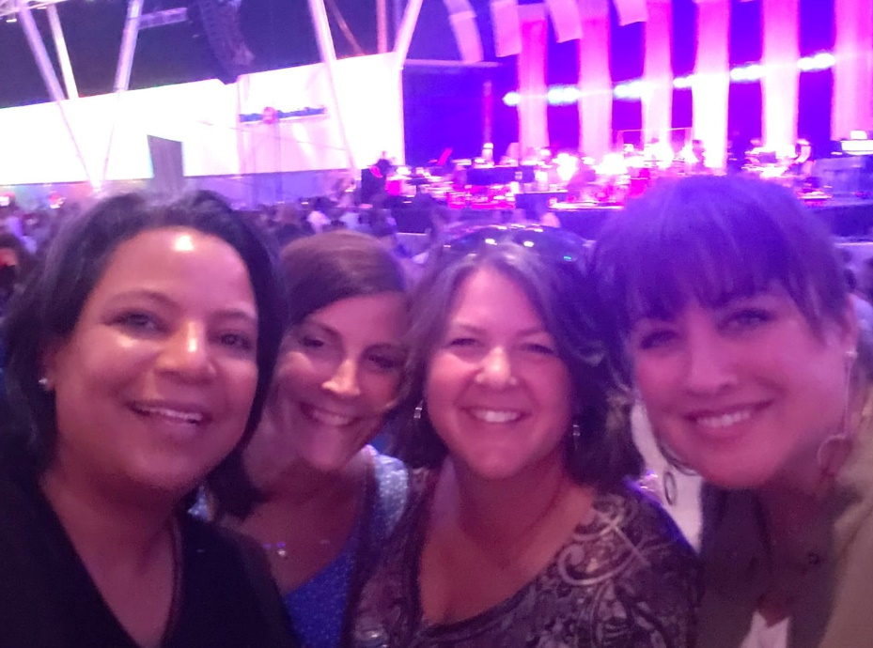
Team Phoenix Private Facebook Group
Because of Team Phoenix, the Impossible Became Possible
Notes:
Team Phoenix also offers a private facebook page for alumnae who want to share health/wellness concerns, successes, and reach out to coordinate gatherings. There are usually multiple opportunities every week for alumnae to get together to complete walks, runs, hikes and a variety of other activities from kayaking to camping.

Slide 13
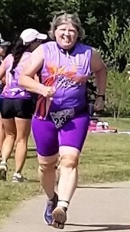
A Testament to Life Changing Behaviors
I needed to meet with my financial planner again because I realized I’m going to live longer than I thought!
“I saw my Primary Care Physician for the first time since Team Phoenix. Had seen her just prior to beginning training.
She said it made her week to see all the TP has done in my life!
Blood pressure down, no more nerve pain….we were both almost giddy with excitement!
I needed to meet with my financial planner again because I realized I’m going to live longer than I thought!”
Notes:
While Team Phoenix isn’t a weight loss program, we’re pleased when we get updates like this from an 2018 alumnae who said she had such a great medical update from her PCP that she needed to talk with her financial planner because she realized that with her lifestyle healthier now, she’s going to live longer than she had thought.

Slide 14
Notes:
We’re always exploring new ways to enhance what Team Phoenix has to offer cancer survivors – and one of our newest offerings is our HEAL Survivorships sessions that we’ve been able to create thanks to the generous funding from the ACS/Kohls HEAL Grant. We’re excited to be offering ALL female cancer survivors opportunities for joining our alumnae for indoor walking/strength training followed by interactive healthy cooking/eating sessions. Our alumnae are thrilled to get to invite other survivors they know, and our clinicians are already referring people to sign up!

Slide 15
Team Phoenix Training Program
100%
Of Team Phoenix athletes would recommend the program to other survivors
DESIGNED SPECIFICALLY FOR FEMALE CANCER SURVIVORS of any type of invasive cancer (DCIS included), created for all stages, ages and ALL fitness levels.
FOCUSED ON RE-CONDITIONINING: No experience needed. Basic walking, biking and swimming ability (Learn to Swim available) Re-building trust, confidence and strength
MEDICALLY OVERSEEN Participants provide a medical clearance, professionally coached, prescribed training plans with individualized support from medical professionals focusing on the individual needs and abilities
CONSISTENT Athletes train for 14 weeks to prepare for a sprint distance triathlon (1/4 mile swim, 15 mile bike, 3.1 mile run/walk) Training begins in mid-April and goes through the end of July. Group training is twice a week, with prescribed training plans for training at home the other 3 days. Pre-season Learn to Swim and Post-season training year-round for alumnae are also offered
MODIFIED There are 3 levels (beginner, intermediate, advanced) of training plans for each of the 4 disciplines (swim, bike, run/walk, strength). Plans are selected for each individual based on their ability, strength, stamina and medical conditions.
COMMUNITY SUPPORTED Subsidized by donor and community support, medical and community volunteers, and alumnae. “Alumnae Mentor Groups” help athletes bond with those who live in close proximity
POPULAR! There is a max capacity of 50 athletes per season and spots fill up quickly! Registration is open for next summer’s training! Word of Mouth recommendations from Clinicians and Alumnae.
A GREAT VALUE The cost of the program is subsidized by the generosity of Aurora Foundation donors and program grants which reduces the participation fee for athletes. Fee includes coaching, training plans, a training shirt, competition jersey, facility fees, race registration, and other training support provided by community partners.
Notes:
In summary, Team Phoenix is focused helping female cancer survivors take back control of their life after going through cancer treatment. We work hard to remove the barriers to joining an exercise program by offering a very comprehensive safe, successful and ongoing training experience in a highly supported “No judgement zone” environment. We’re proud that 100% of our alumnae report that Team Phoenix has had a positive impact on their life and a majority continue to stay active and connected with the Team Phoenix community.

Slide 16
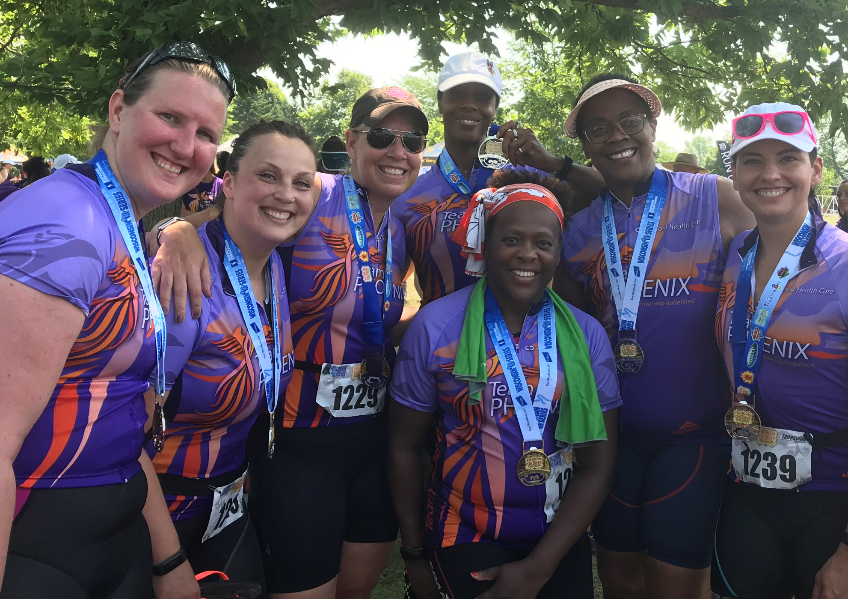
Team Phoenix Cancer Survivor Training Program
Sports Illustrated
Triathlete Magazine
USA Triathlon Magazine
Silent Sports Magazine
Notes:
If you’d like to read more about Team Phoenix, we’re excited to have been featured in a variety of sports magazines, from Sports Illustrated to Triathlete Magazine

Slide 17
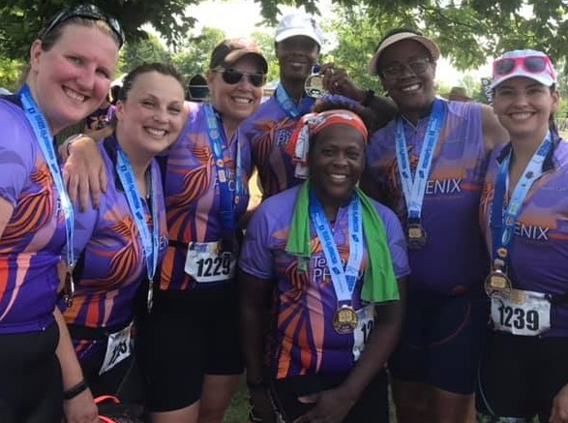
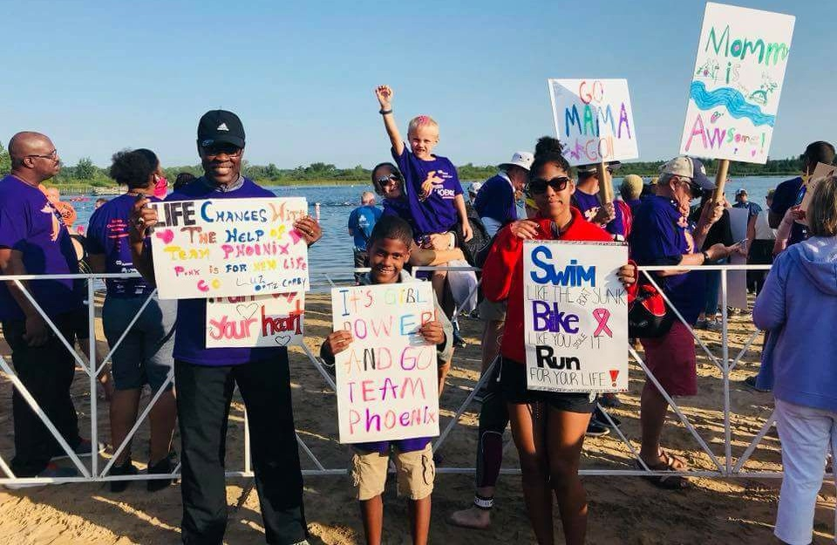
Contact Team Phoenix
If you know female cancer survivors that would benefit from being a part of a survivorship program or if you’d like to get involved
Email: teamphoenix@aah.org or ilka.hoffins@aah.org
Notes:
If you or someone you know is interested in getting involved with Team Phoenix, please contact me.

Slide 18
https://youtu.be/AvvCLfFGb9E
Team Phoenix Video
Cancer Survivorship Program offered by Aurora Health Care
For women whose physical, social and emotional wellness has been affected by cancer treatment
14 week triathlon training program April – July culminating in Sprint distance triathlon
Survivor athletes become "alumnae" - year round training, education, and camaraderie
Ultimate goal of improving quilaty the quality of life and longevity of cancer survivors
Notes:
Optional video overview of the Team Phoenix triathlon training program and includes some wonderful testimonials from our alumnae.

