Slide 1
Radon Testing and Mitigation Project
Stockbridge Munsee
Notes:
Begin Stockbridge Munsee presentation

Slide 2
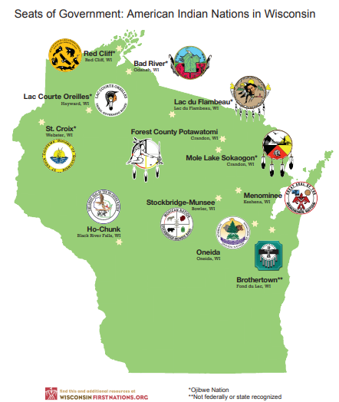
Wisconsin is home to 11 Federally-
Recognized Tribes
Notes:
The US EPA radon grant program has supported several radon projects for our tribal nations.

Slide 3
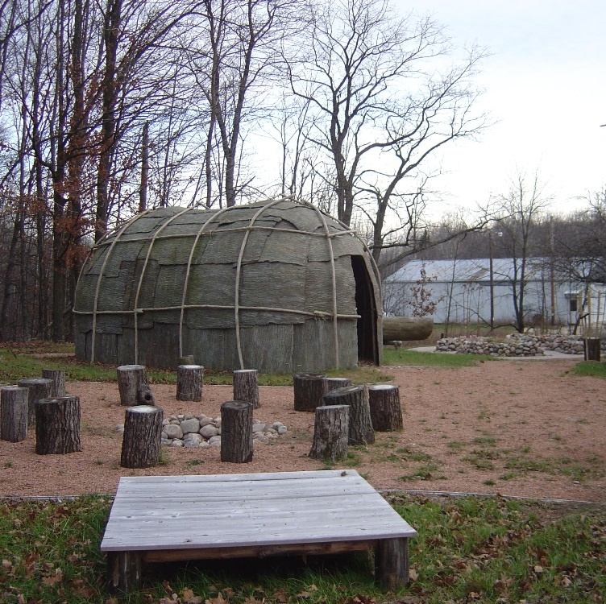
Stockbridge Munsee
1,814 enrolled Tribal members
31% live on reservation of approx. 25,000 acres
766 Employees - largest employer in Shawano County
2 Official languages - Mohican and Munsee
Photo: www.mohican.com/brief-history/ridge-Munsee Band of Mohicans
Notes:
Background information on tribe history
The Stockbridge Munsee are originally from the Eastern United States and have made several moves- being forced to re-settle many times.
After Europeans arrived, disease and warfare killed many Mohican people, and many of the survivors left New England.
They eventually settled in Wisconsin, where the Stockbridge Mohicans still live today.
There are also small Mohican communities remaining in New York and Massachusetts.
The Mohican reservation is shared with the Munsee tribe. Together they are known as the Stockbridge-Munsee. (They have this name because the Mohicans are also known as Stockbridge Indians, after a town in Massachusetts they once settled in.)
Their people were known for settling near river ways where they would build wigwams – circular structures made of bent saplings and bark. The roofs were covered in bark and holes cut to allow for smoke to escape. They also lived in long houses, sometimes up to 100 feet, with separate rooms for each family. Image of a wigwam.
S-M are a major employer in Shawno County. Over 1,800 members of which 26% live on the reservation.

Slide 4
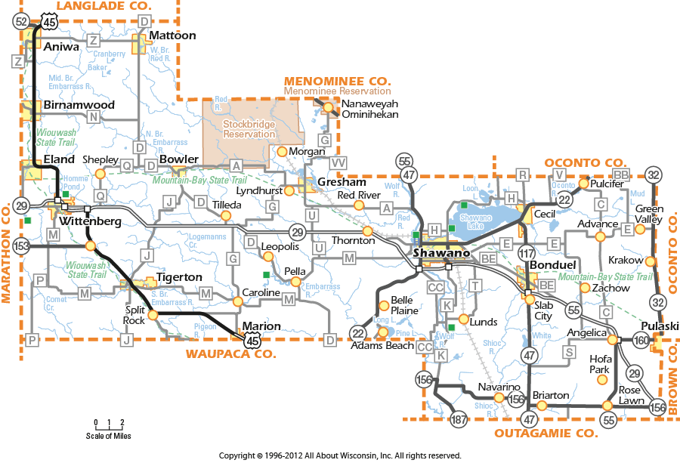

Slide 5
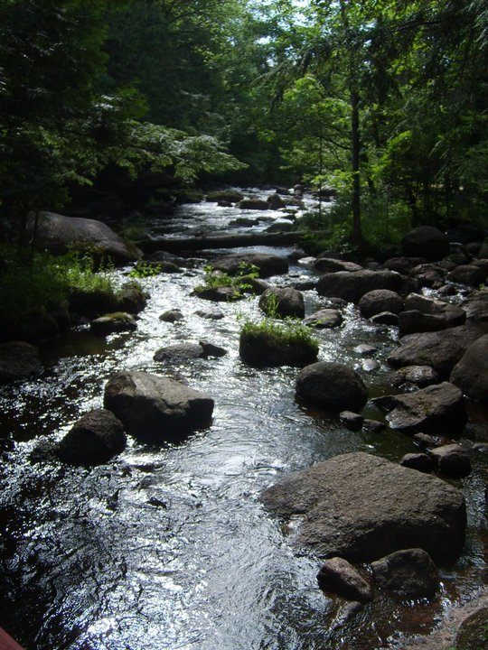
HOME

Slide 6
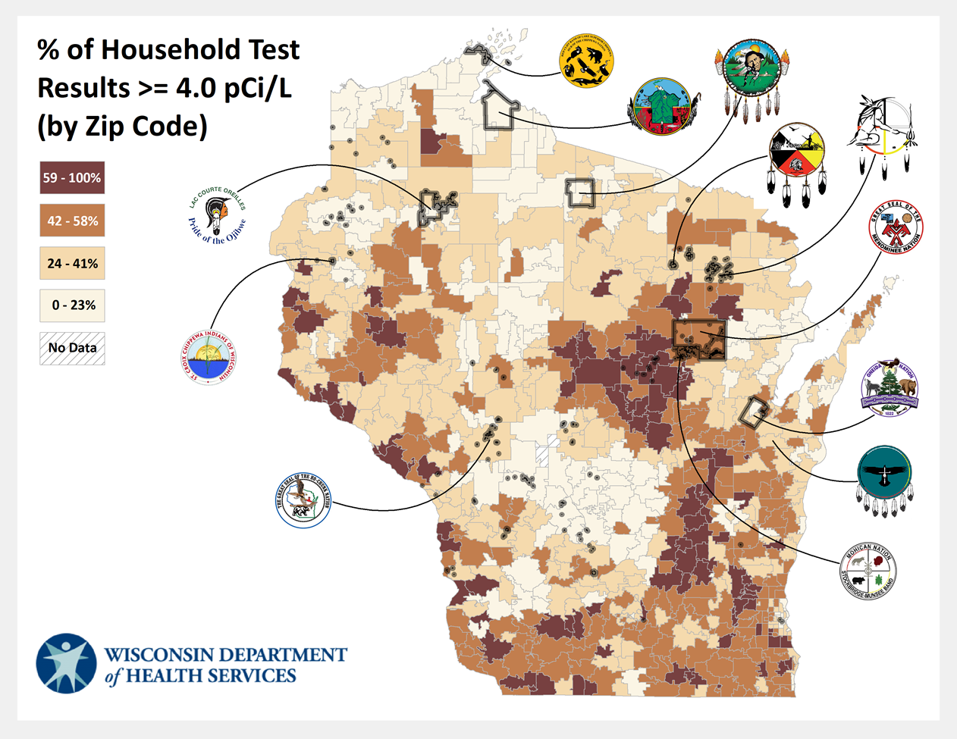
Notes:
For perspective, the radon risk map is overlayed with the symbols of the various WI tribes.
Several of the native lands are in high risk areas.
The Stockbridge Munsee are a Mohican band of American Indians. Their reservation area is circled in red here. You can see most of their lands are showing elevated radon results.

Slide 7
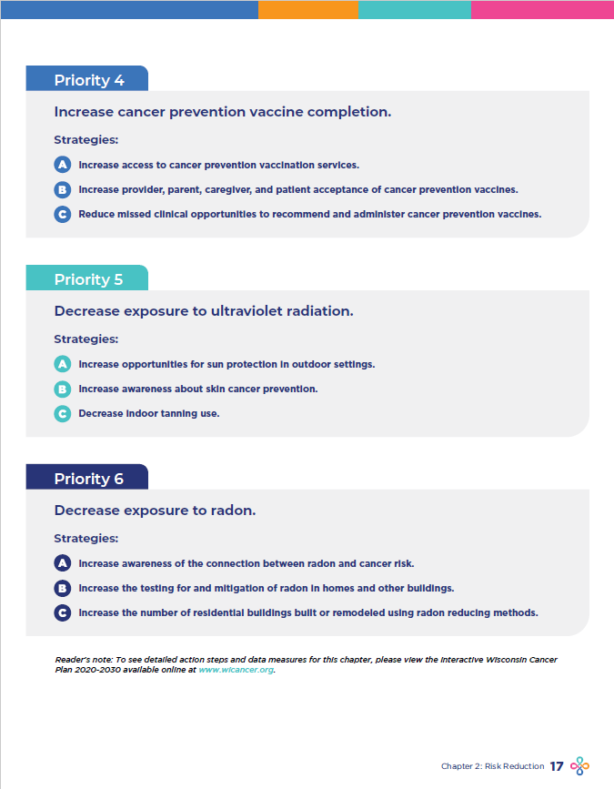
Wisconsin Cancer Plan | Wisconsin Cancer Collaborative (wicancer.org)
Notes:
Wisconsin DHS has partnered with the WI Cancer Collaborative to include radon as a priority.
Funding for mitigation systems is a consistent barrier.
As a result of the collaboration with WCC, we are engaging in supporting the Stockbridge Munsee Band in testing their entire reservation and securing funding to install mitigation systems.
The WCC was able to secure private funding to support hiring a contractor to install mitigation systems for this project.
This effort is taking on momentum as other tribal networks are learning how to engage their members based on some of the successes we’ve had working on project together.

Slide 8
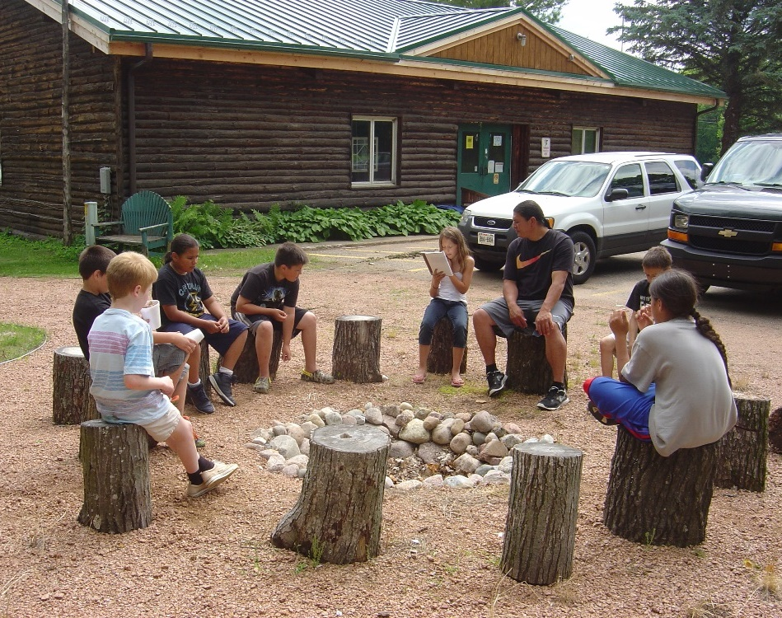
Radon Project Goals
Build awareness
Test all homes on reservation
Install mitigation systems where there is a need
Photo: www.mohican.com/brief-history/ridge-Munsee Band of Mohicans
Notes:
Goals
- build awareness and educate community members on radon
- test the entire reservation
- install mitigation systems where there is a need
Trained a member on testing and mitigation basics.
Obtained a grant from US EPA to perform testing on the reservation and improve awareness.
Met with physicians and WI Cancer Collaborative to discuss radon testing and community outreach in November.
Continue to work with S-M community to talk with community about radon and how to fix it.

Slide 9
Project Overview
Approximately 300 private homes on the reservation
115 # of test kits used to date (84 returned)
Radon results (% >4pCi/L) 64%
25 mitigations completed with outside funding (approx. $30,000)
13 mitigations completed with tribal funding assistance
Notes:
Waiting on data from S-M
Word is spreading on the importance of testing for radon.
Fliers and word of mouth.
Tests
Above 4
Mitigation # to date
Will send name, email, and background of person from Stockbridge Munsee who may present to Adela and others at CDC asap.

Slide 10
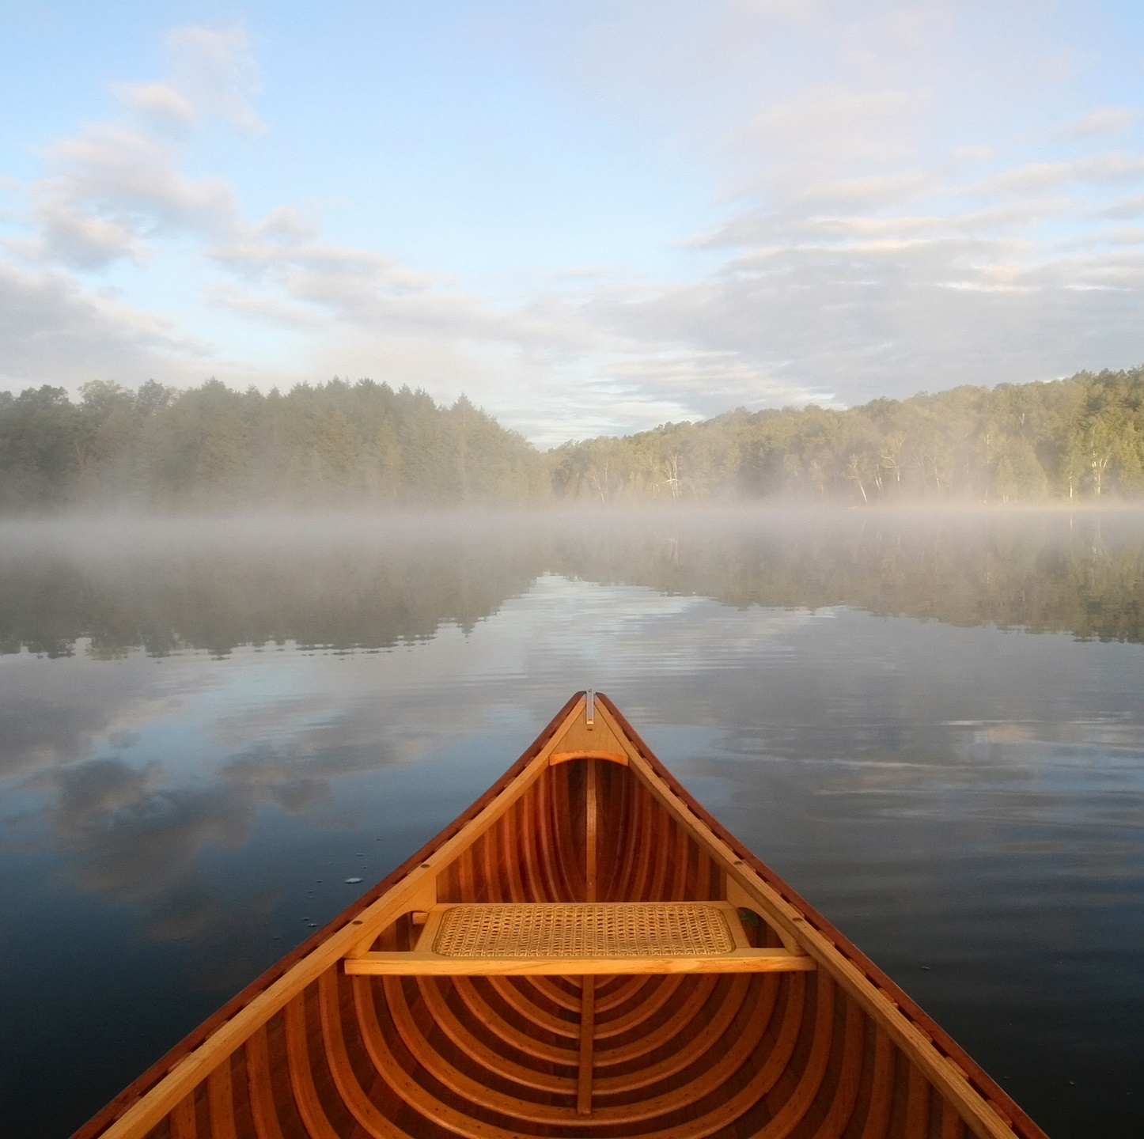
Thank you!
Anushiik (Munsee)
Oneewe ( Mohican)
Special thanks to –
Jessica Maloney
WI Dept Health Services
Noelle LoConte, MD
Carbone Cancer Center
Beth Brunner
Mary Cianciara
Wisconsin Cancer Collaborative
Notes:
Add Toni and/or Judy’s name if co-presenting

