Slide 1
NFL Links to Care Community Grants
November 2, 2023
Notes:
Kim

Slide 2


N.E.W. Community Clinic and Bellin Health

Slide 3

“Achieving the aim of high-quality care that includes appropriate screening, timely follow-up, multimodality treatment, supportive care, and survivorship care requires well-coordinated approaches to care delivery.
Screening is a process, not a singular event, that requires coordination, communication, and cooperation across multiple clinicians, patients, caregivers, and payers.
Breakdowns in this process can inhibit or delay follow-up, may result in duplicative or unnecessary testing, and create needless distress for patients and their loved ones.
Lack of follow-up can also perpetuate disparities in receipt of timely, high-quality care, as well as disparities in cancer-related mortality among minority and underserved populations.”
Sallie J Weaver, Paul B Jacobsen, Cancer care coordination: opportunities for healthcare delivery research, Translational Behavioral Medicine, Volume 8, Issue 3, June 2018, Pages 503–508 https://doi.org/10.1093/tbm/ibx079

Slide 4
NFL Links to Care Community Grants Project

Slide 5

NFL Links to Care
Community
Grants
NFL Links to Care
Objectives
The NFL Links to Care Community Grants Project aims to improve outcomes for people at risk for breast cancer who are served by community health centers.
Patients of community health centers rely on hospitals to provide mammograms, diagnostic procedures, and/or cancer treatment. This project will create connections between the community health centers and NFL affiliated hospitals to ensure that patients complete their needed screenings, follow-up care, and treatment in a timely manner.
Success will be dependent upon a strong partnership between both organizations to assess the current relationship between the two systems and develop an action plan using evidence-based practices to improve referral/follow up processes and existing challenges.

Slide 6
NFL Links to Care Community Grants Project
Partners and Objectives

Slide 7




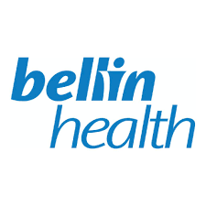



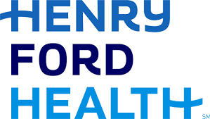





Slide 8
NFL Links to Care
Community
Grants
Project
Objectives
Building connections between community health centers and hospitals to ensure that patients complete their needed screenings, follow-up care, and treatment in a timely manner.
NFL Links to Care
Objectives
Increase
breast cancer screening rates and timely follow-up care
Secure
leadership support from community health center and NFL affiliated hospital
Strengthen
medical neighborhood collaborations
Implement
QI tools to strengthen processes and ensure eligible patients receive breast cancer referrals and are navigated through screening completion and follow-up when needed
Use
data to inform all aspects of the project
Execute
sustainable and meaningful process improvements

Slide 9
NFL Links to Care
Community
Grants
Partner
Roles
NFL Links to Care
Objectives
ACS Staff Partner
Convener/Coach, Project management, QI Support
Improve screening completion process, time to follow up care, and communication of results and treatment plans to referring provider(s).
Hospital
Community Health Center
Improve overall screening rates, referral processes, and communication with hospital partner.
Interventions Team
Data Tracking/Reporting , TA to ACS staff leads, convene best practice calls with FQHCs & hospitals, NFL and ACS leadership liaison
Notes:
Two year project with 6 locations across the country – Green Bay being one of those; Both the FQ and the health system receive grant support for the project.

Slide 10
Why Links to Care?

Slide 11
NFL Links to Care
Community
Grants
Why Links to Care?
NFL Links to Care
Objectives
Mammography
Early detection through mammography screening can reduce mortality from breast cancer. (1)
A similar pattern of excess late-stage disease is observed in some groups of Hispanic, Native-American, Asian, and low-income women, particularly those who are immigrants or less acculturated, presumably due to less access to screening. (2)
The Problem
Successful breast cancer screening relies on timely follow-up of abnormal mammograms. Delayed or failure to follow-up abnormal mammograms undermines the potential benefits of screening and is associated with poorer outcomes. (3)
The Problem
Fear was the most prominent and prohibitive barrier to screening mammography. However, transportation and no paid time off were the most significant barriers to timely breast cancer screening. (4)
Major Barriers
This Project
How can this partnership improve timely breast cancer screening, diagnostic testing, and treatment for low-income people?
Notes:
https://www.ncbi.nlm.nih.gov/pmc/articles/PMC3117308/
https://www.ncbi.nlm.nih.gov/pmc/articles/PMC1492136/
https://bmccancer.biomedcentral.com/articles/10.1186/s12885-021-08100-3
https://bmcwomenshealth.biomedcentral.com/articles/10.1186/s12905-022-01793-z

Slide 12
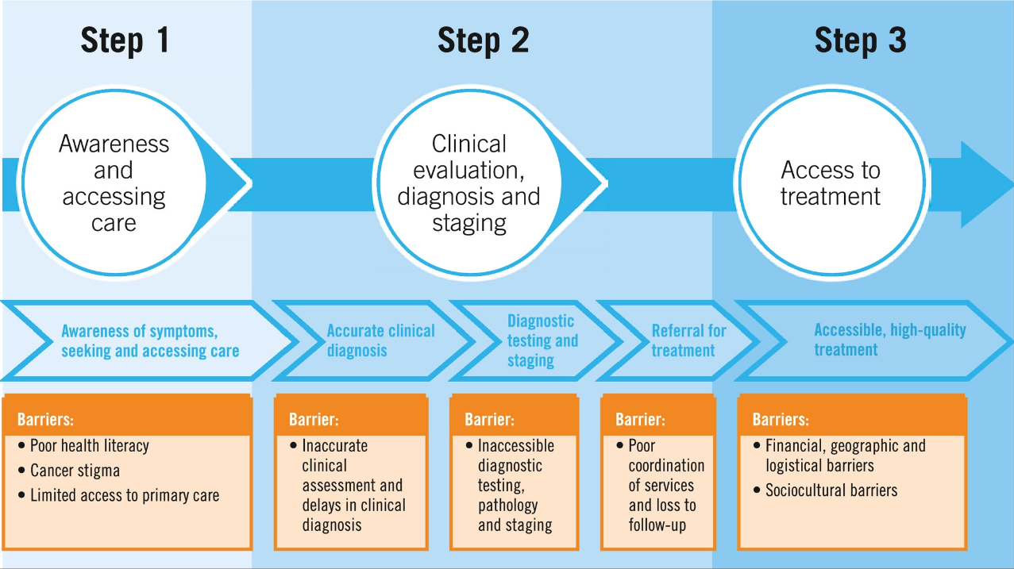
NFL Links to Care
Community
Grants
Why Links to Care?
If a screening program, however well intentioned, is introduced into a health care system that is not equipped to refer, diagnose, and treat the abnormalities it detects, then the program will not succeed and may be counterproductive.
NFL Links to Care
Objectives
Breast cancer early detection: A phased approach to implementation. Cancer, 126: 2379-2393. https://doi.org/10.1002/cncr.32887
Notes:
https://www.ncbi.nlm.nih.gov/pmc/articles/PMC3117308/
https://www.ncbi.nlm.nih.gov/pmc/articles/PMC1492136/
https://bmccancer.biomedcentral.com/articles/10.1186/s12885-021-08100-3
https://bmcwomenshealth.biomedcentral.com/articles/10.1186/s12905-022-01793-z

Slide 13
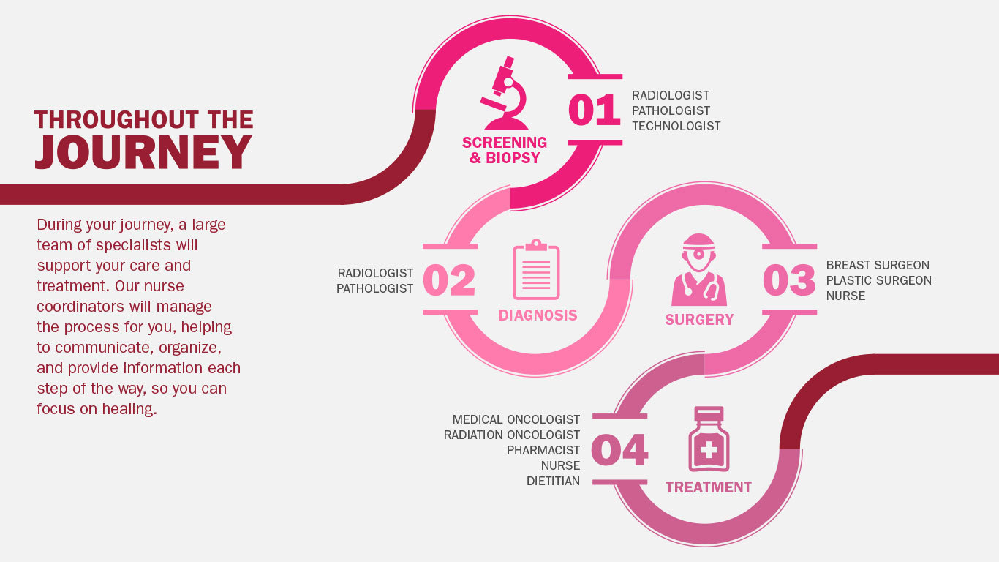

Slide 14
NFL Links to Care Community Grants Project
Progress to Date

Slide 15
NFL Links to Care
Community
Grants
Progress to
Date
NFL Links to Care
Objectives
Kick Off – April 21, 2023
Action Planning Meetings
Developed Aim statement
Baseline Data via REDCap
Monthly Team meetings
Process mapping

Slide 16
Core Team Members
NFL Links to Care
Community
Grants
NFL Links to Care
Objectives
Core Team Member | N.E.W. Community Clinic | Bellin Health
Health System Leadership | Kim Franzen | Jen Macdonald and Sarah Jensen
Clinical Champion (MD, DO, PA, NP, RN, MA) | Penny LePine | Amy Bradley and Jill Spejcher
Quality Improvement Lead | Penny LePine | Lori Notz
Information Technology | Penny LePine | Lori Notz
Populations Health Manager | Kim Franzen and Penny LePine | Maggie Koch
Care Coordinator/Navigator | Penny LePine and case management team | Maggie Koch and case management team
Marketing/Community Outreach | Kim Franzen | Holly Schroeder
Grant Administration | Kim Franzen | Jeannette Brittain Ashley Jones
American Cancer Society Staff Partner | Kim Kinner | Kim Kinner
Meeting Schedule:
Monthly- 3rd Tuesday of every month @ 10am for 1 hour

Slide 17
NFL Links to Care
Community
Grants
AIM Statement
NFL Links to Care
Objectives
AIM Statement | We aim to increase access to breast cancer screening and reduce delays in follow up care in women aged 40 and older by increasing breast cancer screening rates from 44% to 64% and developing a process to ensure timely follow-up and treatment through multicomponent interventions in partnership with Bellin Health by December 31, 2024. It is important for us to work on this now because breast cancer is the most common diagnosed cancer in WI and it's about preventative care to keep the community well and increase access to care while ensuring quality outcomes with evidenced based practices.

Slide 18

Thank You

