Slide 2
Neighborhood Health Partnerships (NHP) Program
Program Overview
Wisconsin Cancer Summit
November 2, 2023

Slide 3
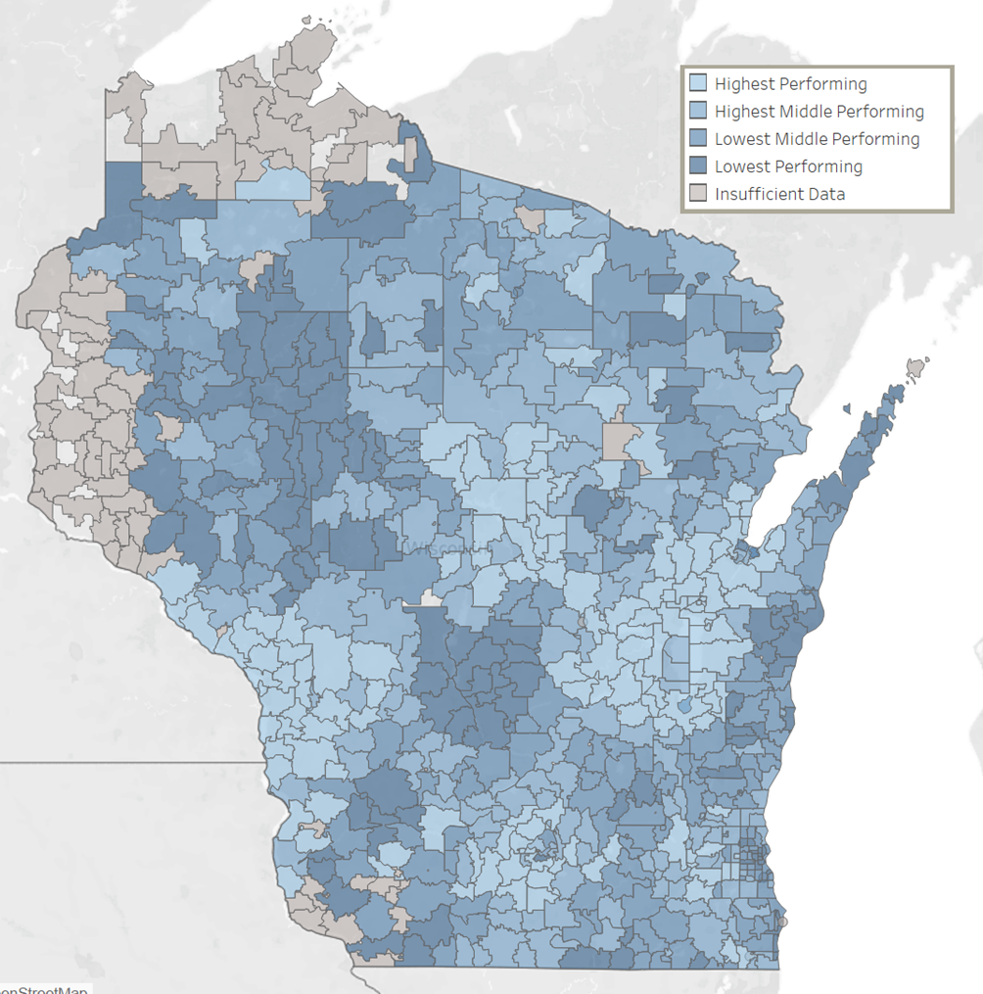
The Challenge and Opportunity
The Challenge
Health is shaped by local conditions but...
most health data are only available at county level or higher and/or updated infrequently
making it challenging to identify priority areas and monitor the effectiveness of programs and interventions
The Opportunity
Partnership with WCHQ for EHR data at the ZIP code level for >5 million patients

Slide 4
The Opportunity
Electronic health record data from over 75% of primary care providers in Wisconsin
27 primary care measures identically coded across health systems
Vaccinations/Wellness | Childhood vaccinations Adolescent vaccinations HPV vaccination Pneumonia vaccination Well Child Visit in first 15 months of life
Screenings | Breast cancer screening Cervical cancer screening Chlamydia screening in women Colorectal cancer screening Depression screening
Risk Factors for Chronic Disease | Recommended Body Mass Index Blood Pressure Control
Heart Disease Care | Blood Pressure Control Daily Aspirin Statin Use Tobacco-Free Optimal Control
Diabetes Care | Blood Pressure Control Blood Sugar Control Blood Sugar Testing Daily Aspirin eGFR Test | Kidney Function Monitored Optimal Control Optimal Testing Tobacco-Free Statin Use

Slide 5
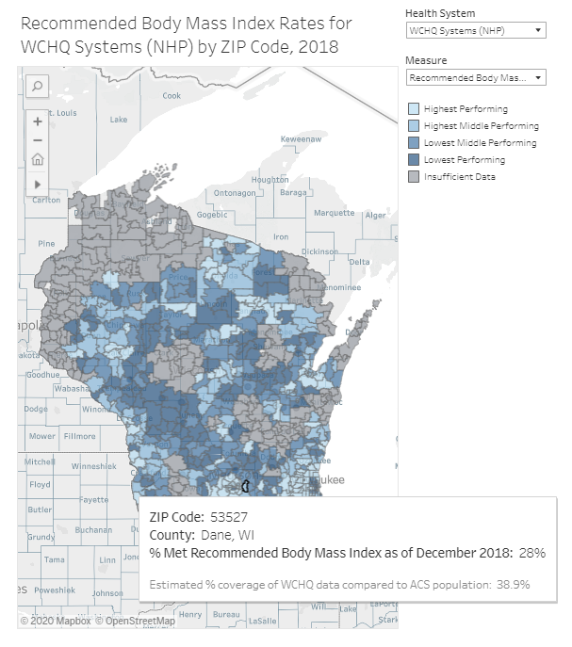
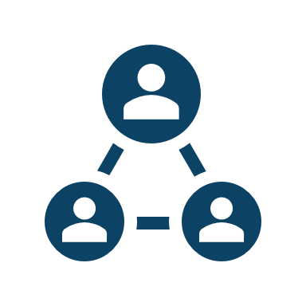
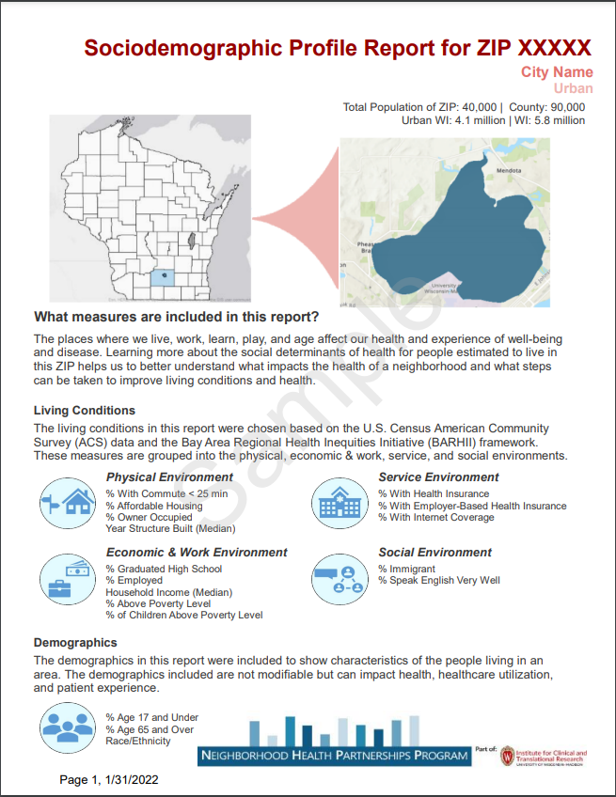
NHP Resources
Maps
Reports
Tools
2 Categories
Social Determinants of Health Reports using Census data
Action tools
Health Outcome and Care Reports using WCHQ data
Partnerships tool
Policy tool
Placing SDOH in context tool
Maps to help in selecting measures/ZIPs of interest

Slide 6
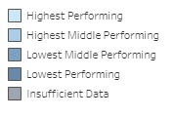
Colorectal Cancer Screening Rates (2022)

Slide 7
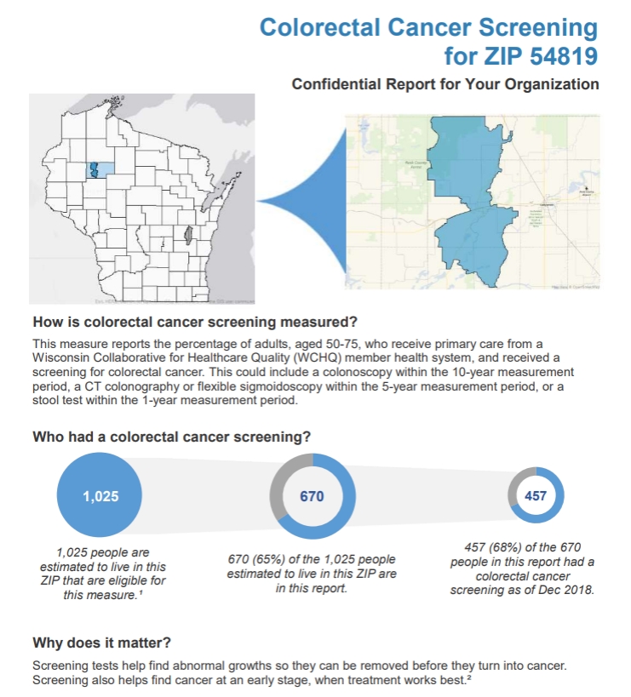
Sample Report: Page 1

Slide 8
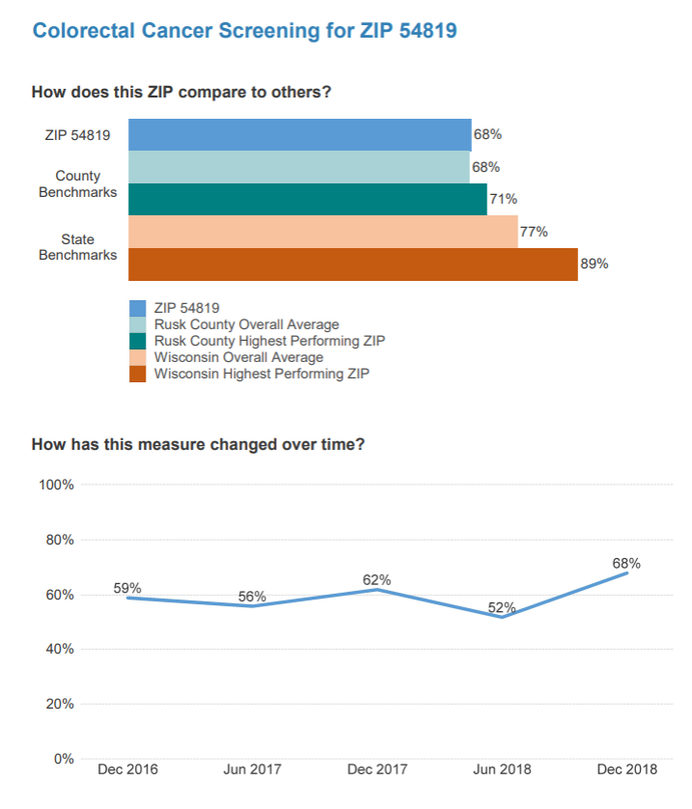
Sample Report: Page 2

Slide 9
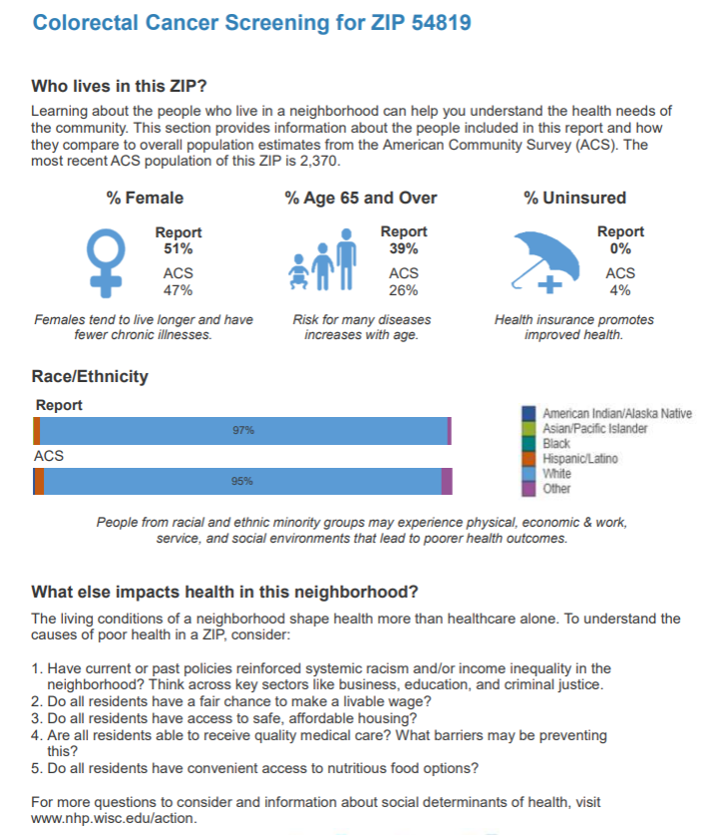
Sample Report: Page 3

Slide 10
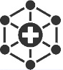
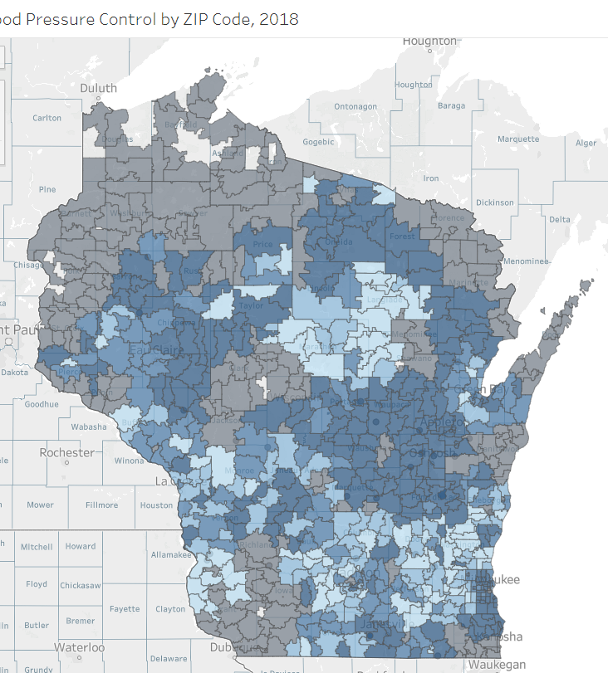
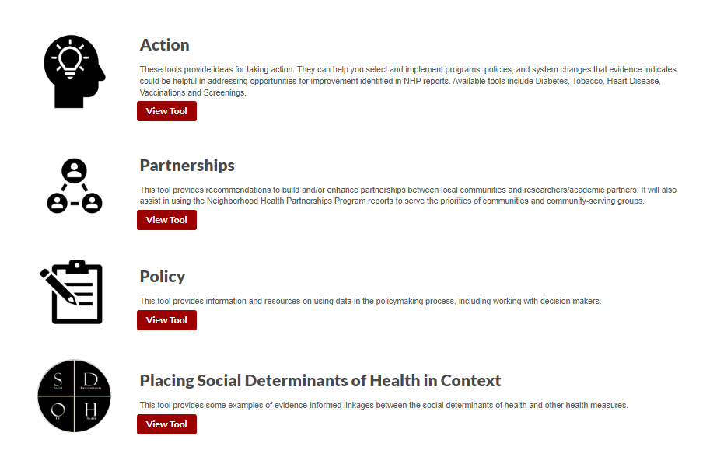
NHP request process, stakeholders, and uses
Uses
Data: Submit request form on NHP website
Health Systems
& Clinics
Identify & target disparities
Direct services/ resources
example
Community Organizations
Strengthen grant applications
Researchers
Establish new partnerships
NHP
Navigators
Action tools: Available on NHP website
Develop new programs
State and Local Government
Organizations
Monitor & evaluate
Community Pharmacies
Prioritize focus areas
Tools
Notes:
The NHP website is the destination for requesting data reports and viewing actions tools
Our current model allows for anyone to request our free reports by filling out a short Qualtrics form available on our website.
Once your report is ready (within 48 hours typically) an NHP navigator will email you with the report and additional information to support you in using the report. The Navigator is also available to you to answer any questions you may have.
We have Navigators who work with a variety of stakeholders that you see listed here and these stakeholders utilize the reports for a variety of uses including:
Strengthening grant applications
directing services and resources
developing new programs or interventions
monitoring and evaluating
prioritizing
And others

Slide 11
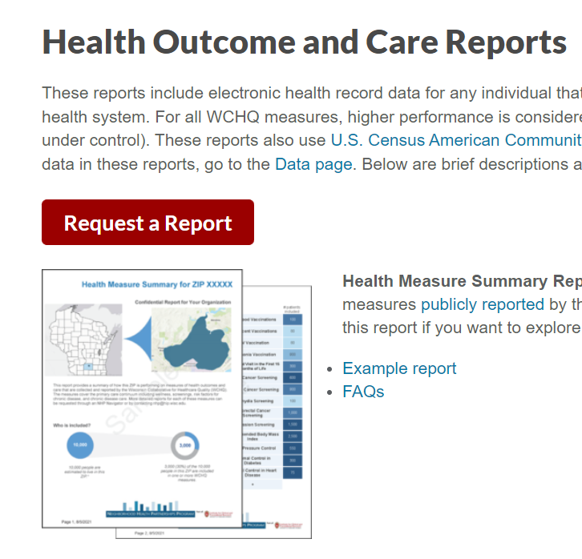
Requesting NHP Reports
Visit www.nhp.wisc.edu/reports
View example reports
Click "Request a Report"
Fill out brief Qualtrics form
Reports typically delivered within 2-3 business days

Slide 12
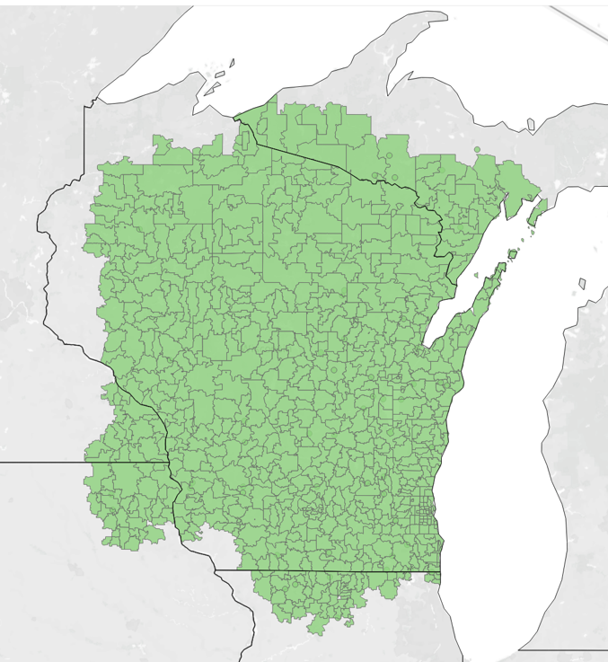
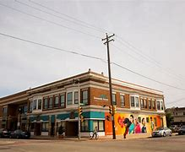
Data improvements in progress
Updating data from 2018 to 2022
Regularly update every 6-9 months
Look at trends over time
Addition of Sixteenth Street Community Health Center data
Extending NHP data to bordering states

Slide 13
NHP Sponsors and Partners Over Time

Slide 14
www.nhp.wisc.edu/reports
nhp@hip.wisc.edu

