Slide 1
READ FIRST: How to use this slide deck
Review the content of this presentation and the guiding notes on each slide, and think about your audience. Pull out any information that may not be relevant to them, and change wording where necessary. Consider retitling the presentation as necessary.
Insert local information and data where indicated — especially on issues that will speak to your audience.
Remove any slides or information that are not relevant for your purposes.
OPTIONAL: The appendix at the end contains resources (videos, images, etc.) that may be helpful throughout the presentation. Review these and place them where desired in the presentation.
DELETE THIS SLIDE and the appendix before presenting!

Slide 2
Tobacco in Wisconsin
Your Name
Your Organization
Notes:
Speaker Notes:
The Wisconsin TPCP recognizes that traditional and commercial tobacco are different in the way they are planted, grown, harvested, prepared, and used.
Traditional tobacco is and has been used in sacred ways by American Indians for centuries.
Commercial tobacco is manufactured by companies for recreational and habitual use in cigarettes, smokeless tobacco, pipe tobacco, cigars, hookahs, and other products. Commercial tobacco is mass produced and sold for profit.
The term tobacco used in this presentation refers to commercial tobacco products. It does not seek to impinge upon sacred use of traditional tobacco in American Indian communities.

Slide 3
Alliance Name
Notes:
Speaker Notes:
Overall takeaways for this section:
Basic understanding of your alliance.
Ideas:
Add your logo to this slide
Add slides with bullet points highlighting your coverage area, information about your alliance and populations of focus, etc.
Include pictures
Keep it a little basic to leave room for more in-depth information at the end in the section about local efforts to address tobacco

Slide 4
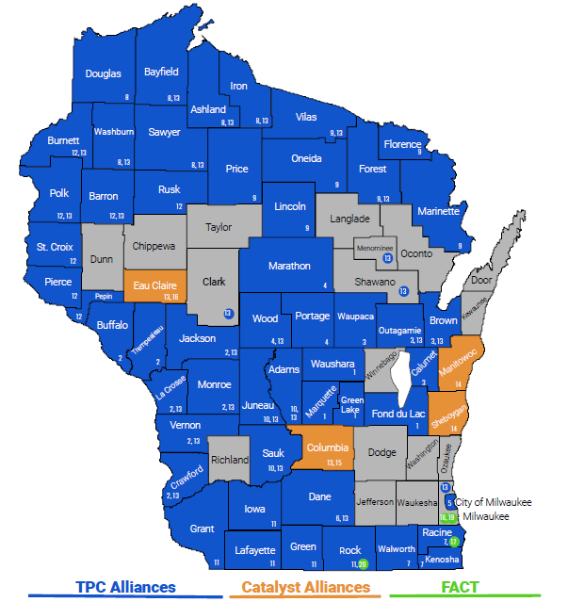
Notes:
OPTIONAL: Alliance map
Speaker Notes:
The Tobacco Prevention and Control Program funds 16 Alliances across the state (13 TPC Alliances and 3 Catalyst Alliances). In addition, Wisconsin Wins activities are conducted in all counties except three. Due to limited resources, there are not Alliances and FACT groups in all counties of the state.

Slide 5
Tobacco is still a problem in Wisconsin.

Slide 6
Tobacco is the #1 preventable cause of death in WI.
Each year
7,900
Residents Suffer
Smoking-Related Deaths
(almost 22 every day)
Source: Campaign for Tobacco-Free Kids
Notes:
Speaker Notes:
Though adult smoking has decreased in Wisconsin, tobacco is still the leading cause of preventable death in the state.
Source: https://www.tobaccofreekids.org/problem/toll-us/wisconsin

Slide 7
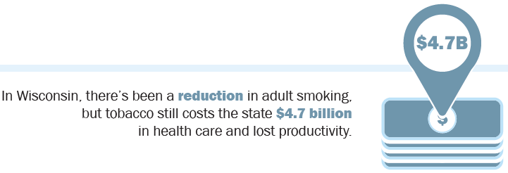
Tobacco-Related Costs
Notes:
Speaker Notes:
Tobacco use is expensive — and not only for the user.
Source: https://www.tobaccofreekids.org/problem/toll-us/wisconsin

Slide 8
Local Tobacco Issues
ADD LOCAL INFO HERE
Notes:
Speaker Notes:
Use this slide to add information about tobacco issues that are specific to your local area. Consider the issues that are most likely to be of interest to your specific audience.

Slide 9
Notes:
Speaker Notes:
SLIDE DIRECTIONS: Pick and choose dates that are relevant to you and your audience and make your slide personalized based on the timeline
For Example:
2010 - Smokefree Air Law Passes
2018 - Wausau passed smoke free parks
Source: https://tobwis.org/documents/451/Orientation_Kit_Policy_timeline.pdf

Slide 10
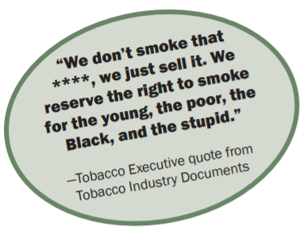
Industry targeting and other factors drive up tobacco use.

Slide 11
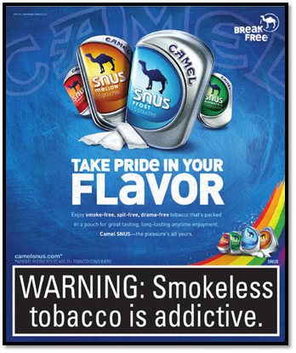
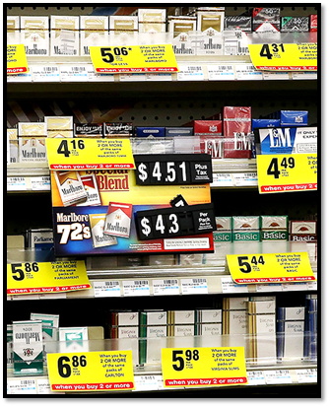
Industry Targeting
Notes:
Speaker Notes:
Key takeaways:
The tobacco industry targets certain population groups — typically those who are already marginalized.
The tobacco industry targets these populations by:
Developing culturally tailored images and messages
Sponsoring cultural events and offering free samples
Advertising more heavily in their neighborhoods
Using price promotions and coupons to make tobacco more affordable and easier to access
Portraying tobacco as a way to relieve stress and look confident
Ad Examples:
A: Targets LGBTQ community
B: Targets Race/Ethnic groups
C: Targets low-socioeconomic status
D: Targets persons with behavioral health issues
Image sources:
A: Trinkets & Trash, https://trinketsandtrash.org/detail.php?item_number=213662
B: Trinkets & Trash, https://trinketsandtrash.org/detail.php?artifactid=3645&page=5 (cropped)
C: New York Times, http://www.nytimes.com/2014/03/17/business/states-urge-retail-giants-with-pharmacies-to-stop-selling-tobacco-products.html (cropped)
D: Trinkets & Trash, https://trinketsandtrash.org/detail.php?artifactid=9775&page=4

Slide 12
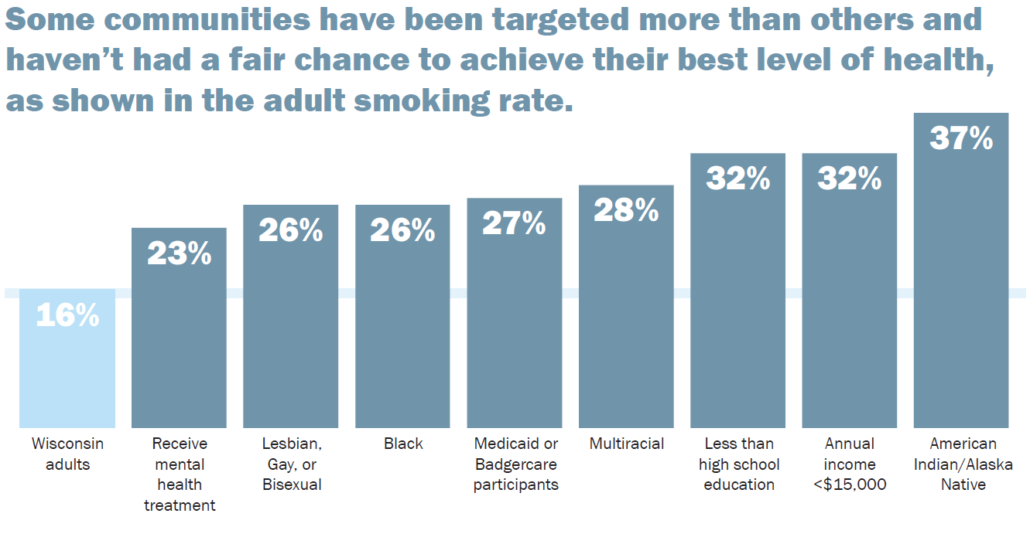
Industry Targeting
Source: 2018 WI Behavioral Risk Factor Surveillance System
Notes:
Speaker Notes:
This targeting increases adult smoking rates among these groups, and their negative health outcomes as a result.
Callout (if needed) certain populations and compare it to WI adult average
Source: 2019 BRFSS

Slide 13
Industry Targeting
Notes:
Speaker Notes:
Not everyone has a fair opportunity to achieve their greatest level of health.
The circumstances surrounding a person’s life also increases their rate of commercial tobacco use.
Strategies that address issues such as poverty and discrimination should be considered a public health issue and are social determinants that impact tobacco prevention and control.

Slide 14
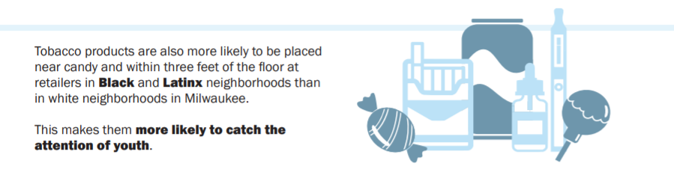

Slide 15
Inequitable enforcement of tobacco prevention and control policies also contributes to racial disparities by criminalizing people of color for the purchase, possession, sale, and distribution of tobacco products.

Slide 16
Industry Targeting
ADD INFORMATION HERE ABOUT LOCAL POPULATIONS OF FOCUS

Slide 17
Local WRAP Results
Notes:
Speaker Notes:
Use this slide to add any relevant information or graphics from the WRAP results for your area.

Slide 18
Flavored, accessible tobacco products are addicting our kids.

Slide 19
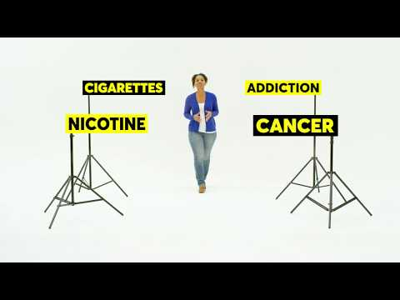
Tobacco is Changing Campaign
Notes:
Speaker Notes:
The Wisconsin Department of Health Services “Tobacco is Changing” campaign, focuses on educating parents about candy flavored tobacco products, including e-cigarettes, that are tempting kids into tobacco addiction.
Parents can learn more at www.TobaccoisChanging.com, where they can view the different types of tobacco products, read about issues like flavoring, packaging, and menthol, get tips for talking to their kids, and even get connected with their local tobacco prevention and control coalition. In addition, the campaign and website include short videos that are meant to be shared on social media. Let’s take a look at one of those videos now.

Slide 20
Notes:
Speaker Notes:
Flavored cigarettes were banned in the U.S. in 2009, in part because of their popularity with kids. Because the new law only applied to cigarettes, flavored tobacco quickly took on new shapes and styles. Now a tide of next generation tobacco products in sweet, candy, and fruit flavors have made their way onto store shelves.
Today, you can find the same flavorings used to make popular candies and treats in cigars, e-cigarettes, and smokeless tobacco products. One trendy new e-cigarette is even sold with a multi-pack of sweet flavors. The options seem endless and include flavors like cherry, grape, cotton candy, sour apple, fruit medley, root beer float, and gummy bear. But such flavors aren't really surprising once you realize most tobacco users start before they turn 18.
How much do sweet flavors matter to young people? A lot. In Wisconsin, 89% of high schoolers say they wouldn't try an e-cigarette—the most popular tobacco product among youth today—if it wasn't flavored.

Slide 21
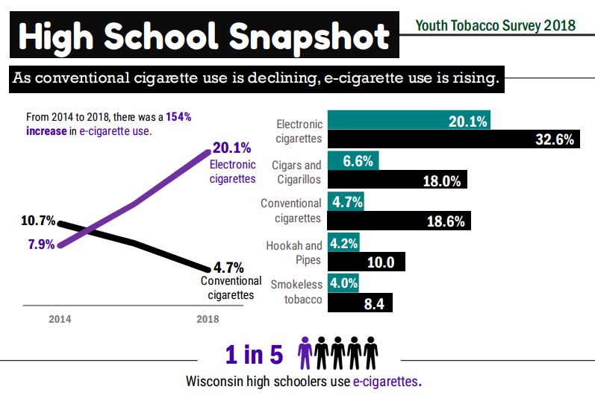
Latest Trends | Youth Data
Notes:
Speaker Notes:
As conventional cigarette use is declining, e-cigarette use is rising.
Why is this a problem?
Most e-cigarettes contain nicotine, which is highly addictive.
Can harm brain development

Slide 22
Latest Trends | Youth Data
SHARE LOCAL DATA HERE
Notes:
Speaker Notes:
Tell the story about the work you’ve done with school districts. What have you heard from leadership? What are they struggling with? What initiatives have you helped implement?

Slide 23
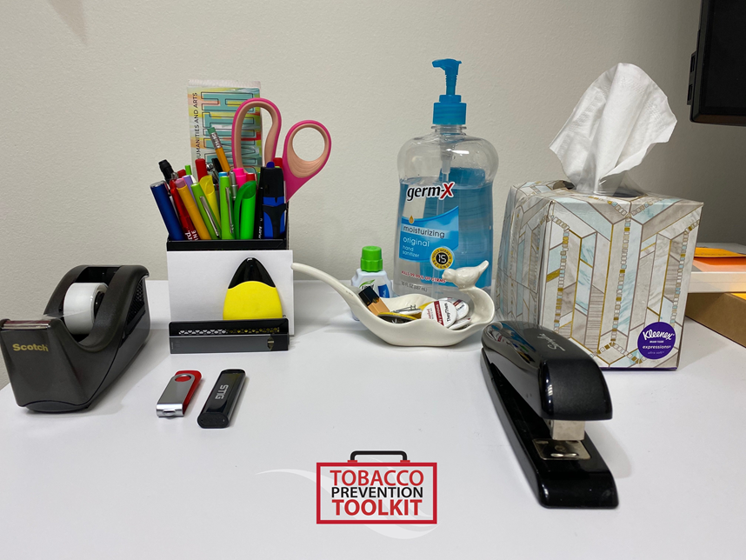
Latest Trends
How many e-cigarettes can you spot hidden in this picture?
Notes:
Speaker Notes:
With the dramatic increase of e-cigarette use over the last few years, we wanted to see if you can identify these new products addicting youth
Recently, tobacco products are designed to mimic other youth items, increasing their appeal and making them easy to camouflage from parents/guardians.
Coordinator note: keep up to date on ENDS market and current trends and update as needed
Explain what you have heard from school leadership, resource officers, and community members for what’s trending.
Explain how these pose a challenge due to the loophole in the federal flavor restriction (products like JUUL aren’t allowed to be flavored because they are cartridge based, but these products either use e-liquid or are disposable, exempting them from the ban).
Vaping Lingo Dictionary

Slide 24
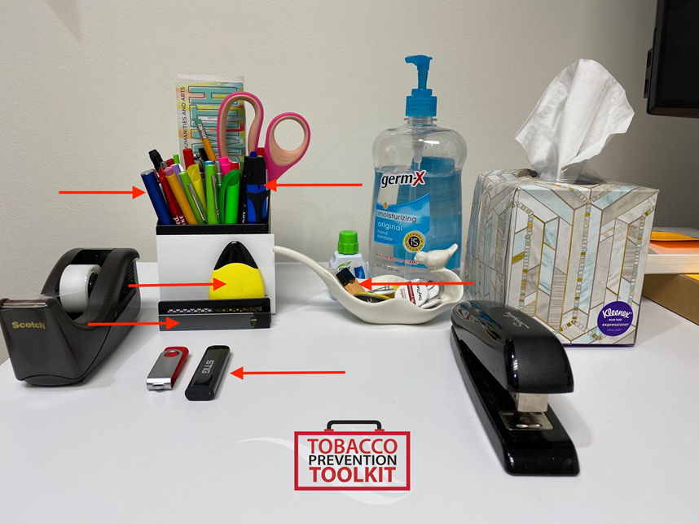
Latest Trends
How many e-cigarettes can you spot hidden in this picture?
There are 6 (six) e-cigarettes hidden in plain sight!
Notes:
Speaker Notes:
Recently, tobacco products are designed to mimic other youth items, increasing their appeal and making them easy to camouflage from parents/guardians.
Products shown are
JUUL pod
STIG
Sourin Drop
JUUL Device
Multiple vape pens/devices
Additional interactive activity (after covid and in person meetings resume). FACT has provided the Spot The Not activity to be printed and used. Consider using FACT members to present this topic

Slide 25
Latest Trends | Products
Notes:
Speaker Notes:
In discussing latest trends, it’s important to first know about the components of the latest and most popular products among youth. Most products made today contain similar components and that is a battery, atomizer, the e-liquid, a cartridge, and the aerosol.
Show the products if you have them available:
Battery
Atomizer
E-liquid – this is for refillable products only
Cartridge – this Is for cartridge based products only
Aerosol – this is what’s inhaled and released into the air

Slide 26
Latest Trends
Notes:
Speaker Notes:
As you can see by these images, products are different. But how the tobacco industry gets people addicted has remained the same.
We know that tobacco is still the #1 cause of preventable death and disease in the United States. What’s at the root of that? Nicotine addiction.

Slide 27
Tobacco addiction and secondhand exposure can lead to deadly consequences.

Slide 28
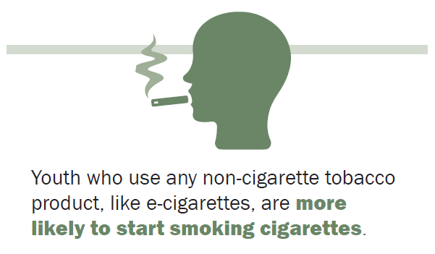
Notes:
Speaker Notes:
Youth who use any non-cigarette tobacco product, like e-cigarettes, are more likely to start smoking cigarettes, resulting in the potential to reverse public health gains in combating smoking.
Source: JAMA Pediatrics

Slide 29
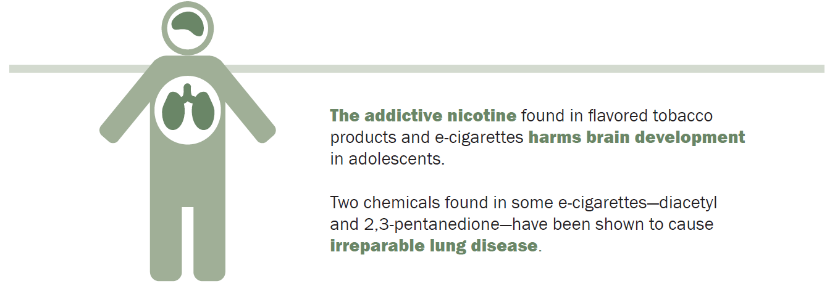
Notes:
Speaker Notes:
The addictive nicotine found in flavored tobacco products and e-cigarettes harms brain development in adolescents, which may affect memory and attention.
Can also prime the adolescent brain for addiction to other tobacco products and drugs.
Chemicals found in e-cigarettes can cause irreparable lung disease.

Slide 30
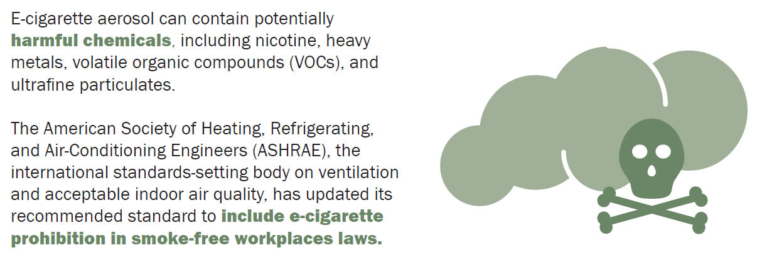
Notes:
Speaker Notes:
E-cigarette aerosol can contain harmful chemicals.
E-cigarettes can undermine clean indoor air policies. If exempt from clean indoor air policies, the ‘smoky look’ creates confusion with enforcement.
Instead of comparing the aerosol from e-cigarettes to secondhand smoke, we should be comparing it to clean air.

Slide 31
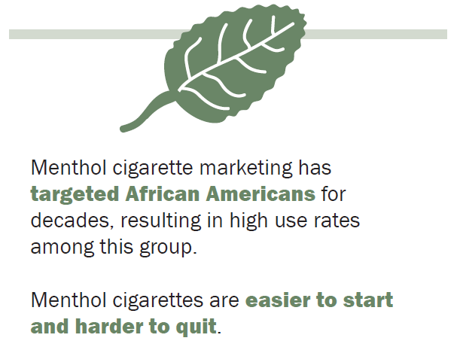
Notes:
Speaker Notes:
Menthol’s minty, cooling effect helps mask the harshness of cigarette smoke and e-cigarette aerosol, reducing airway pain and irritation.
Because of this, many people believe menthol products are less harmful. Nothing could be further from the truth.

Slide 32
Alliance Efforts to Address Tobacco
Notes:
Speaker Notes:
Add slides here to provide some information on what your alliance is doing to address tobacco issues in your area. Again, think about what will be most important / interesting / relevant to your audience.

Slide 33
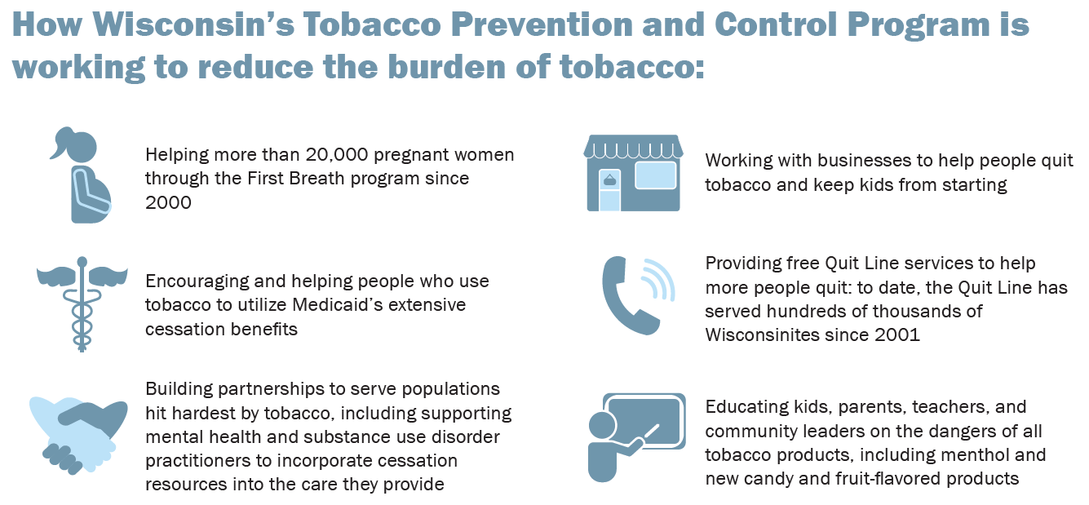
Notes:
Speaker Notes:
Link the alliance work to these efforts. For example, our alliance works with statewide agencies like First Breath and the Quit Line to help people quit, Our alliance works closely with schools and retailers to keep youth from starting to use tobacco.

Slide 34
Limiting Secondhand Smoke Exposure
SHARE LOCAL WORK HERE
Notes:
Speaker Notes:
Share work your alliance/coalition has done to protect people from the dangers of secondhand smoke by adding e-cigarettes to municipal ordinances, multi-unit housing, First Breath etc.
This is your opportunity to add stories to bring the issue close to home and showcase the work being done by the alliance/coalition.

Slide 35
INSERT OTHER LOCAL WORK HERE
Notes:
Speaker Notes:
Share anything else that’s been done locally related to local tobacco prevention efforts
What’s been accomplished?
Where are we headed?
How to get involved.

Slide 36
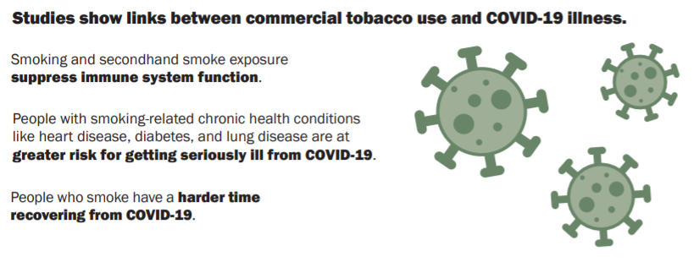
Tobacco, COVID-19, and Racism

Slide 37
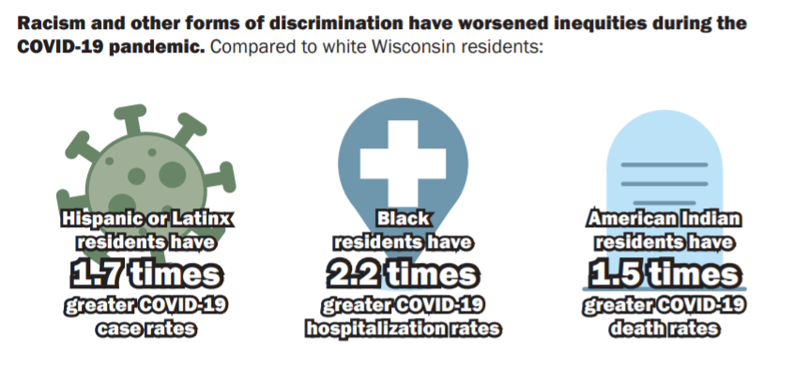

Slide 38
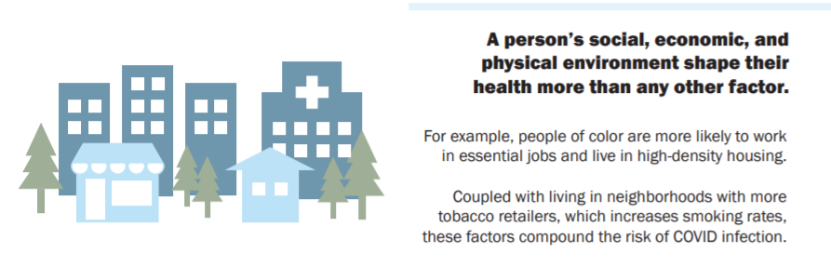

Slide 39
QUESTIONS?
Insert contact information
Notes:
Speaker Notes:
Ending Slide
Insert logo

Slide 40
Appendix: Additional Slides, Topics, and Images

Slide 41
APPENDIX: (Optional) Tobacco Use and COVID-19
Notes:
Speaker Notes:
New research from the Journal of Adolescent Health demonstrates young people who have ever used e-cigarettes are more likely to be diagnosed with COVID-19..

Slide 42
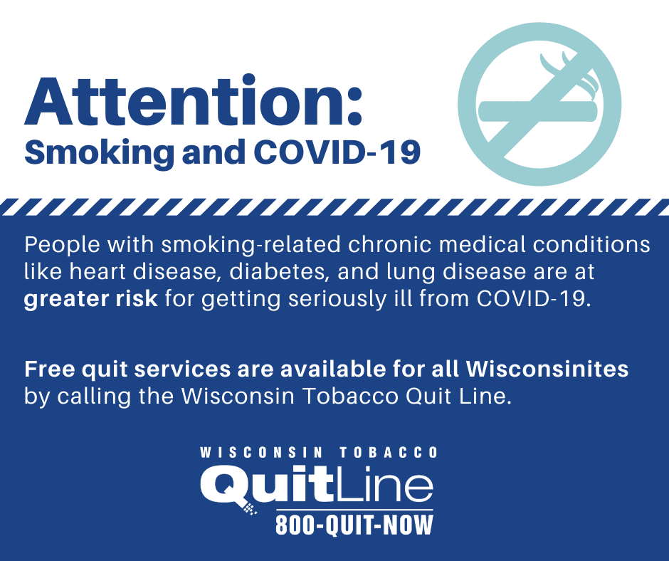
APPENDIX: OPTIONAL IMAGES

Slide 43
APPENDIX: NATIONAL NEWS/POLICY UPDATES
Notes:
Speaker Notes:
Share anything that recently happened nationally that could be relevant to your audience (example: Tobacco 21 or CA passing a flavor restriction)

Slide 44
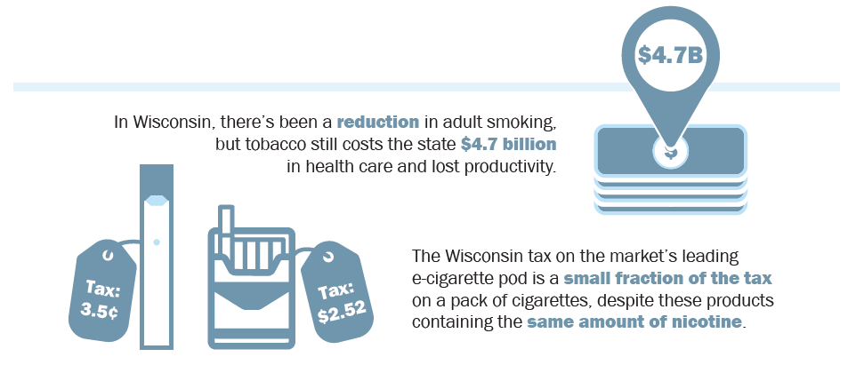
APPENDIX: OPTIONAL IMAGES
Notes:
Speaker Notes:
If you’d like to discuss funding somewhere in the presentation, consider including this info from the education packet.
Background information: In 2002, Wisconsin traded 25 years worth of tobacco settlement payments to partially balance a single budget.

Slide 45
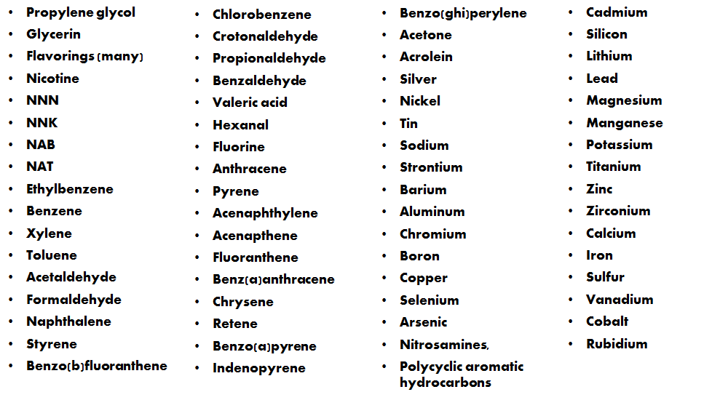
APPENDIX: OPTIONAL IMAGES
Notes:
Speaker Notes:
E-cigarettes produce an aerosol (also referred to as vapor) upon each inhalation that resembles and tastes like the smoke produced by cigars and cigarettes.
While the health effects of the aerosol are unknown, initial lab tests conducted by the FDA found detectable levels of toxic cancer-causing chemicals, including an ingredient used in anti-freeze.
10 known carcinogens, heavy metals (including tin, silver, copper, and lead) and volatile organic compounds have been identified in the e-cigarette aerosol.

Slide 46
APPENDIX: OPTIONAL RESOURCES TO SHARE
Tobacco is Changing
Cessation resources:
Wisconsin Tobacco Quit Line: 800-QUIT-NOW, or text READY to 200-400
Vaping Lingo Dictionary
https://truthinitiative.org/research-resources/emerging-tobacco-products/most-juul-related-instagram-posts-appeal-youth-culture
https://www.youtube.com/watch?v=gjYT4YG7jOk
Governor Evers’ Letter to Schools Regarding E-Cigarettes
EVALI Video
Education Packet Content
More data: https://www.dhs.wisconsin.gov/tobacco/data.htm
Notes:
Speaker Notes:
Potential resources to share, depending on audience.

