Slide 1
Welcome! 2019 Monthly WI Cancer Council Networking Webinar Series
Notes:
A couple of quick housekeeping items before I start the recording. Please mute your phone line if you aren’t talking - *6 to mute and #6 to unmute. Feel free to use the chat box for questions or comments throughout the presentation. We’ll be monitoring that throughout the call today. This call will be recorded and the slides will be available afterwards.
RECORD!
Welcome!
Introductions
Our goal with these calls is to share interesting, relevant information with you that you can hopefully take back to your own work, and more importantly, leaving time on each call for discussion and conversation with the presenters, the WI CCC Team and your fellow council members. The format will be the same for all of the calls but the topics will change (more on that at the end). We’ll use half the call to share information and the second half for dialogue. Please come prepared with questions, comments and stories to share from your own work. We can accomplish so much more by working together and that’s the ultimate goal of the WI Cancer Council.
Feel free to use the chat box for questions. Without further ado, I’m excited to introduce….

Slide 2
TOBACCO & E-CIGARETTES IN WISCONSIN
Sandy Bernier, BSW, CSW
Five Counties for Tobacco Free Living Coordinator
Fond du Lac Health Department
Darcie K.G. Warren, MPA
Partnership for a Tobacco Free Wisconsin Coordinator
American Lung Association
Notes:
Both:
Each introduce themselves, roles in the TPCM, and how they’re connected to the Cancer Council.

Slide 3
WHAT TO EXPECT FROM TODAY’S WEBINAR
Understand current status of tobacco and e-cigarette use in Wisconsin
Learn about tobacco prevention and control programing impacting tobacco usage
Hear about the movement’s action plan, including policy priorities and legislative update
Notes:
Sandy:
Today we’ll use the polling feature, so EXPLAIN HOW TO SIGN UP.
During the webinar, you will have the opportunity to better understand the current status of tobacco and e-cigarette use in Wisconsin,
Learn about tobacco prevention and control programing impacting tobacco usage, and
Hear about the movement’s action plan, including policy priorities and legislative update.
We will reserve time for questions at the end.

Slide 4
TOBACCO IS STILL A PROBLEM IN WISCONSIN
Notes:
Darcie:
Currently, tobacco prevention is funded at $5.3 million, less than one-tenth of the $57.5 million recommended for Wisconsin by the Centers for Disease Control.
As you may know, no cigarette tax revenue is directed to fund the tobacco control or prevention programming.
No master settlement funding is available either.
Governor Evers included a $3.3 million increase for tobacco control in his proposed budget. This was dependent on the Medicaid expansion and would be new cessation dollars made available by taking the expansion. The Department of Health Services was planning to dedicate most of that to the Quit Line and some to ACES field work.
The budget that passed did not include an increase, but instead flat funding for the tobacco prevention and control program. So, it’s going to remain funded at less than one-tenth of what the CDC recommends for the next biennium.
We know tobacco is still a problem in Wisconsin.

Slide 5
SOME POPULATIONS USE TOBACCO MORE THAN OTHERS
Notes:
Darcie:
Even as the adult smoking rate declines, severe tobacco-related disparities exist in Wisconsin. Native Americans smoke at more than double the average rate. The smoking rate of African Americans is almost as high. Again, this graph shows Badgercare recipients and lower income Wisconsinites smoke at a much higher rate than average, and more than a quarter of LGB folks smoke. 29% of those who have been diagnosed with depression smoke.
Public health professionals across the state would love to work more with mental health clinicians and AODA facilities, for example, but funding Wisconsin’s Tobacco Prevention and Control programming at less than a tenth of what the Centers for Disease Control recommends cannot provide everything that’s necessary to address these problems.

Slide 6
HOW WISCONSIN’S TOBACCO PREVENTION AND CONTROL PROGRAM IS REDUCING THE BURDEN OF TOBACCO
Notes:
Darcie:
Smoking prevalence is at an all-time low of 16%! It decreased another percentage point this year. Despite the disparities, this is a success.
It’s due, in part, to all the good work done across the state with that $5.3 million investment in this programming.
We in tobacco control are celebrating this victory! The Tobacco Prevention and Control Program funds 20 coalitions and networks throughout the state, which leverage partnerships with local public health departments, schools and youth prevention programing, and others to lead to this success. They also fund the Quit Line and outreach specialists at UW’s Center for Tobacco Research and Intervention, who partner with healthcare systems for Quit Line referral, as well as quit coaches who specilize in helping pregnant women and their families quit smoking.
We’re proud of our partnerships, as well as the support for mental health and substance use disorder practitioners to incorporate tobacco cessation into the care they provide and encouragement to help people who use tobacco to utilize Medicaid’s extensive cessation benefits.

Slide 7
HOW WISCONSIN’S TOBACCO PREVENTION AND CONTROL PROGRAM IS REDUCING THE BURDEN OF TOBACCO
Notes:
Darcie:
We’re also proud of the great work with businesses to help people quit and to keep kids from starting. The community education provided across the state by coalitions, like Sandy’s coalition, as well as First Breath counselors, who specialize in helping pregnant women and new mothers and their families quit tobacco. The Wisconsin Quit Line has helped hundreds of thousands since 2001.
Dollars spent on prevention pay dividends. I’m going to pass it back to Sandy to explain more about the activities of coalitions and networks.

Slide 8
15 TOBACCO PREVENTION COALITIONS
To find a coalition or network near you, visit:
www.tobwis.org/connect
Notes:
Sandy:
Local implementation of statewide goals are carried out by 15 multi-jurisdictional coalitions or MJC’s and 5 disparity networks.
Explain how the map is color coded by jurisdiction and how the dark grey represents parts of the state NOT covered by MJCs, due to limited funding resources.

Slide 9
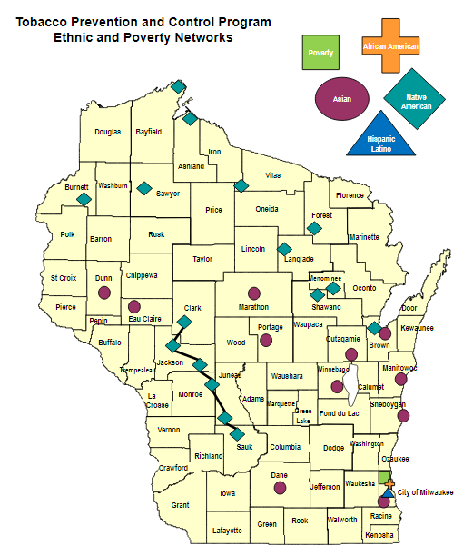
FIVE DISPARITIES NETWORKS
To find a coalition or network near you, visit:
www.tobwis.org/connect
Notes:
Sandy:
The 5 disparity networks are the Wisconsin African American Tobacco Prevention Network, Wisconsin Hispanic Latino Tobacco Prevention Network, Wisconsin Asian American Tobacco Prevention Network, the Native American Tobacco Prevention Network, and Wisconsin Tobacco Prevention and Poverty Network.
If you would like to learn more about the local tobacco prevention coalition for your area, you can visit tobwis.org/connect.

Slide 10
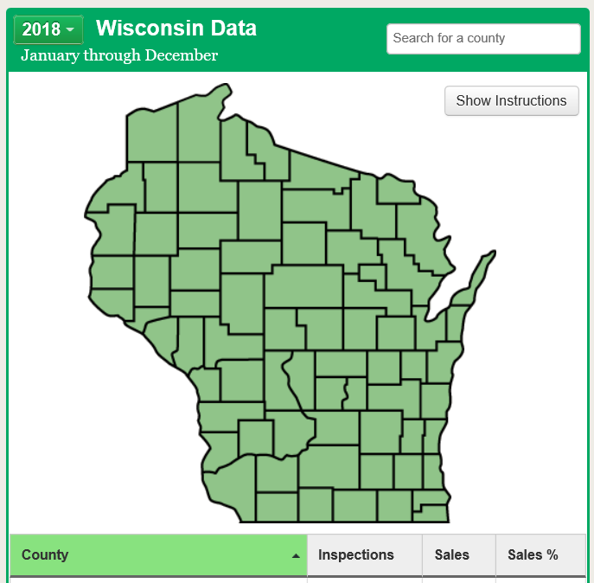
WI WINS COMPLIANCE CHECKS
To look up your WINS information, visit: http://wiwins.org.
Notes:
Sandy:
Explain WI WINS compliance checks and free retailer training. Explain how anyone can look up their county’s sales rates online.

Slide 11
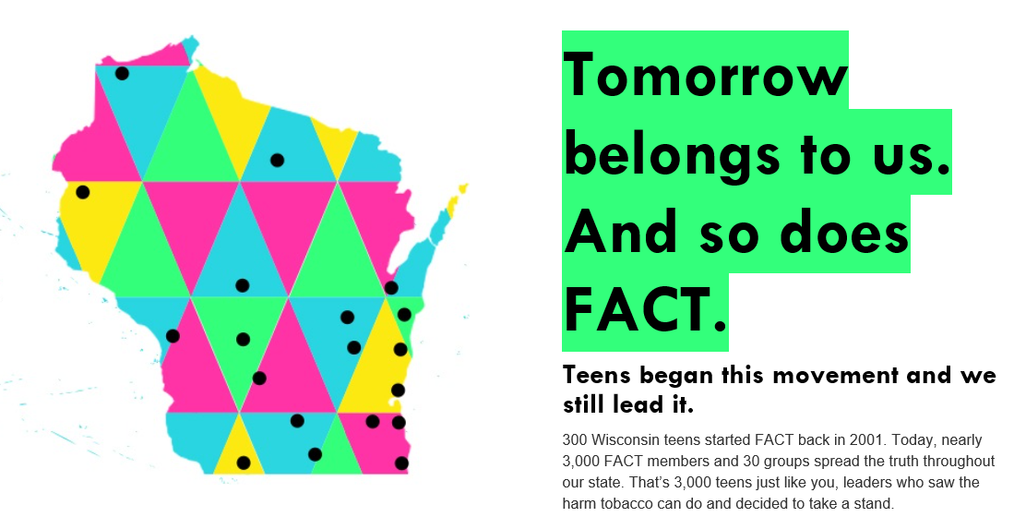
Notes:
Sandy:
300 Wisconsin teens started FACT in 2001, and now there are nearly 3,000 youth members across the state. FACT teaches leadership skills and requires kids to take part in actions drawing attention to how tobacco and e-cigarette companies target kids. It’s a peer-to-peer youth prevention intervention program.

Slide 12
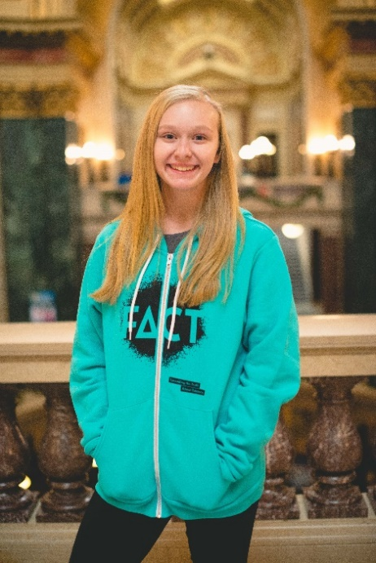
FACT YOUTH PREVENTION PROGRAM
https://youtu.be/W8mXRt_cdPM
Allie, age 16
FACT member from Wrightstown, Wisconsin
Notes:
Sandy
Set up video of Allie, so she can speak in her own words.

Slide 13
FACT YOUTH PREVENTION PROGRAM
“Vaping and Juuling are very common in my school. Juuling, especially, has become more prominent in my school due to it being discrete. I hate seeing people use e-cigs just to look "cool" because these people don't actually know the consequences these products do to their health!"
Jackie, age 16 FACT member from Wisconsin Rapids
Notes:
Sandy
Let folks read the slide.
Talk about recent cases of children and young adults with lung disease linked to vaping.

Slide 14
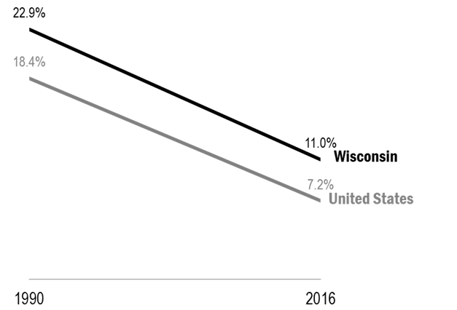
FIRST BREATH PROGRAM & PREGNANT SMOKERS
Notes:
Sandy:
Pregnant Women Remain a Priority Population to Help Quit Smoking
While smoking continues to decrease among pregnant women in Wisconsin, the smoking rate remains higher than the national average.
The WI TPCP funds counselors through the First Breath program of Wisconsin Women’s Health Foundation to target this population.
The program serves 71 of Wisconsin’s 72 counties and helps pregnant women, new moms, and their families quit smoking and maintain smoke-free homes. Nearly 1/3 of participants quit smoking and stay quit postpartum.^{xii} An additional one-fifth of the participants cut down on their tobacco use.
First Breath Program Data, 2018.

Slide 15
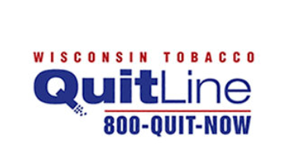
TOBACCO RESEARCH AND INTERVENTION
Notes:
Sandy:
Wisconsin’s Tobacco Prevention and Control Program funds the University of Wisconsin Center for cessation. This includes the Wisconsin Tobacco Quit Line and outreach to health systems to refer patients to quit.
King, BA, Peck, RM, & Babb, SD (2014). National and State Cost Savings Associated With Prohibiting Smoking in Subsidized and Public Housing in the United States. Preventing Chronic Disease, 11.

Slide 16
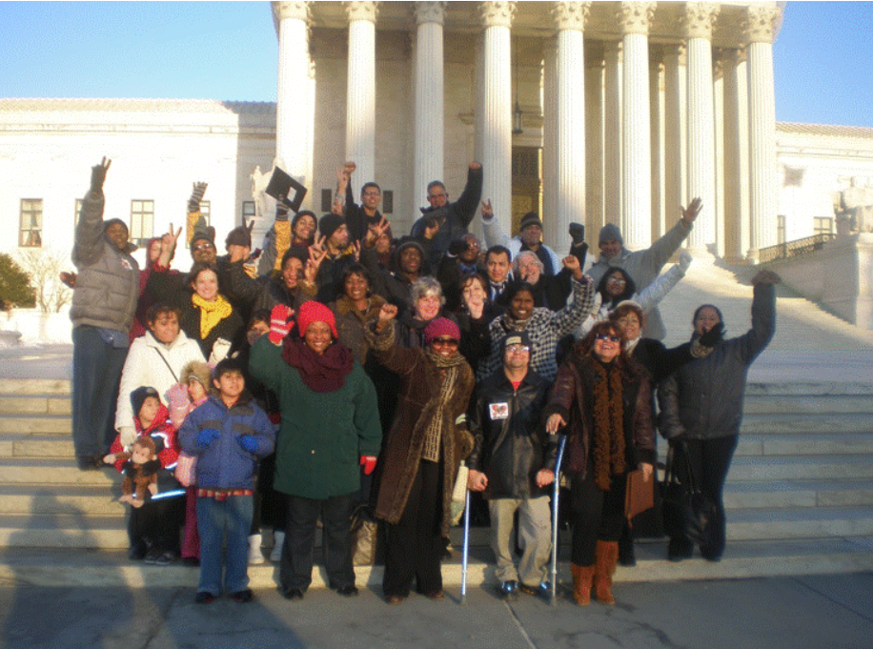
FIVE COUNTIES FOR TOBACCO FREE LIVING
Notes:
Sandy:
Explain more about what the Five Counties coalition is and what it does. ADD PHOTOS OR GRAPHICS
Partners
Fond du Lac County Health Department Serves as the Lead Agency for a multi-jurisdictional coalition providing services and support to Green Lake, Waushara, Marquette, and Washington Counties and collaborating to address the specific needs of each county. (Example some counties have higher rates of smokeless tobacco use)
We want our partnerships to be wide and varied, so that we have a reflection of the entire community we serve.
Here is a partial listing of the sectors represented on our coalition: Law Enforcement Schools Health Systems Non-Profit, Community Service Agencies Parents Youth Statewide Partners Citizens ATODA Groups. Work at the local level to help decrease the burden of tobacco. Increase clean indoor air, prevent tobacco sales to minors, Long-term goals:
1. Preventing tobacco use initiation by adults and youth (support best practice Public Health Policy and educate community as well as local and state leaders what best practice policy is.
2. Eliminating the exposure to secondhand smoke (HUD, MUH Section 8 Public as well) Work with workplaces interested in tobacco-free policies
3. Promoting the use of evidence-based practices for the treatment of tobacco dependence Talk more about this later
4. Identifying and eliminating tobacco-related disparities ( working with various community organizations that provide services to groups that are disproportionately impacted by tobacco (Local Food Pantry)

Slide 17
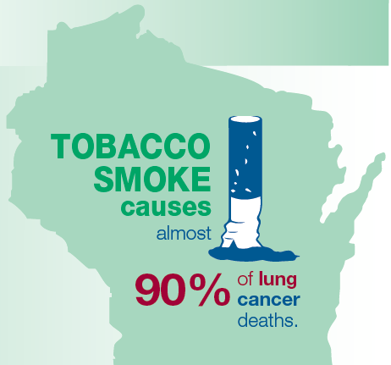
CONNECTION BETWEEN TOBACCO AND CANCER
Notes:
Sandy:
Tobacco prevention and control is an important component of cancer control. Smoking causes cancer. Smoking causes 90% of lung cancer deaths, and more people in Wisconsin die from lung cancer than from prostate, breast, and colorectal cancers. Smoking not only causes lung cancer, but it also increases the risk for many other cancers.
Smoking kills more Americans than alcohol, car accidents, HIV, guns, and illegal drugs combined.
Cigarettes, cigars, pipes, and smokeless tobacco all cause cancer. There is no safe way to use tobacco.
Although e-cigarette use is likely to be significantly less harmful for adults than smoking regular cigarettes, the health effects of long-term use are not known.
No youth should use e-cigarettes or any tobacco product. Most e-cigarettes contain addictive nicotine that can harm the brain development of teenagers.
Studies have shown that vaping by youth is strongly linked to later use of regular cigarettes and other tobacco products.
PASS IT BACK TO DARCIE

Slide 18
A WISCONSIN
NOT BURDENED BY TOBACCO
Notes:
Darcie:
I work with American Lung Association, and part of my job is coordinating the Partnership for a Tobacco Free Wisconsin. We’re a statewide coalition working to reduce the burden of tobacco in Wisconsin.
Despite its overwhelming successes and very effective programing, Wisconsin’s Tobacco Prevention and Control Program is currently funded at only $5.3 million, as I mentioned earlier. As you may know, no tobacco settlement funding is available to address these problems, and no cigarette tax revenue is directed to fund this important programing. As I have already mentioned, this is less than one-tenth of what’s recommended by the Centers for Disease Control.
However, there’s no shortage of investment by the tobacco industry. Right? They target children with candy flavors, new products, and cheaper prices, and it leads to lifelong addiction.

Slide 19
“YOUTH USE OF E-CIGARETTES HAS REACHED AN EPIDEMIC PROPORTION,” – DR. SCOTT GOTTLIEB
Notes:
Darcie:
E-cigarettes and e-juice are not regulated like most tobacco products. Vape shops don’t need a license to open, and the new excise tax on vaping liquid pales in comparison to the cigarette tax.
The state budget that recently passed included a 5 cents excise tax on vaping liquid. The budget proposed by Governor Evers included a 71% manufacturers’ price on all e-cigarettes and their components, which would have almost brought these products to parity with cigarettes. A pack of cigarettes has a $2.52 excise tax added, which makes Wisconsin about middle-of-the-pack compared to all states for cigarette taxing. The new vaping liquid tax is problematic because it’s weight-based, a tobacco industry tactic to keep products affordable for teens. The devices still have no excise tax at all. With more and more concentrated fluid possible with advancing technology, this new 5 cents tax barely registers compared to the cigarette tax. Coalition partners asked the governor to veto that part of the budget, but his office declined to do so.
This slide shows the most popular e-cigarette brand: Juul. It’s so popular among youth that many refer to “juuling” instead of e-cigarette use or vaping. Each container of e-juice for this product contains more nicotine than a pack of cigarettes, and it costs less than a pack. It’s customizable in design, comes in cool mint, fruit medley, and mango flavors, and has become extremely popular in social media sharing apps like Snapchat. Brands like this are part of why the FDA has called this an epidemic among youth.
With the new 5 cents per mL tax, a JUUL pod will have 3.5 cents tax, as compared to $2.52 cents per pack of cigarettes.

Slide 20
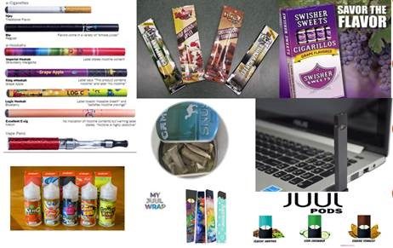
DEVICES COME IN A VARIETY OF SHAPES AND SIZES
Notes:
Darcie:
E-cigarettes come in a variety of shapes and sizes. These products have proliferated. Some are discreet and look like flash drives like the JUUL. Some are not discreet at all, and they produce huge plumes of secondhand aerosol. I have no doubt that everyone on the webinar today has noticed seeing more people vaping over the past year.
You can see other flavored products in this picture, which obviously appeal to kids and teens.
https://e-cigarettes.surgeongeneral.gov/getthefacts.html

Slide 21
WISCONSIN HIGH SCHOOLER USE RATES SKYROCKETING
Notes:
Darcie:
From 2014 to 2018, current e-cigarette use increased 272% among Wisconsin middle schoolers to 4.1%, and the high school rate has increased 154% to 20.1%.^{v}
Data from the 2018 Wisconsin Youth Tobacco Survey. Wisconsin Tobacco Prevention and Control Program; Madison, WI. https://www.dhs.wisconsin.gov/publications/p01624a.pdf.
This mirrors national statistics. Kids are vaping nicotine and other substances. School officials are reporting it a crisis among all groups of students. You may have heard about a cluster of hospitalizations from vaping in the past couple weeks. This is a real crisis situation. In addition to the FDA calling youth vaping an epidemic, the Wisconsin Department of Health Services released a public health advisory around the issue.

Slide 22
Notes:
Darcie:
Many people ask me about how dangerous the vape clouds produced are to inhale.
Everyone has the right to breathe clean indoor air, and that includes air that is free from e-cigarette aerosol.
E-cigarette aerosol is not harmless. It can contain harmful and potentially harmful constituents.
E-cigarette aerosol is made up of a high concentration of ultrafine particles, and the particle concentration is higher than in conventional tobacco cigarette smoke.
Exposure to fine and ultrafine particles may exacerbate respiratory ailments like asthma, and constrict arteries which could trigger a heart attack.
Short term exposure causes eye, throat, and airway irritation.
Long term inhalation exposure can result in children developing asthma.
Since the statewide smoke-free workplaces law doesn’t include e-cigarettes or vaping, many communities are updating their local policies to keep air inside public places clean.
Sandy FDL Public Housing Included prohibiting in all HUD public Housing MUH and has worked with section 8 housing as well to prohibit the use.

Slide 23
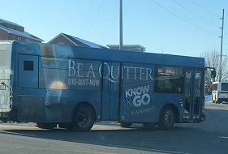
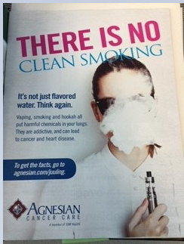
COLLABORATION ON EDUCATIONAL EFFORTS
Notes:
Sandy
The Coalition was fortunate enough to develop a relationship with the Radiologist Oncologist at Agnesian Cancer Center who was very passionate about educating kids, parents, and the community. Dr. Filip Troicki presented at our annual 5 counties breakfast, at candidate forums, and collaborated with me to do community presentations on Tobacco and E-Cigarettes, co-presented at Fond du Lac Private and public schools, and worked with the Public Relations department to get a full page add on E-cigarettes in our free paper, as well as the magazine inspire and for years I asked for just one bus with the WI Quit Line on it and because of Dr. Troicki’s Efforts it finally happened.

Slide 24
AGNESIAN ONCOLOGIST RECEIVES HONOR
Notes:
Sandy
Filip Troicki, MD, a radiation oncologist with the Agnesian Cancer Center receives the Exemplary Leadership in Tobacco Prevention and Control award from the Five Counties for Tobacco-Free Living. Dr. Troicki received the honor during their recent annual breakfast, which had more than 60 community members, as well as local and state leaders in attendance. The award recognizes Dr. Troicki's commitment to youth tobacco prevention and control issues within the community. In addition, Dr. Troicki provided a presentation at the breakfast titled, “Electronic Smoking Devices Addicting a New Generation.”

Slide 25
PREEMPTION AND TOBACCO CONTROL POLICY
Notes:
DARCIE:
I want to pause to briefly to explain preemption since it’s relevant and not everyone knows what it means.
Local initiatives that we can work on are limited because of preemption.
Preemption occurs when a “higher” level of government eliminates or limits the authority of a “lower” level of government to regulate a certain issue.
For example, federal laws and policies can preempt state and local laws; and state laws and policies can preempt local laws, including ordinances and board of health rules. In areas where local laws are preempted, the state law invalidates or trumps the local law.
Traditionally, the strongest and most innovative tobacco control policies have emerged at the local level – often after long and hard-fought grassroots community efforts – before ultimately being adopted at the state or federal levels. Because local control is so integral to progress in tobacco prevention, the tobacco industry and its allies have historically used, and continue to use, preemptive strategies to limit progress locally.
We need to remain vigilant to avoid any new preemption that may come up. The statewide smoke-free workplaces law that passed a decade ago included some new preemption, specifically around local policies stronger than the statewide law in terms of outdoor areas an patios at privately-owned businesses.
Wisconsin law also expressly preempts local governments from adopting higher taxes on tobacco products than the state, and it preempts any licensing at the local level. Case law preempts other youth access areas, like restricting flavoring in tobacco, moving all products behind the counter or in a located case, or increasing the age to buy tobacco products to 21. I’ll talk through these in more detail next.

Slide 26
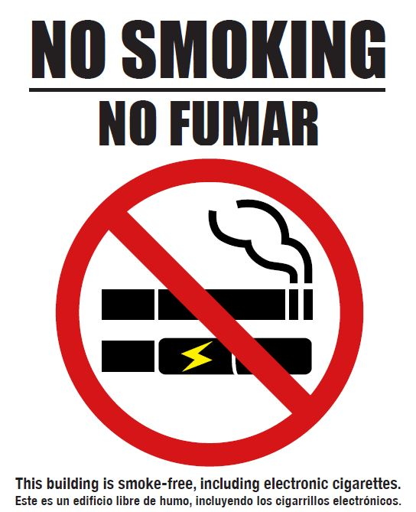
Notes:
Darcie:
Many communities have adopted ordinances to incorporate e-cigarettes and vaping into their smoke-free workplaces policies. That’s not preempted in Wisconsin, and many city councils and village boards have moved ahead of the state to keep workplaces’ air clean, including bars and restaurants.
There’s also a statewide bill that was released for co-sponsorship last week that would do just that.

Slide 27
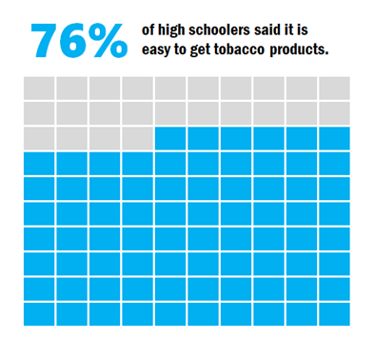
Notes:
Darcie:
Another issue is the product placement. Three out of four Wisconsin high schoolers say it’s easy to get tobacco products. This is from the mouths of babes, reported from the Wisconsin Youth Tobacco Survey.

Slide 28
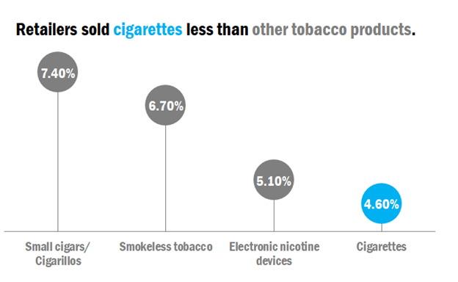
Notes:
Darcie:
You can see the sale of e-cigarettes is significantly higher than cigarettes, and smokeless tobacco and little cigars are even higher than e-cigarettes.
Note that vape shops do not require tobacco retail licenses or any license at all to open or operate. It’s difficult to say how many of those comply with the 18 year old sales age, and online sales of these products are very common, as well.
You can also see the product sold the most are little cigars. This data is from SYNAR, a federally-run scientific survey of tobacco retailers.

Slide 29
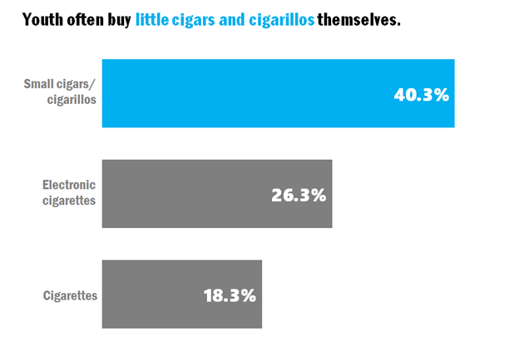
Notes:
Darcie:
Wisconsin youth report being able to buy e-cigarettes and little cigars more easily than cigarettes. This is startling! It’s from the Wisconsin Youth Tobacco Survey in 2018.
Youth say they can buy themselves little cigars at over 40% when they’re getting a hold of them. One in four youth who have access to e-cigarettes are saying they’re buying them themselves. When compared to 18% of young smokers who say they buy them themselves. These are flavored products, like cotton candy, grape, and bubblegum.

Slide 30
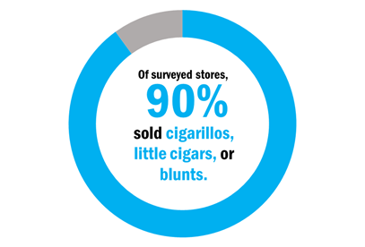
Notes:
Darcie:
According to the Wisconsin Retail Assessment Project, 9/10 surveyed stores sold little cigars. So when a store sells tobacco, it’s very common that they sell these products that kids have such an easy time buying.
When you see their packaging, it’s easy to tell a story about why. They come in bright colors, packs of two or three. They look and smell like candy.

Slide 31
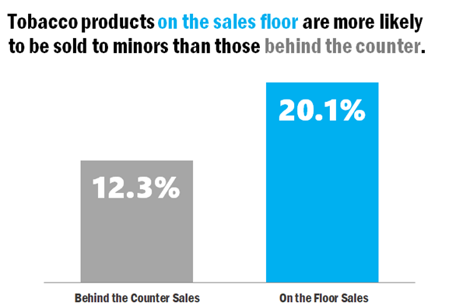
Notes:
Darcie:
Little cigars and e-cigarettes and other flavored products are in often kept front of the counter, too. Federal law says all cigarettes and chewing tobacco must be kept behind the counter or in a locked case for clerk-assisted sale. However, many tobacco retailers and vape shops keep other products in front of the counter because there’s no law saying they can’t do that.
Our state’s compliance checks showed on the floor sales were much more common than behind the counter sales - 20% versus 12%.

Slide 32
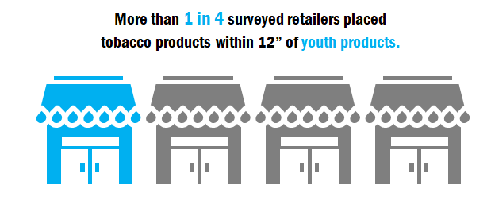
Notes:
Darcie:
It gets even more sickening when we examine the Wisconsin Retail Assessment Project data and find that more than 1 in 4 retailers surveyed place these tobacco products within a foot of candy and chips.

Slide 33
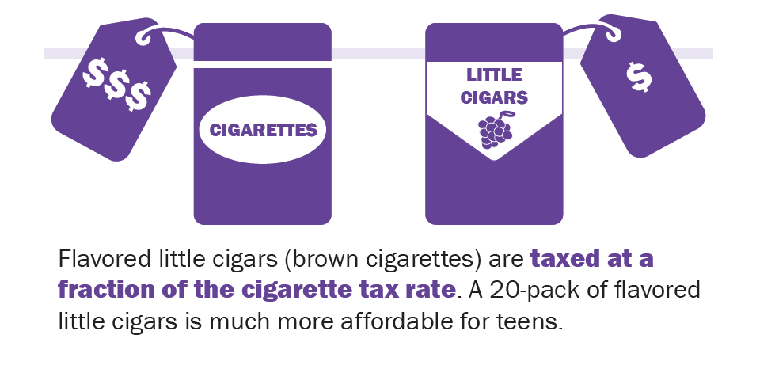
Notes:
To add fuel to the fire, these products are much more affordable for teens than cigarettes. Cigars are taxed by weight, not like the cigarettes, which are taxed by pack.
As I mentioned concerning preemption, taxing products and licensing retailers is expressly preempted in Wisconsin law. This means no local action can occur in these areas, but the State could change policy.
An increased tax on brown cigarettes was included in Governor Evers’ budget. This would not include the type of little cigars that are displayed in front of the counter, are often flavored, and sold in packs of two or three. It would only include brown cigarettes in packs of 20 that have the cellulose filter. The version of the budget that passes did not include this tax or any other tax change with brown cigarettes or little cigars.

Slide 34
PROGRAMMING CANNOT COVER THE ENTIRE STATE
Notes:
Darcie:
I want to point out a few adult use disparities, too, because obviously the problem with tobacco is not solely a youth prevention issue. When looking at adult tobacco users in all demographics, rural Wisconsinites smoke at 20% versus urban Wisconsinites at 18% - both higher than the statewide average of 16%.
The chewing tobacco rates in rural Wisconsin are double that in urban Wisconsin.
It’s a stark reminder of the limited funding to address tobacco prevention and control. Again, these problems cannot be adequately addressed with less than one-tenth of the recommended funding of this important programming.

Slide 35
EDUCATION PREDICTS ADULT SMOKING
Notes:
Darcie:
I am impressed by how hard those dollars work every day, but no one can expect 100% of the work to get done with an investment of less than one-tenth of what’s recommended.
Wisconsin’s smoking rate continues to decline, but a gap continues to widen when considering educational attainment level. You may be shocked to learn the adult smoking rate of Wisconsin adults with less than high school is five times that of the rate for Wisconsinites who have a college degree or more education.

Slide 36
SMOKING RATES VARY BY INCOME
Notes:
Darcie:
Challenges persist in reaching lower income smokers with cessation programs. There’s a more than 20% difference in the smoking rate between those Wisconsinites surviving on the lowest income and those making $35,000 or more.

Slide 37
STATE PARTNERS IN TOBACCO CONTROL POLICY
tobaccofreewisconsin.org
Notes:
We in tobacco control have the benefit of established organizations who work across the country on these issues. The statewide coalition is housed within American Lung Association, so that’s where I work. I’m happy to work with you to help solve these problems, and we have a nationwide staff with experts in policy and marketing and PR and cessation. American Cancer Society and American Heart Association have a similar interest in tobacco control policies.
These three organizations have huge amounts of volunteers across the state and they also employ lobbying staff. They’re very willing to work with policymakers on solutions to problems I’ve described. All the organizations listed here have joined the statewide coalition, too.
You can join the statewide coalition, too, as an individual or an organization. Fill out the JOIN US form at tobaccofreewisconsin.org today if you’re not already on our list.

Slide 38
TOBACCO & E-CIGARETTES IN WISCONSIN
Sandy Bernier, BSW, CSW
Five Counties for Tobacco Free Living Coordinator
Fond du Lac Health Department
Darcie K.G. Warren, MPA
Partnership for a Tobacco Free Wisconsin Coordinator
American Lung Association
Notes:
Both:
Thank participants and answer questions.

Slide 39
Questions for the presenters
Notes:
Sarah

Slide 40
Discussion:
What suggestions or lessons learned do you have about tobacco and e-cigarette policy?
What are you currently doing to provide education to the public (parents, teachers, local leaders, students) on the dangers of e-cigarettes?
Any helpful resources to share with members currently doing e-cigarette/tobacco work?
Notes:
Sarah

Slide 41
Upcoming Webinars & Topics
September 12 – Cancer Policy Update
October – No webinar
Join us at the Summit on October 17th
Have a topic that you’d like to learn more about or something you feel passionate about that you’d like to share with others? Let us know!
Notes:
Sarah

Slide 42
Notes:
Sarah

